Slide 1
Production Design Adaptation
Enriching the Humanities Through Opera
Made possible by the generous support from the

Slide 2
How does production and visual design aid in storytelling?
Today’s Objectives:
Respond to the musical and storytelling elements of opera to develop criteria for visual artistic choices.
Refine an adaptation pitch to demonstrate critical understanding of the visual elements of production design and opera to tell a story.
Create visual representations of set and costume designs based on opera adaptation pitches.

Slide 3
Listening Activity
As you listen to the music, write down any colors, mood, spaces/places, textures, foods, etc. you can associate with the music.
Track #9
00:00 – 02:22
Notes:
https://ondemand.metopera.org/performance/detail/3762467a-3bab-52d1-8033-e0e16ff1434f

Slide 4
Florencia en el Amazonas Synopsis
The story follows the legendary diva, Florencia Grimaldi, and her fellow passengers on a boat ride down the Amazon. As they travel through the enchanting rainforest toward their destination—the opera house in Manaus, Brazil—each passenger holds a secret hope for what the journey will bring.

Slide 5
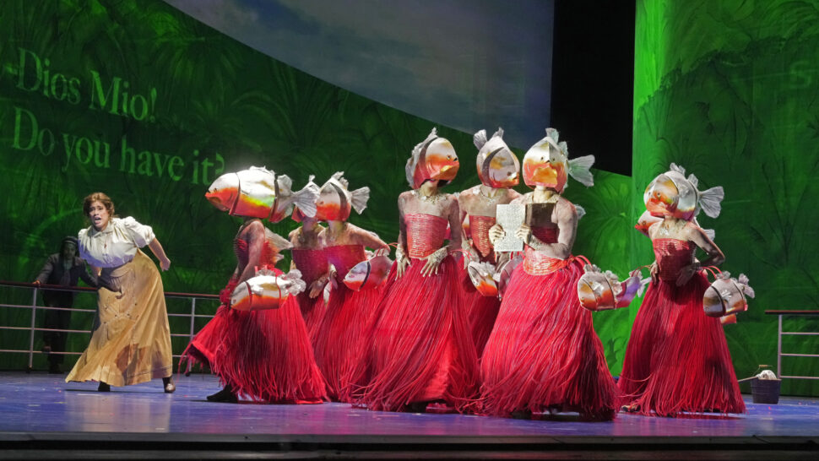
Key Scene #1: Act I, Scene 4: Londres, Tahiti, Sierra Nevada
In this moment Rosalba’s notebook falls into the Amazon. Arcadio warns her not to reach in to grab it due to the piranhas. Will she get it back or will all her work be lost?
Florencia en el Amazonas, Metropolitan Opera (photo: Ken Howard)

Slide 6
Key Scene #1 continued
Met Opera on Demand: Track #7. ACT I: Londres, Tahití, Sierra Nevada
00:28 – 01:23
Notes:
https://ondemand.metopera.org/performance/detail/3762467a-3bab-52d1-8033-e0e16ff1434f

Slide 7
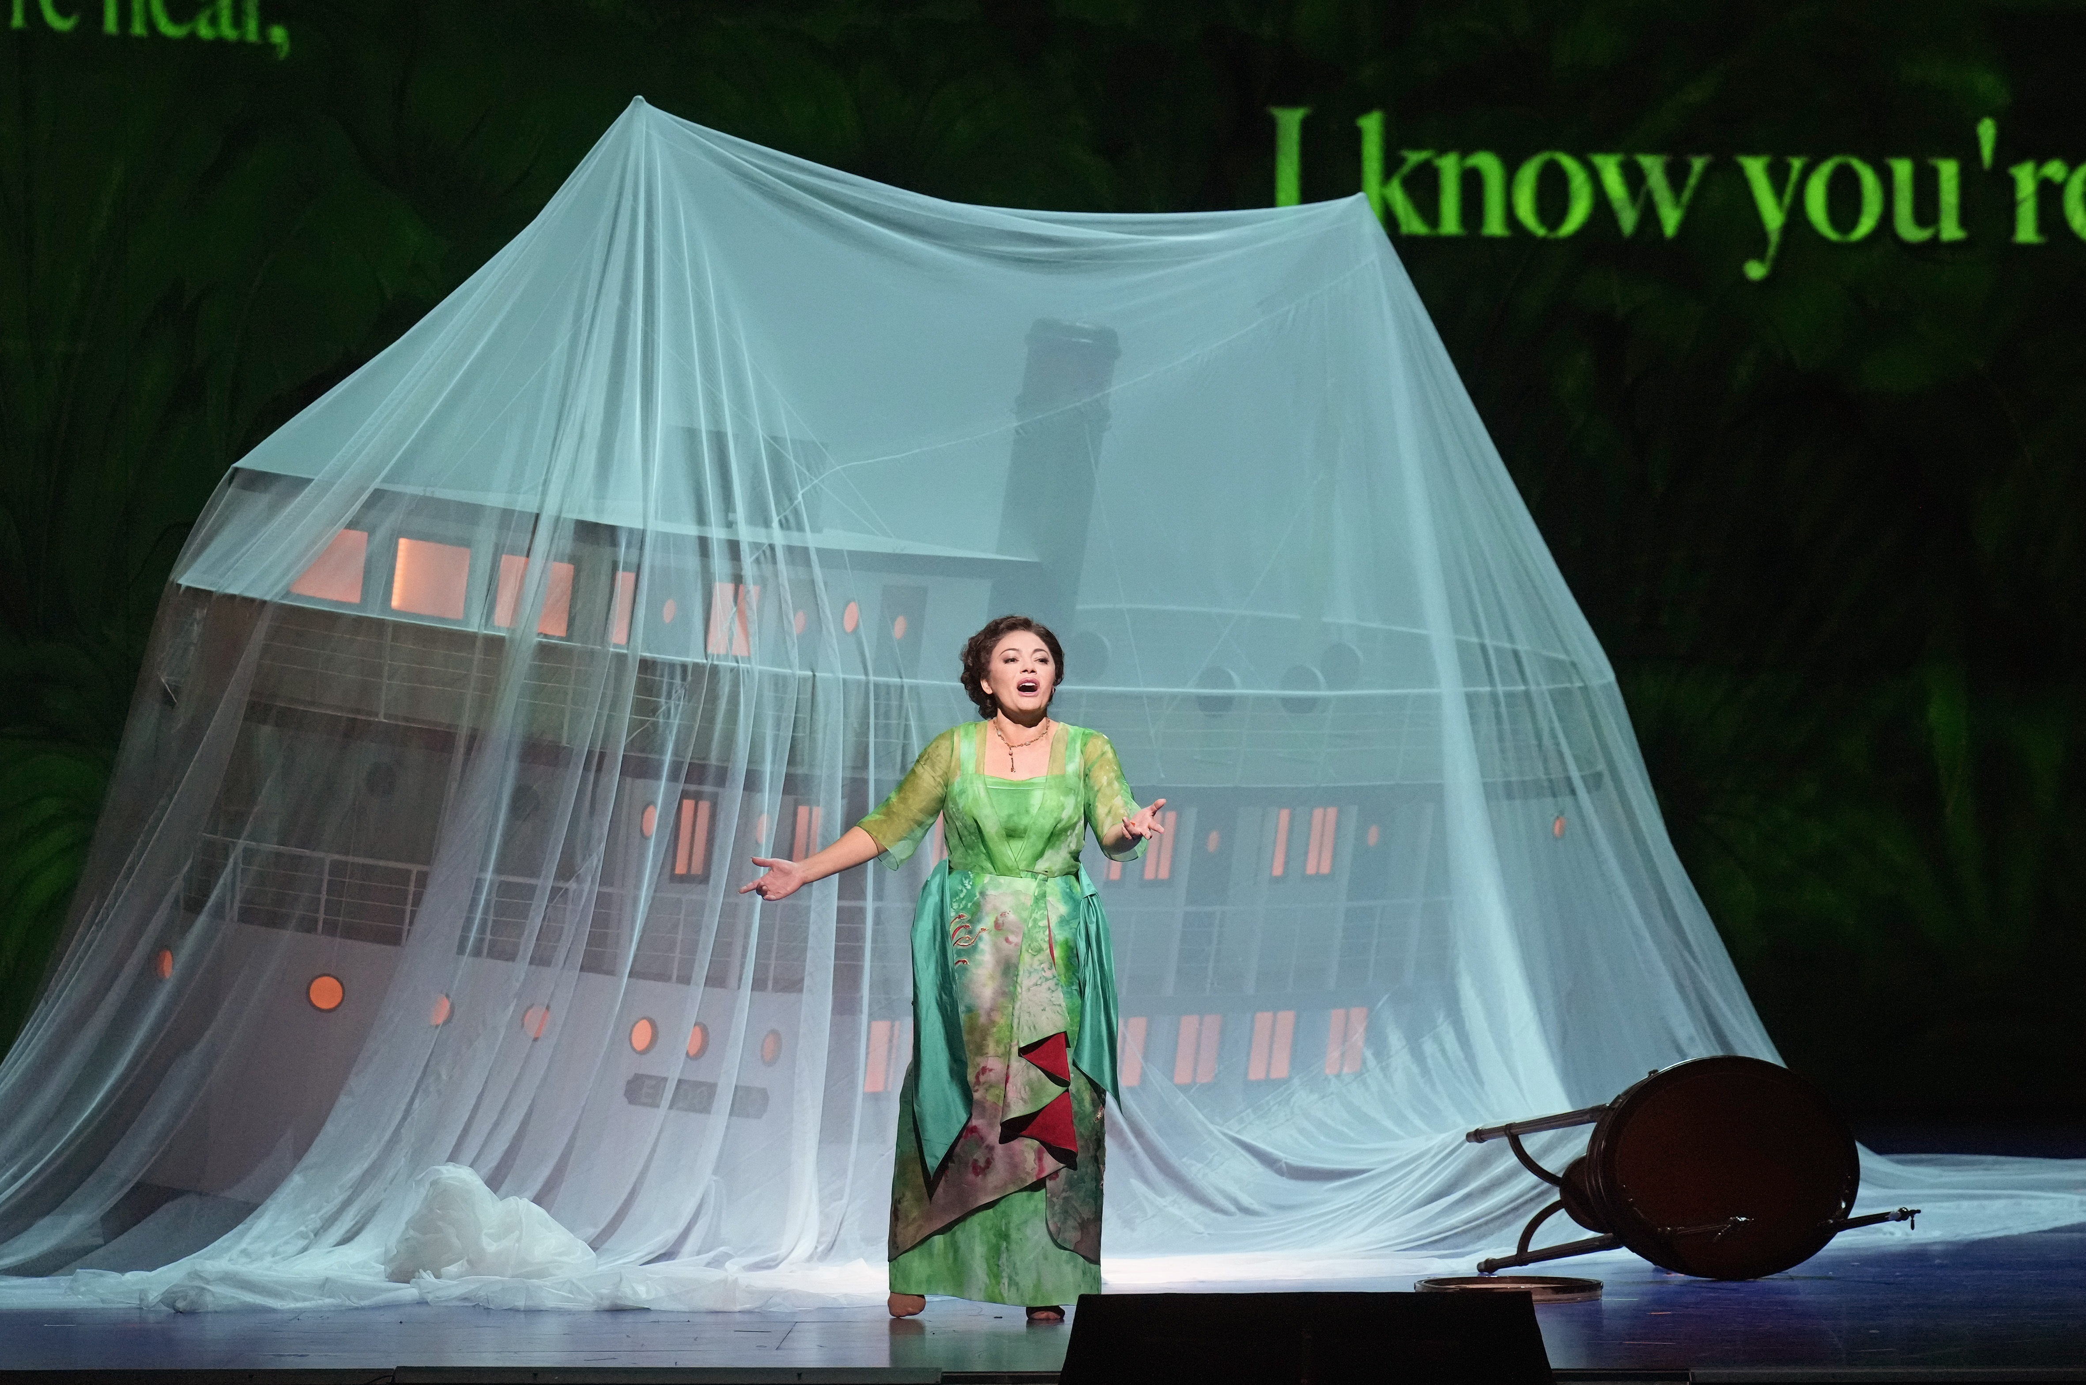
Key Scene #2: Act II, Scene 11: Cristóbal, Cristóbal
A storm has caused the El Dorado to crash. This scene features the aria, “Eschúchame.” Following the storm Florencia wonders if she is dead or alive, can Cristóbal hear her? Is he alive?
Florencia en el Amazonas, Metropolitan Opera (photo: Ken Howard)

Slide 8
Key Scene #2 continued
Met Opera on Demand: Track #15. ACT II: Cristóbal, Cristóbal
03:56 – 05:32
Notes:
https://ondemand.metopera.org/performance/detail/3762467a-3bab-52d1-8033-e0e16ff1434f

Slide 9
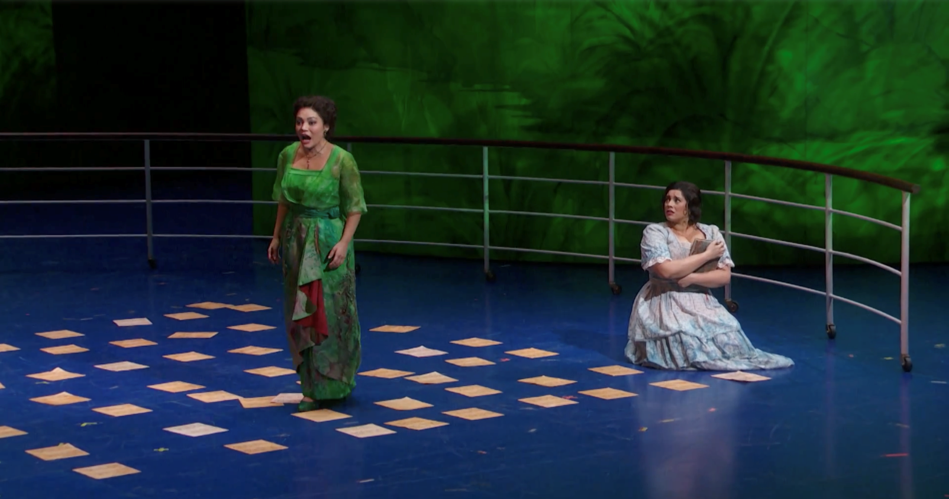
Key Scene #3: Act II, Scene 16: ¡Ya! ¡Quite esa cara! (Now! Take that face off)
Rosalba has given up on love and yet the incognito Florencia explains that it was love that gave La Grimaldi her musical gifts. Has Florencia revealed herself to Rosalba? Will Rosalba realize she is speaking with heroine? Will Rosalba embrace her love for Arcadio?
Florencia en el Amazonas, Metropolitan Opera (photo: Ken Howard)

Slide 10
Key Scene #3 continued
Met Opera on Demand: Track #21. ACT II: ¡Ya! ¡Quite esa cara!
03:01 – 4:54
Notes:
https://ondemand.metopera.org/performance/detail/3762467a-3bab-52d1-8033-e0e16ff1434f

Slide 11
Production Design Definitions
Production Design: The process of creating the visual aesthetic and environment for a film, television show, commercial, or other forms of media. It involves creating sets, props, as well as costumes, projections, and other visual elements that help bring the story to life and immerse the audience in the narrative. The Production Designer is responsible for overseeing the creation of these elements, working closely with the director, producers, and other key creatives to ensure that the visual style of the production aligns with the overall vision and tone of the project.

Slide 12
Production Design Definitions
Stage/Set Design: The art and practice of creating the physical environment in a theatrical production, film, television show, or other visual medium. This includes scenic elements and design layout for sets, lighting, props, and furniture to bring the story or concept to life. It involves arranging these elements in a way that enhances the audience's visual and aesthetic experience. Stage design may also involve creating technical elements such as sound systems, special effects, and rigging to support the production. Stage designers work closely with other production team members to create a cohesive and visually appealing environment complementing the production's overall vision.

Slide 13
Production Design Definitions
Props: A term commonly used in live performance and film production to refer to objects or items used on stage or on set to enhance the performance or scene. Props can include anything from furniture, decorations, weapons, hand-held objects, and more. Props are used to add realism and detail to a production and help bring the world of the play or film to life for the audience.

Slide 14
Production Design Definitions
Lighting Design: Refers to the art and practice of creating and controlling the lighting for a performance. This includes designing the placement and intensity of the lights and using different colors and effects to enhance the performance's mood and atmosphere. Lighting designers play a crucial role in enhancing the storytelling and emotional impact of the production, helping to set the stage, highlight performers, create a sense of place and time, and evoke different emotions in the audience. It is an integral part of the overall visual and artistic design of the production.

Slide 15
Production Design Definitions
Projection Design: The art of creating and manipulating projected images and videos to enhance the visual elements of a live event, such as a concert, theater production, dance performance, or installation. It involves using specialized software and hardware to project images, videos, or other visual content onto a surface, such as a screen, wall, or even the audience itself.

Slide 16
Production Design Definitions
Costume Design: The process of creating costumes and outfits for characters in theatre, film, television, or other visual media. It involves researching the time-period, setting, and character traits to develop pieces that help bring the character to life. Costume designers work closely with directors, actors, and other production team members to ensure that the costumes accurately reflect the vision of the production. This can involve sourcing or creating garments, accessories, and props, as well as coordinating fittings and alterations. Costume design plays a crucial role in storytelling and character development, helping to enhance the overall visual and emotional impact of a production.

Slide 17
Production Design Definitions
Hair and Makeup Design: Refers to the planning and execution of hairstyles and makeup looks for performers and actors. This creative process involves analyzing the characters or themes in the performance, researching historical or cultural references, and designing hair and makeup that enhances the overall aesthetic and storytelling of the production. Hair and makeup designers work closely with directors, costume designers, and performers to create a cohesive and visually impactful presentation on stage or screen.

Slide 18
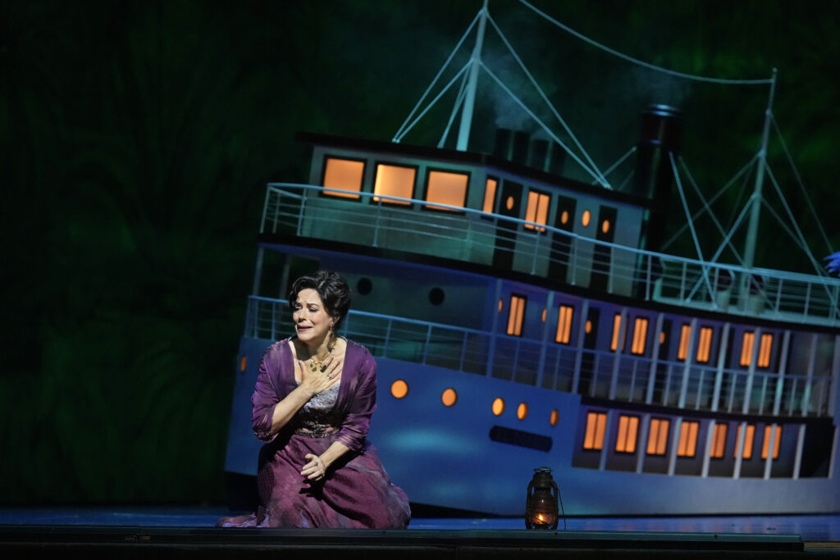
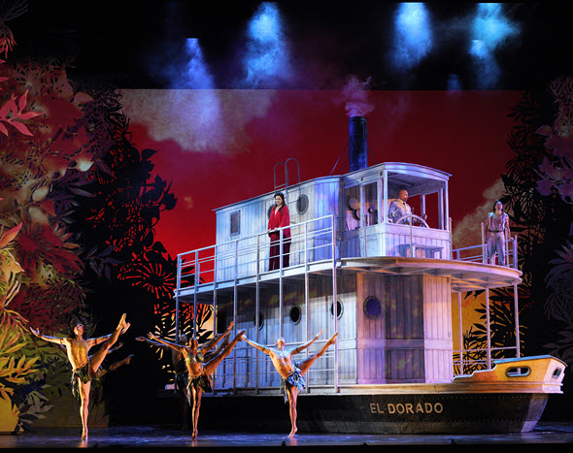
Production Design
Florencia en el Amazonas, Metropolitan Opera (photo: Ken Howard)
Florencia en el Amazonas, Houston Grand Opera (photo: Lynn Lane)

Slide 19
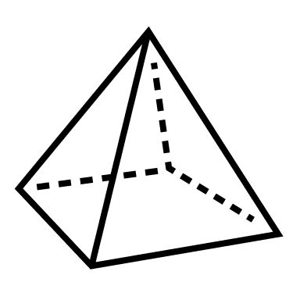
Elements of Design
Color
Line
Shape
Texture
Form
Space
Value
Pattern

Slide 20
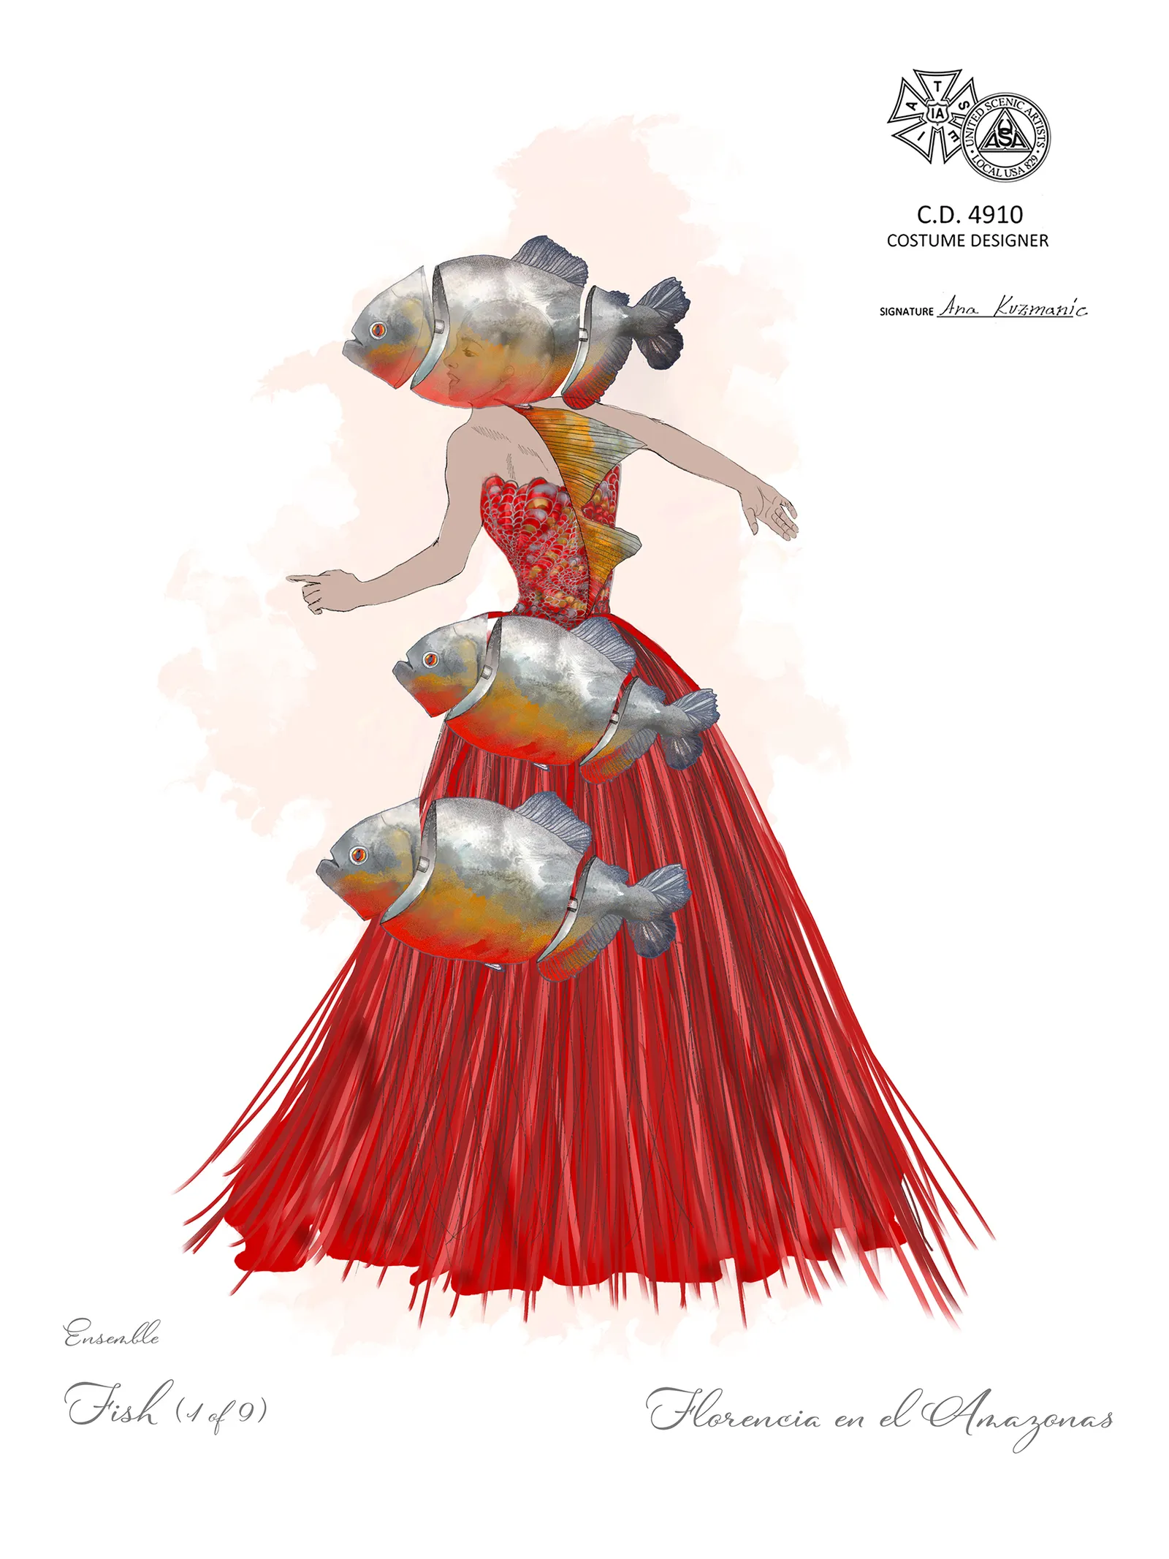
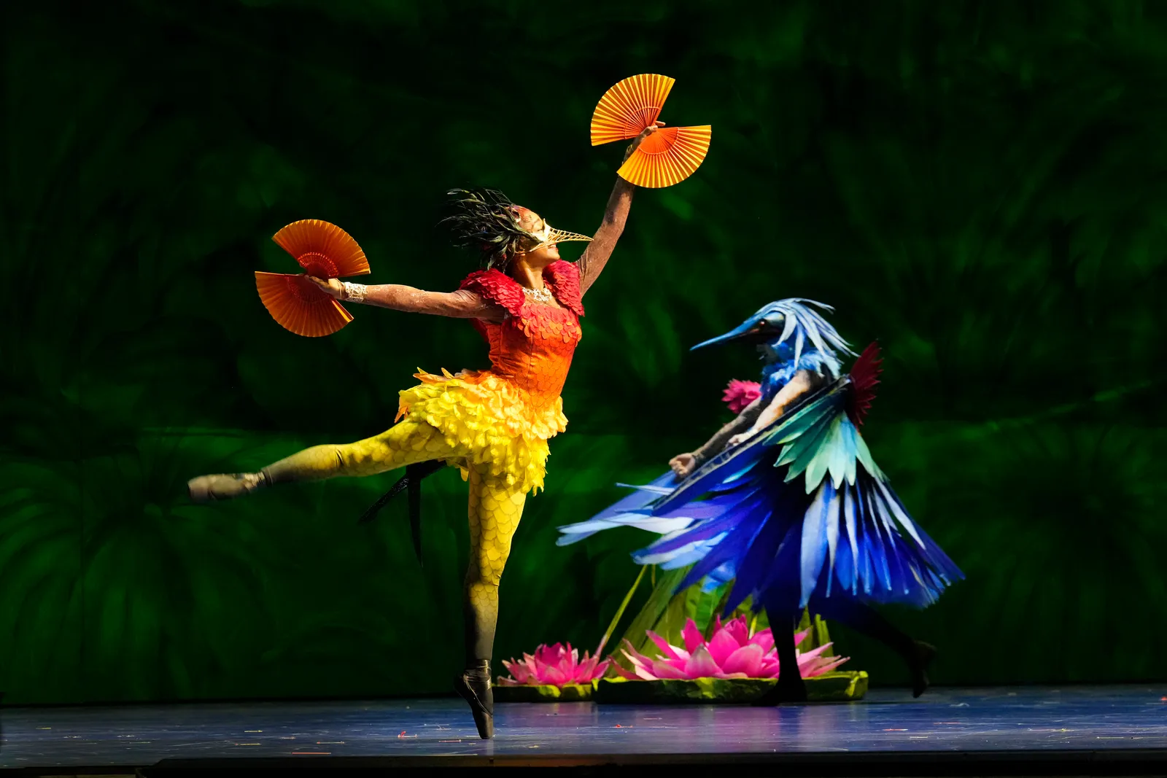
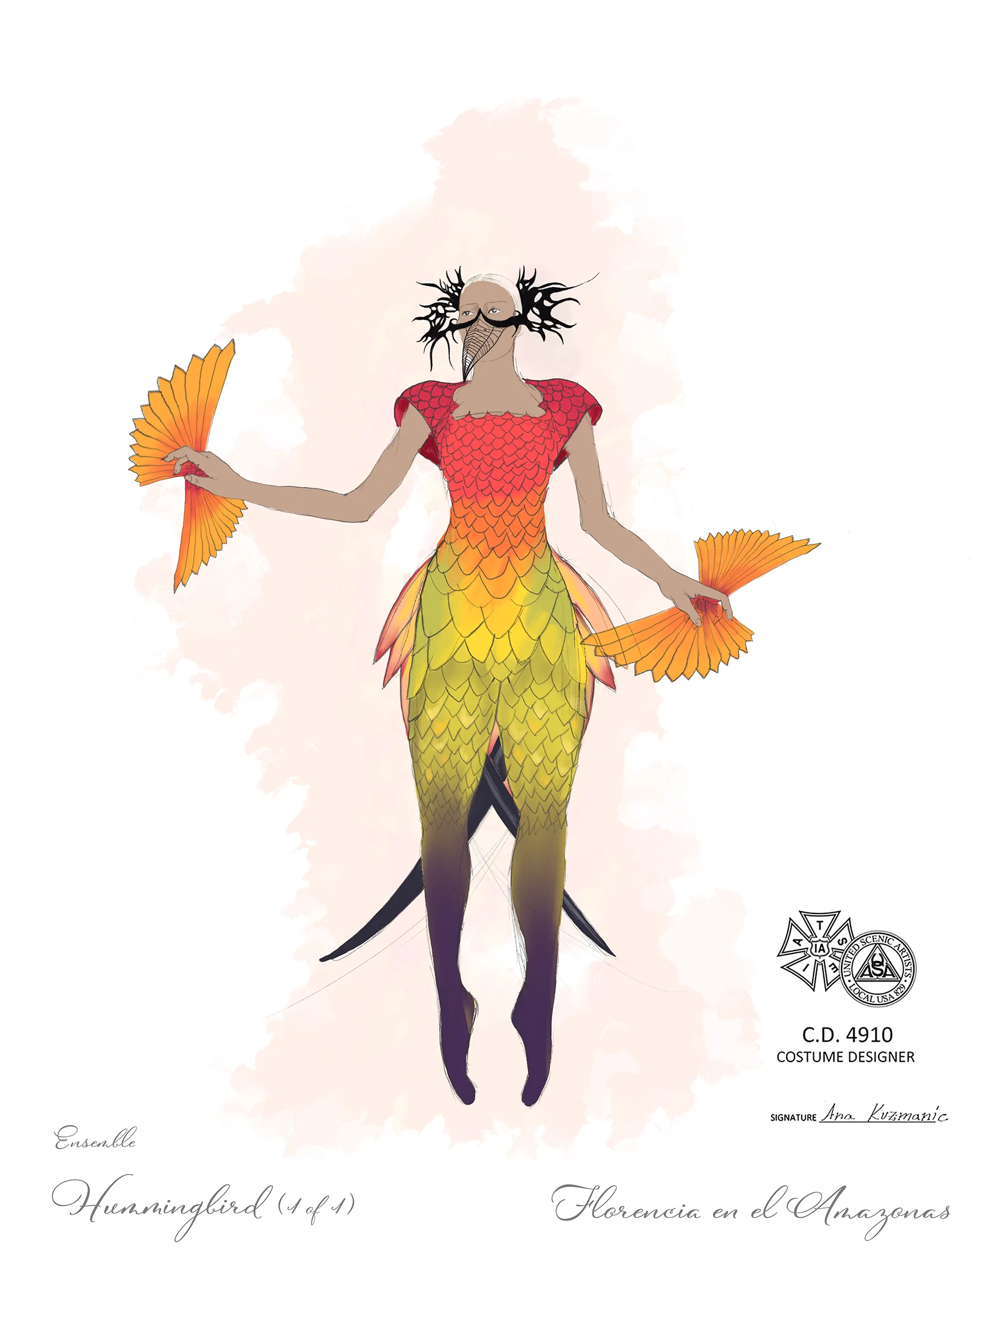
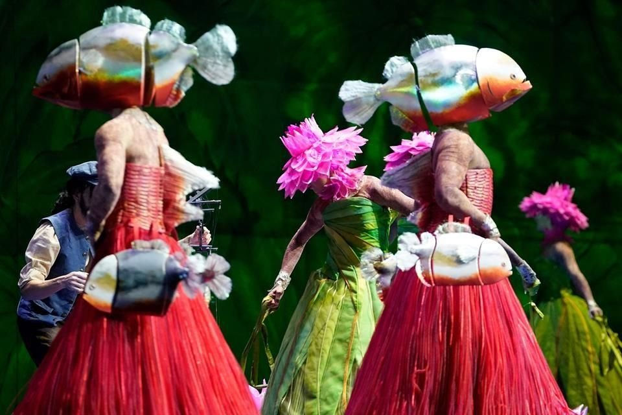
Elements of Design
Costume designs by Ana Kuzmanic, courtesy of the Metropolitan Opera
Florencia en el Amazonas, Metropolitan Opera (photo: Ken Howard)
Color/Shape/Texture: Dancers in vibrant, nature-inspired costumes using bold shapes, striking colors, and rich textures. Bird-like designs feature warm tropical oranges and reds alongside cool blues, with feathered layers and fans adding motion. Fish-themed costumes include large headpieces, cone-like red skirts, and vivid pink and green floral accents. Metallic and layered textures in background enhance depth, creating a dynamic, surreal blend of aquatic elements.
Florencia en el Amazonas, Metropolitan Opera (photo: Ken Howard)

Slide 21
Production Design Guidelines
Consider all that was discussed when designing your production: color, mood, textures, spaces/places, etc.
Production design should include:
Set and costume designs based on your opera adaptation pitch
At least 3 elements of design in your work

Slide 22
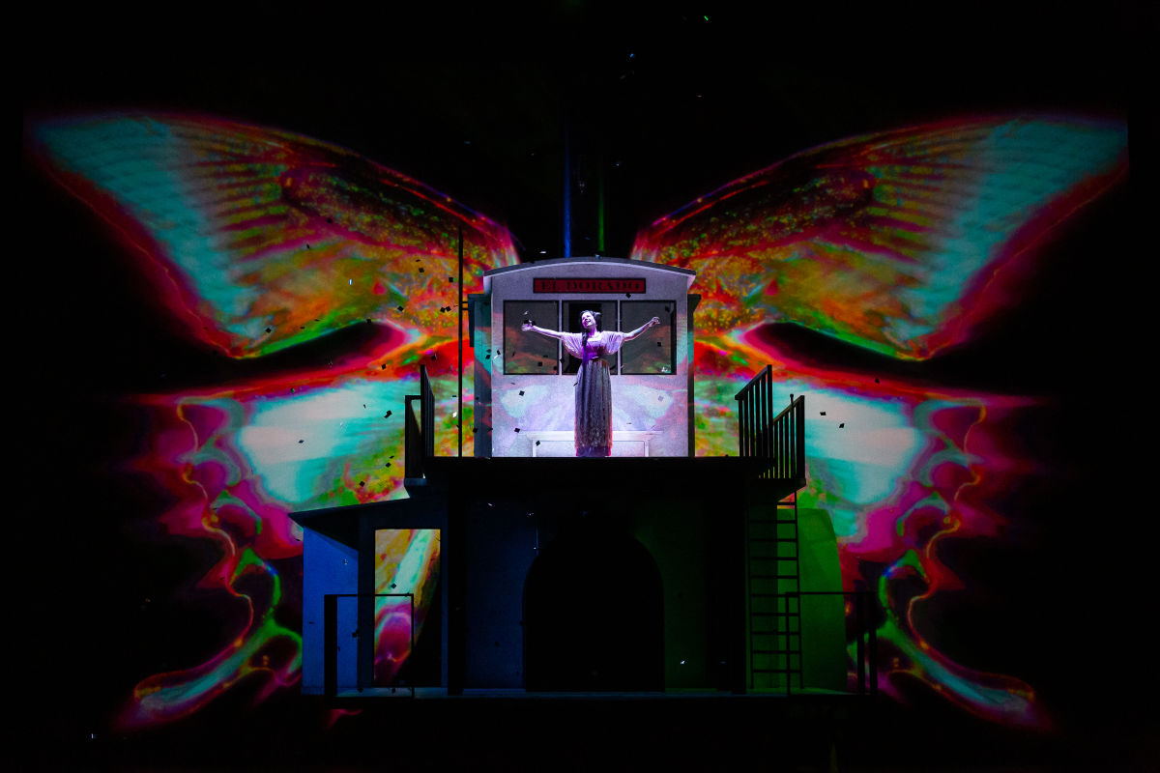
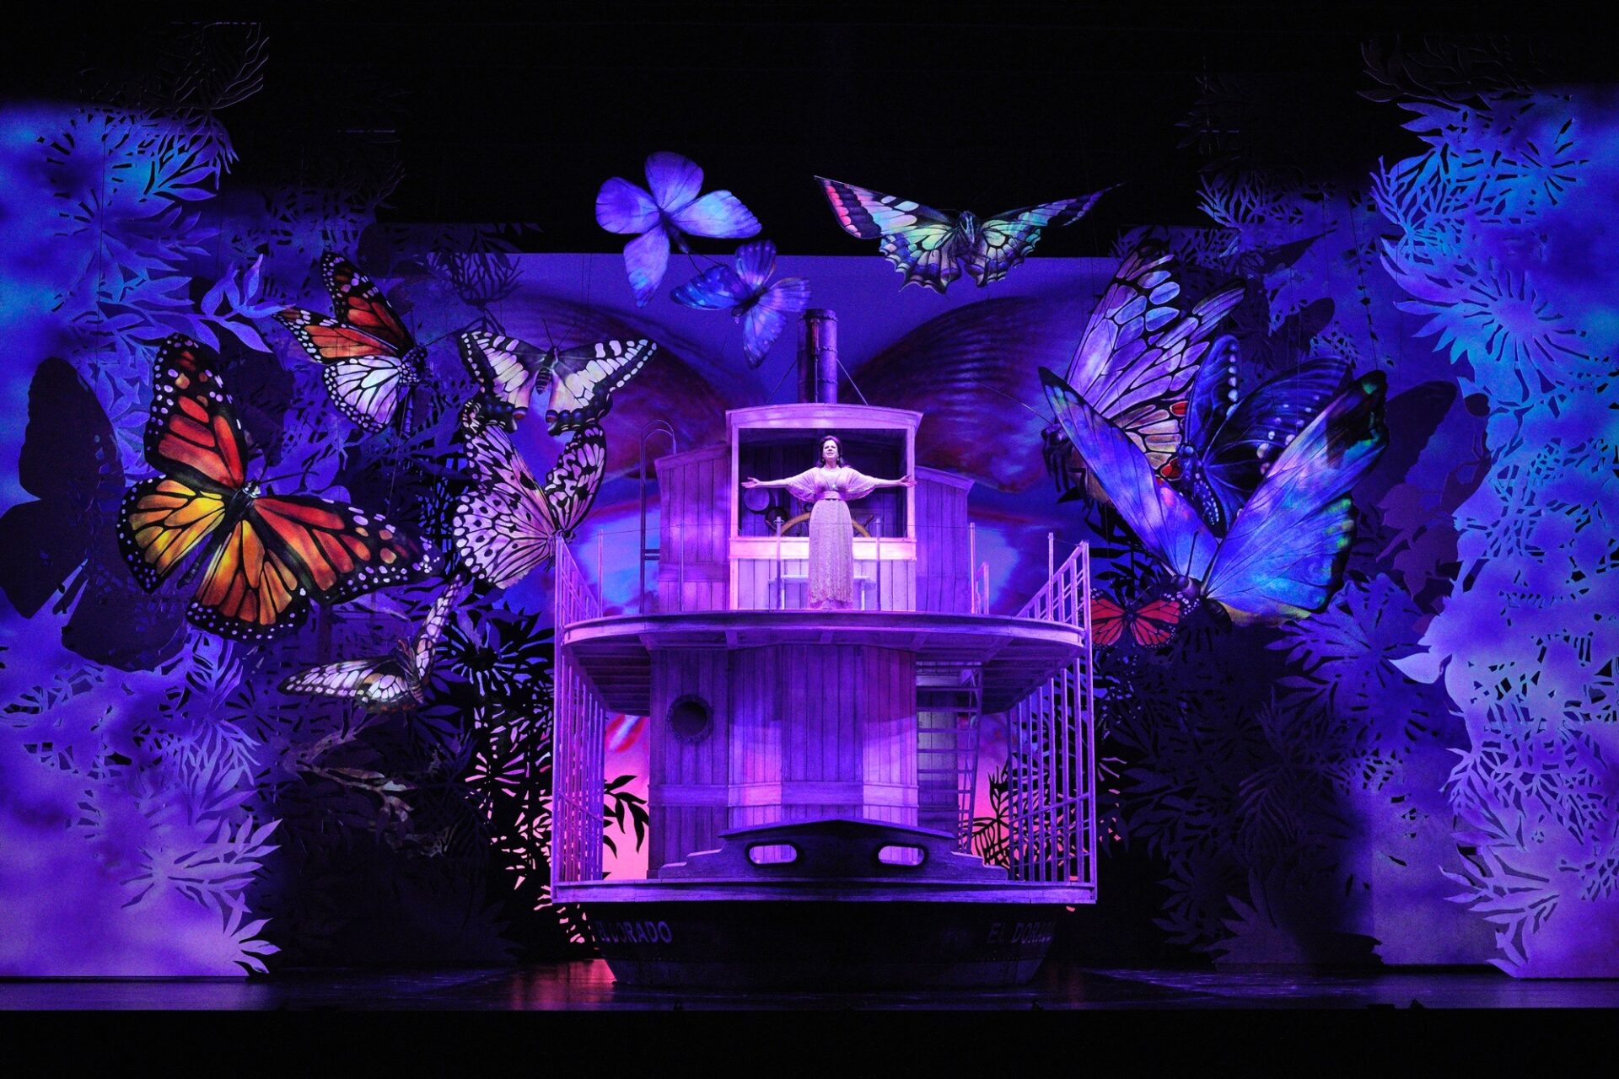
Production Design Examples
In this moment, Florencia, aboard the steamboat El Dorado, undergoes a profound metamorphosis as she connects spiritually with the love and longing that have guided her journey. The presence of the large, luminous butterflies symbolizes renewal, transcendence, and the mystical forces of the Amazon, reflecting the opera's themes of love, loss, and transformation.
Florencia en el Amazonas, Houston Grand Opera (photo: Lynn Lane)
Florencia en el Amazonas, Lyric Opera of Chicago (photo: Cory Weaver)

Slide 23
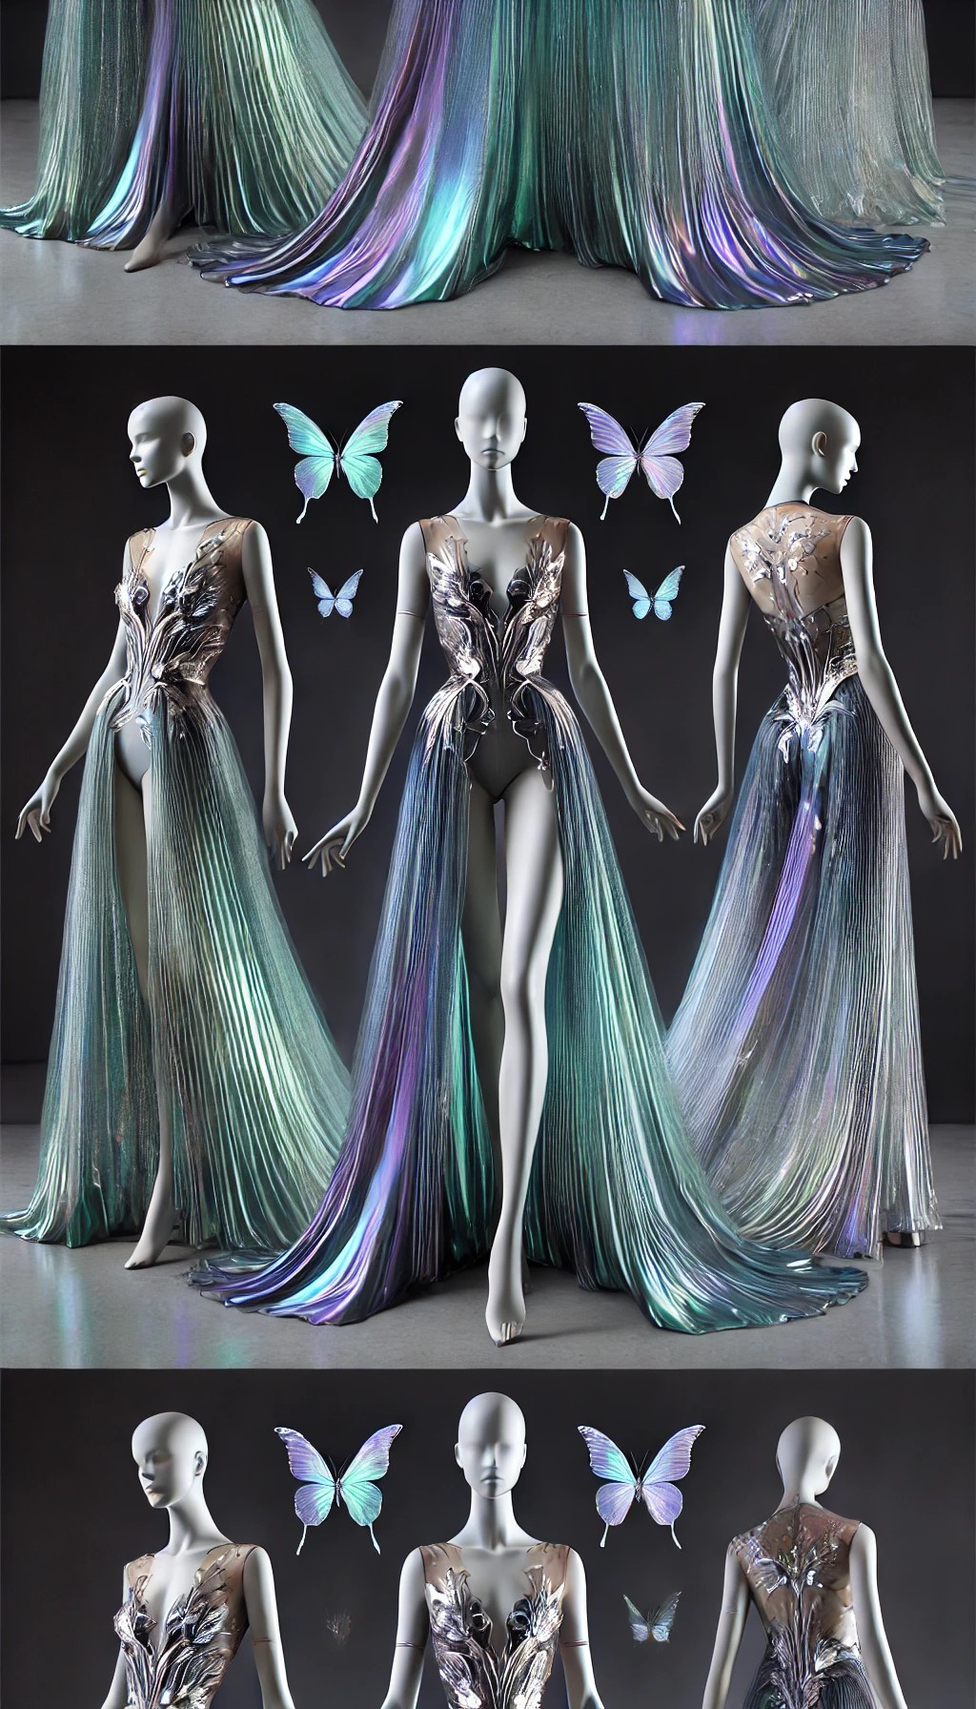
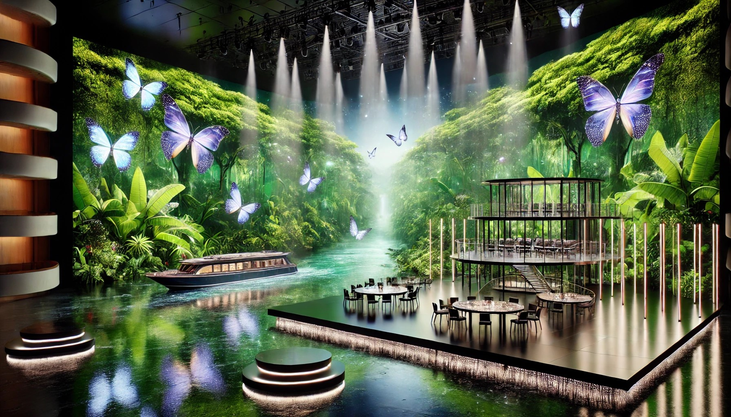
Production Design Examples
Costume design features modern design for Florencia, blending sleek elegance with organic inspiration. The gown features flowing, iridescent fabric in shades of teal, violet, and silver, with subtle butterfly motifs and holographic accents with glowing, ethereal quality, symbolizing transformation.
Set design with sleek, minimalist elements like a steel-and-glass riverboat set against dynamic digital projections of lush greenery. LED-lit trees and holographic butterflies create a magical, futuristic atmosphere, while modular platforms depict the river’s flow. The soft greens, blues, and purples in the lighting enhance the surreal and contemporary feel.
Images generated using AI

Slide 24
Production Design Questionnaire
What are the reasons behind your choices? Are your choices based on the music, story, or libretto, and/or a combination of these?
How are you visually representing the time and location?
How are you visually communicating mood and emotion?

Slide 25
Present

Slide 26
Reflection
Share thoughts on the production design process.
How has your experience with adapting a story visually change your perspective on storytelling or your approach to developing ideas?

