Slide 1
Exploring Story Adaptation
Enriching the Humanities Through Opera
Made possible by the generous support from the

Slide 2
What is story adaptation and how is it relevant to opera?
Today’s Objectives:
Analyze an opera synopsis based on a literary work.
Compare a literary work with the opera adaptation synopsis.
Identify elements of adaptation across multiple versions of the same key scene present in the literary source and opera.
Collaboratively brainstorm a pitch for an opera adaptation of the literary work.

Slide 3
Write down the first word that comes to mind.
Opera
Romeo & Juliet
Adaptation

Slide 4
Story Arc Review
Climax
Falling Action
Rising Action
Resolution
Exposition

Slide 5
Roméo et Juliette Synopsis
The opera Roméo et Juliette, based on Shakespeare's play, tells the story of Romeo and Juliet, two teenagers from the feuding Montague and Capulet families. They meet at a ball, fall in love, and secretly marry, knowing their families will never approve. After Romeo kills Juliet’s cousin in a street fight, he is forced into hiding to escape the Capulets' vengeance. Meanwhile, Juliet fakes her own death to avoid an arranged marriage, but the plan goes tragically wrong. Within a few days, the drama culminates in the tragic deaths of both Romeo and Juliet.

Slide 6
Talk & Turn
Compare the story structure of Romeo and Juliet, the literary work and opera.
Is the setting/time period the same for both the opera and literary work?
Is there a difference in point of view? In historical context? In narrative structure?
What else did you notice?

Slide 7
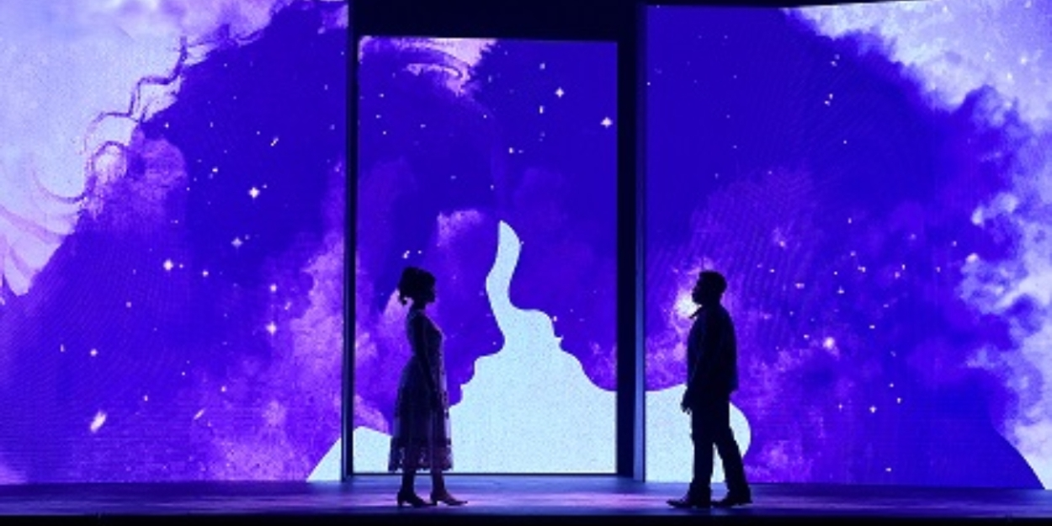
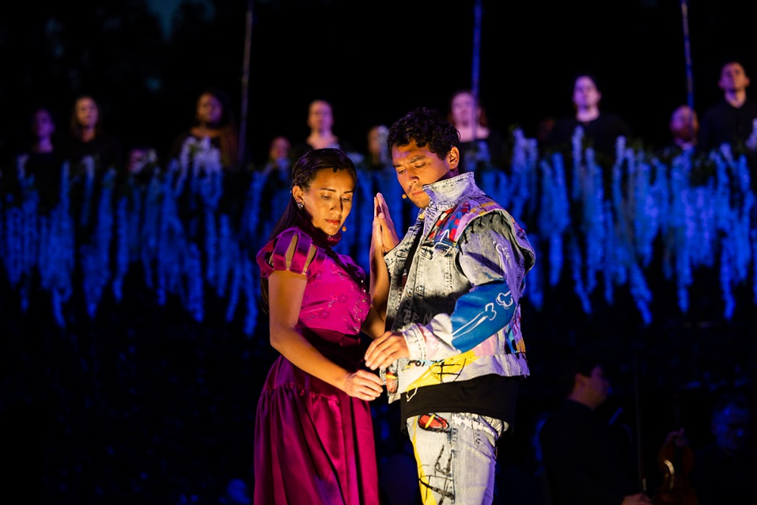
Key Scene #1
Act I: Scene 1, No. 4 - Romeo and Juliet meet
Romeo and Juliet meet at the ball and are both captivated by each other. Romeo, being more experienced, tries to woo Juliet, while Juliet, who is more innocent, is intrigued by Romeo despite the conflict with her beliefs.
Romeo & Juliet, Boston Lyric Opera (photo: courtesy of Boston Lyric Opera)
Romeo and Juliet, Arizona Opera (photo: Tim Trumble)

Slide 8
Key Scene #1 continued
Met Opera on Demand: Track #15. ACT I: Ange adorable
00:00 – 04:43
PBS LearningMedia™ : Roméo et Juliette | Act I | The Metropolitan Opera
32:21 – 37:04
Notes:
https://ondemand.metopera.org/performance/detail/b89905e1-e418-5550-aacb-b3516ef9121a
https://ny.pbslearningmedia.org/resource/romeo-juliette-metropolitan-opera/romeo-juliette-metropolitan-opera/

Slide 9
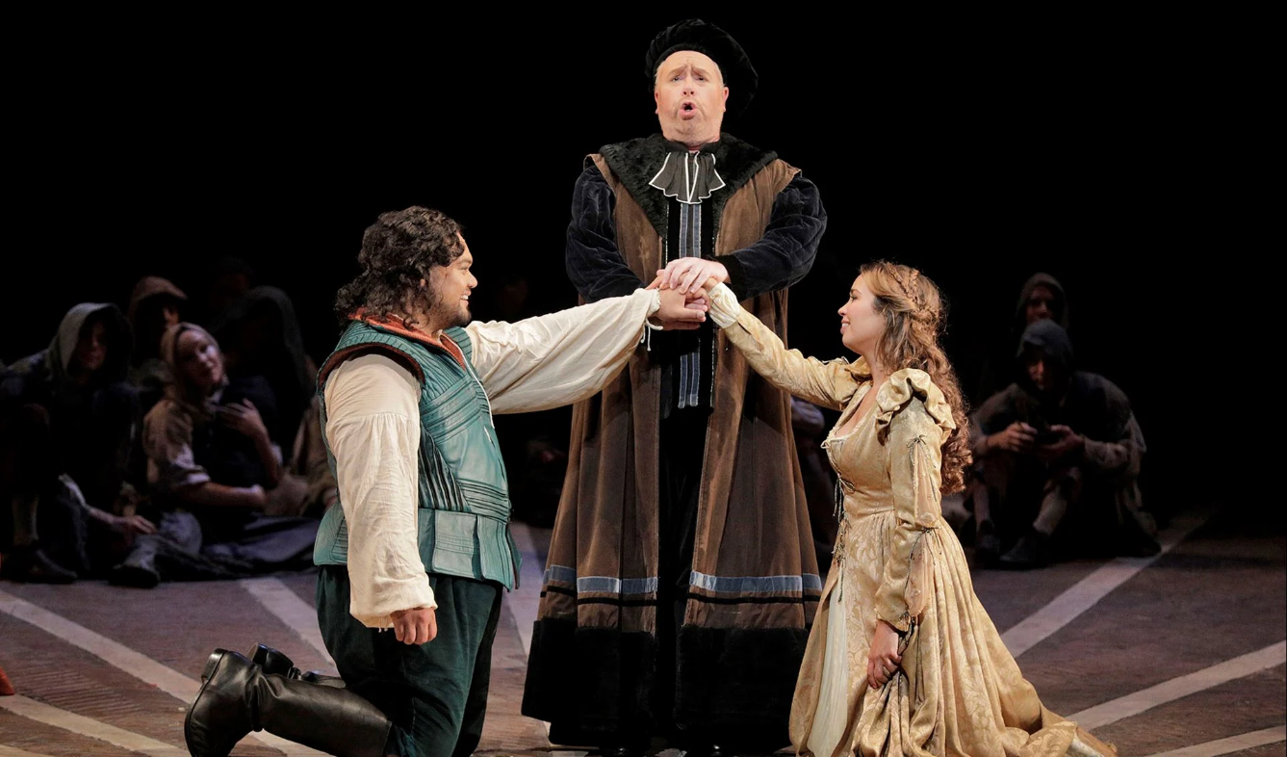
Key Scene #2
Act III: Scene 1, No. 10 - Meeting Friar Laurence
As Romeo and Juliet’s romance has developed very quickly, Friar Laurence mistakes Romeo’s lovesick behavior for feelings toward his former lover, Rosaline. Although Friar Lawrence knows he should not, he performs the marriage of Juliet and Romeo in the hope that their union will end the fighting between their families.
Romeo and Juliet, San Francisco Opera (photo: courtesy of San Francisco Opera)

Slide 10
Key Scene #2 continued
Met Opera on Demand: Track #27. ACT III: Mon père! Dieu vous garde!
00:00 – 03:32
PBS LearningMedia™ : Roméo et Juliette | Act III | The Metropolitan Opera
1:43 – 5:30
Notes:
https://ondemand.metopera.org/performance/detail/b89905e1-e418-5550-aacb-b3516ef9121a
https://ny.pbslearningmedia.org/resource/romeo-juliette-metropolitan-opera/romeo-juliette-metropolitan-opera/

Slide 11
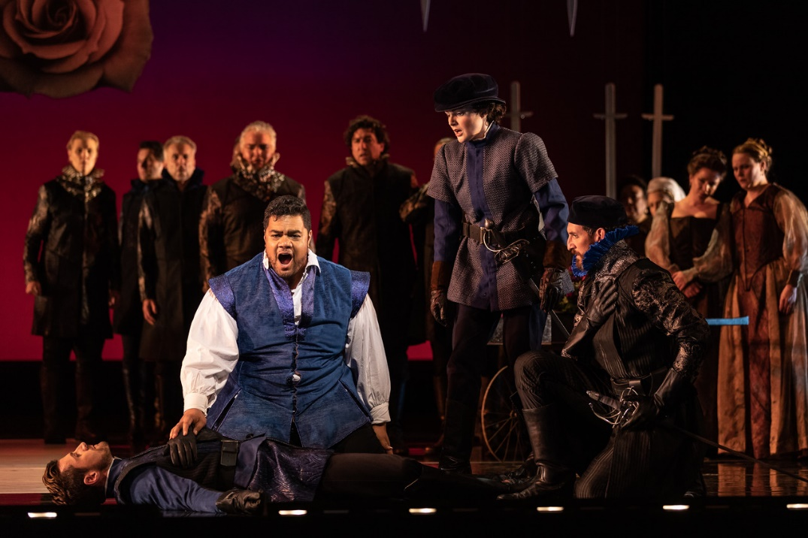
Key Scene #3
Act III: Scene 2, No. 13 - Romeo kills Tybalt
At the climax of the opera, a fierce street fight erupts between the two rival families. Romeo, desperate to stop the violence, pleads for peace, but neither side listens. During the chaos, Romeo’s best friend, Mercutio, is killed by Juliet’s cousin, Tybalt. Overcome with grief and rage, Romeo seeks revenge and kills Tybalt. This act seals Romeo’s fate, deepening the Capulets' hatred for him and leading to his exile.
Roméo et Juliette, Washington National Opera (photo: Scott Suchman)
Roméo et Juliette, San Diego Opera (photo: Karli Cadel)

Slide 12
Key Scene #3 continued
Met Opera on Demand: Track #32. ACT III: Allons! tu ne me connais pas, Tybalt,
00:06 – 05:39
PBS LearningMedia™ : Roméo et Juliette | Act III | The Metropolitan Opera
19:33 – 25:04
Notes:
https://ondemand.metopera.org/performance/detail/b89905e1-e418-5550-aacb-b3516ef9121a
https://ny.pbslearningmedia.org/resource/romeo-juliette-metropolitan-opera/romeo-juliette-metropolitan-opera/

Slide 13
Why do we adapt stories?

Slide 14
Adaptation Guidelines
Adapting the Who, What, When, and Where.
Who: character/character identity
Note: character identity can be adapted, but characters may not be eliminated or added.
What: key scene, action in the story - what is happening?
When: time period, time of day, year, etc.
Where: location and setting

Slide 15
Adaptation Pitch
Who (characters in the scene):
What (scene action):
When (time period, time of year/day):
Where (location/setting):
Why did you choose to adapt the opera this way?
How will these changes affect the rest of the story?

Slide 16
Present

Slide 17
Reflection
Share thoughts on the story adaptation pitch process.
How did your understanding of the story change as you adapted it?
Were there any new insights or perspectives that emerged?

