Slide 1
Exploring Story Adaptation
Enriching the Humanities Through Opera
Made possible by the generous support from the

Slide 2
What is story adaptation and how is it relevant to opera?
Today’s Objectives:
Analyze an opera synopsis based on a literary work.
Compare a literary work with the opera adaptation synopsis.
Identify elements of adaptation across multiple versions of the same key scene present in the literary source and opera.
Collaboratively brainstorm a pitch for an opera adaptation of the literary work.

Slide 3
Write down the first word that comes to mind.
Opera
Emile Griffith
Adaptation

Slide 4
Timeline of Emile Griffith’s Life
Emile Griffith was born in St. Thomas, U.S. Virgin Islands in 1938.
As a class, complete timeline of major events in Emile Griffith’s life.

Slide 5
Champion Synopsis
The powerful and deeply personal story of Emile Griffith, a six-time world champion boxer, whose life was shaped by triumph and tragedy. Griffith rose from a hat factory worker to a boxing legend, culminating in his infamous 1962 fight with Benny "Kid" Paret, which resulted in Paret’s death. Haunted by this event and grappling with his identity, Griffith seeks forgiveness and reconciliation in his later years.

Slide 6
Talk & Turn
Compare the opera synopsis with the timeline created and Knock Out!.
What events did the librettist choose to include and what did they leave out?
Is there a difference in point of view? In historical context? In narrative structure?
What else did you notice?

Slide 7
Key Scene #1: Act I, Scene 8: Hey, Mr. Albert
Emile relocates to New York from the U.S. Virgin Islands in search of his mother, Emelda. When he finally finds her. Determined to help Emile find work, she introduces him to Howie Albert, a hat manufacturer. Howie quickly notices Emile’s athletic build and, seeing potential, decides to train him as a boxer.
Champion, Lyric Opera of Chicago (photo: Michael Brosilow)

Slide 8
Key Scene #1 continued
Met Opera on Demand: Track #12. ACT I: Hey Mr. Albert
00:00 – 3:43
Notes:
https://ondemand.metopera.org/performance/detail/a8ba44f0-b86e-539e-8ef6-8006e70d9eab

Slide 9
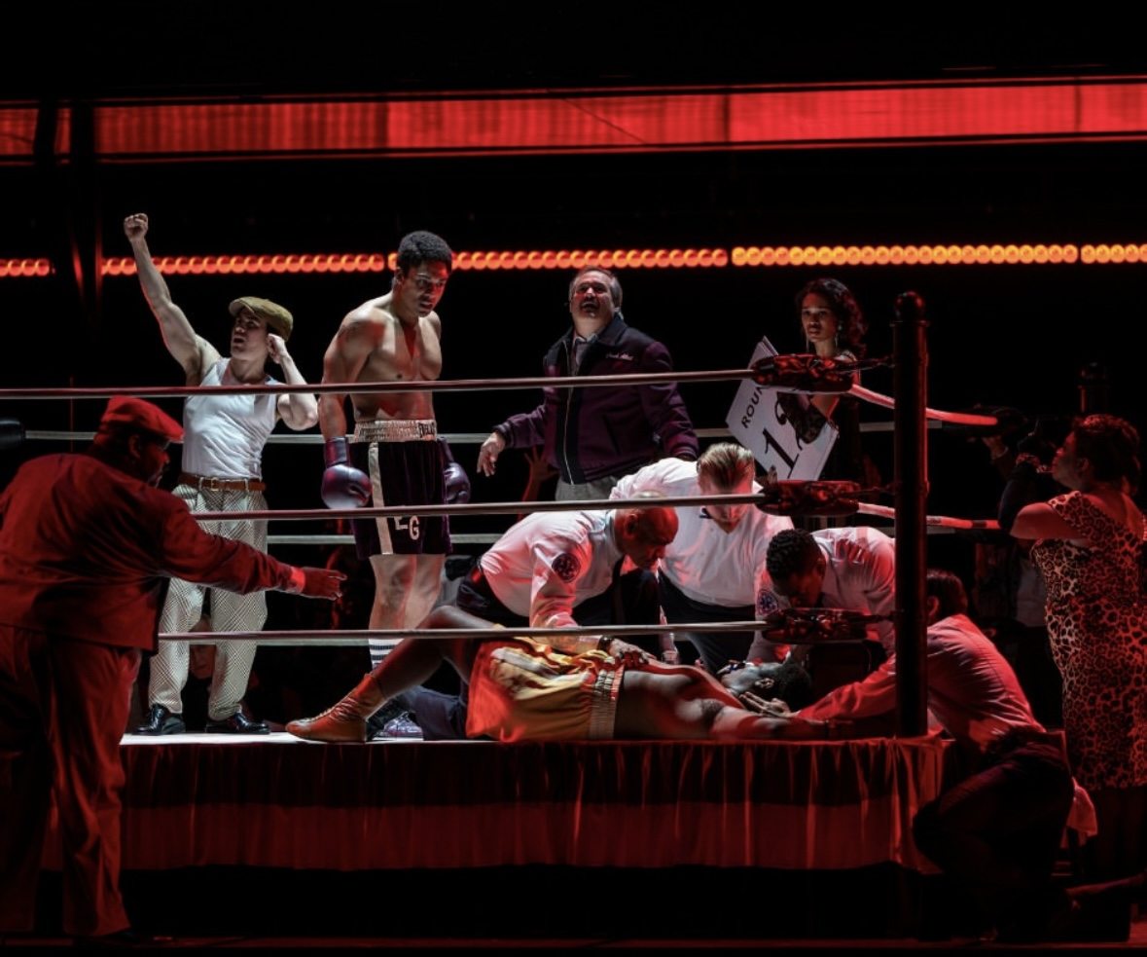
Key Scene #2: Act I, Scene 22-23: Don’t listen, Emile. Don’t think–In my head it happens fast
During the weigh-in, Benny “Kid” Paret taunts Emile about his sexual orientation, provoking tension between the two fighters. Once in the ring, Paret continues to antagonize Emile. In a burst of fury, further encouraged by Howie’s coaching, Emile delivers seventeen blows in less than seven seconds, knocking Paret into a coma.
Champion, Lyric Opera of Chicago (photo: Michael Brosilow)

Slide 10
Key Scene #2 continued
Met Opera on Demand: Track #27. ACT I: Don't listen, Emile. Don't think—In my head it happens fast
04:56 – 07:03
Notes:
https://ondemand.metopera.org/performance/detail/a8ba44f0-b86e-539e-8ef6-8006e70d9eab

Slide 11
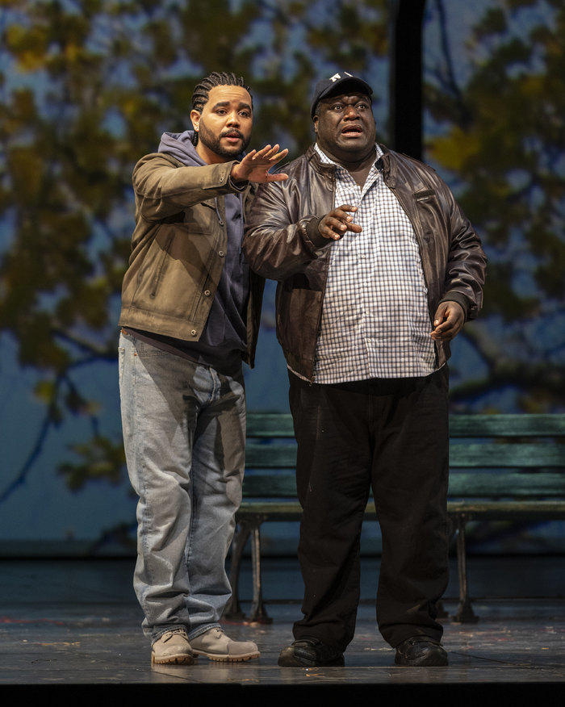
Key Scene #3: Act II, Scene 20: What is it you want from me? (I’m sorry)
Emile, suffering from brain trauma from his boxing career and haunted by his past, faces Benny Paret Jr. seeking forgiveness for the fatal fight that took the now young man’s father.
Champion, Lyric Opera of Chicago (photo: Michael Brosilow)

Slide 12
Key Scene #3 continued
Met Opera on Demand: Track #47. ACT II: What is it you want from me?
00:00 – 03:02
Notes:
https://ondemand.metopera.org/performance/detail/a8ba44f0-b86e-539e-8ef6-8006e70d9eab

Slide 13
Why do we adapt stories?

Slide 14
Adaptation Guidelines
Adapting the Who, What, When, and Where.
Who: character/character identity
Note: character identity can be adapted, but characters may not be eliminated or added.
What: key scene, action in the story - what is happening?
When: time period, time of day, year, etc.
Where: location and setting

Slide 15
Adaptation Pitch
Who (characters in the scene):
What (scene action):
When (time period, time of year/day):
Where (location/setting):
Why did you choose to adapt the opera this way?
How will these changes affect the rest of the story?

Slide 16
Present

Slide 17
Reflection
Share thoughts on the story adaptation pitch process.
How did your understanding of the story change as you adapted it?
Were there any new insights or perspectives that emerged?

