Slide 1
Exploring Story Adaptation
Enriching the Humanities Through Opera
Made possible by the generous support from the

Slide 2
What is story adaptation and how is it relevant to opera?
Today’s Objectives:
Analyze an opera synopsis based on a literary work.
Compare a literary work with the opera adaptation synopsis.
Identify elements of adaptation across multiple versions of the same key scene present in the literary source and opera.
Collaboratively brainstorm a pitch for an opera adaptation of the literary work.

Slide 3
Write down the first word that comes to mind.
Opera
The Marriage of Figaro
Adaptation

Slide 4
Story Arc Review
Climax
Falling Action
Rising Action
Resolution
Exposition

Slide 5
Le nozze di Figaro Synopsis
Set within a single day, the story is a comedic exploration of love, deception, and social class. It follows Figaro and his fiancée Susanna as they navigate the scheming intentions of Count Almaviva, who wishes to seduce Susanna before her marriage. Through a series of clever disguises, misunderstandings, and unexpected alliances, the characters ultimately triumph over the Count’s advances, celebrating love and the spirit of equality in the end.

Slide 6
Turn & Talk
Compare the story structure of The Marriage of Figaro, the literary work and opera.
Is the setting/time period the same for both the opera and literary work?
Is there a difference in point of view? In historical context? In narrative structure?
What else did you notice?

Slide 7
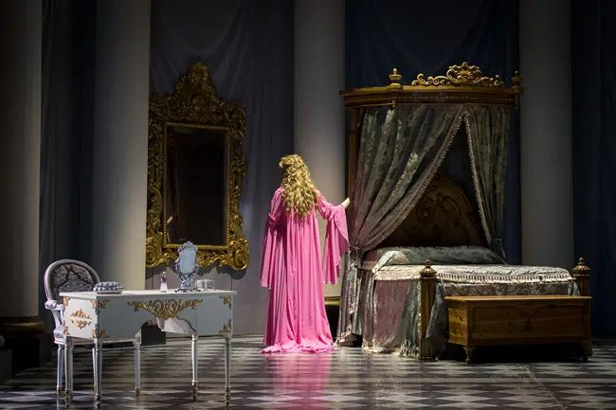
Key Scene #1
Act II, Scene 1: Porgi, amor, qualche ristoro (Grant, love, some relief)
Countess is longing for the love of her husband, Count Almaviva, who has grown distant and unfaithful.
Le nozze di Figaro, Washington National Opera (photo: Scott Suchman)

Slide 8
Key Scene #1 continued
Met Opera on Demand: Track #16. ACT II: Porgi, amor, qualche ristoro
01:07 – 04:01
Act II, Scene 1: Porgi, amor, qualche ristoro
48:08 – 51:26
Notes:
https://ondemand.metopera.org/performance/detail/e8174902-82fb-5e94-b1ef-54dd3387dbe9
https://www.youtube.com/watch?v=Yy-DTtJ5q-A

Slide 9
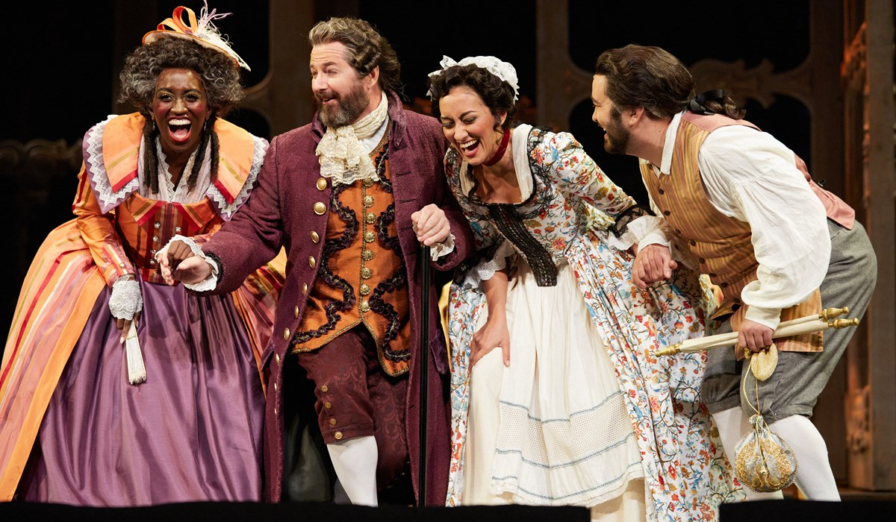
Key Scene #2
Act II, Scene 5: Riconosci in questo amplesso (Recognize in this embrace)
Figaro is brought to court over a broken marriage contract with Marcellina. During the proceedings, it is revealed through a birthmark that Figaro is Marcellina’s long-lost son, and Bartolo is his father, turning into a joyful family reunion. Susanna enters and, misunderstanding the embrace between Figaro and Marcellina, initially reacts with anger but is soon relieved when the truth is explained.
Le nozze di Figaro, Portland Opera (photo: Philip Newton)

Slide 10
Key Scene #2 continued
Met Opera on Demand: Track #36. ACT III: Riconosci in questo amplesso — Eccovi — Io vi dico
00:48 – 06:27
Act #, Scene #
2:01:22 – 2:06:57
Notes:
https://ondemand.metopera.org/performance/detail/e8174902-82fb-5e94-b1ef-54dd3387dbe9
https://www.youtube.com/watch?v=Yy-DTtJ5q-A

Slide 11
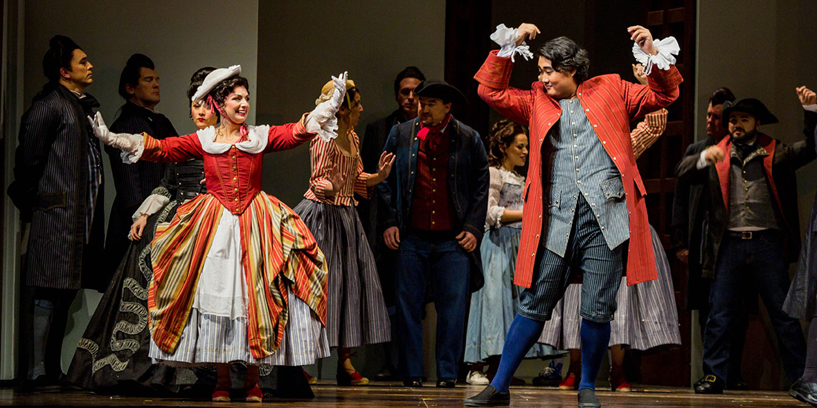
Key Scene #3
Act IV, Finale: Gente, gente, all'armi, all'armi!... Questo giorno di tormenti (Gentlemen, to arms!... This day of torments)
Chaos erupts as the elaborate disguises and misunderstandings reach their peak. Figaro, Susanna, the Count, and the Countess become entangled in a whirlwind of mistaken identities, culminating in the Count mistakenly accusing the disguised Countess of infidelity. The commotion attracts others, who rush in, adding to the confusion.
Le nozze di Figaro, Seattle Opera (photo: Tuffer)

Slide 12
Key Scene #3 continued
Met Opera on Demand: Track #47. ACT IV: Gente, gente, all'armi — Questo giorno di tormenti
00:00 – 05:24
Act IV, Scene 14: Gente, gente, all'armi, all'armi!... Questo giorno di tormenti
2:59:50 – 3:05:28
Notes:
https://ondemand.metopera.org/performance/detail/e8174902-82fb-5e94-b1ef-54dd3387dbe9
https://www.youtube.com/watch?v=Yy-DTtJ5q-A

Slide 13
Why do we adapt stories?

Slide 14
Adaptation Guidelines
Adapting the Who, What, When, and Where.
Who: character/character identity
Note: character identity can be adapted, but characters may not be eliminated or added.
What: key scene, action in the story - what is happening?
When: time period, time of day, year, etc.
Where: location and setting

Slide 15
Adaptation Pitch
Who (characters in the scene):
What (scene action):
When (time period, time of year/day):
Where (location/setting):
Why did you choose to adapt the opera this way?
How will these changes affect the rest of the story?

Slide 16
Present

Slide 17
Reflection
Share thoughts on the story adaptation pitch process.
How did your understanding of the story change as you adapted it?
Were there any new insights or perspectives that emerged?

