Slide 1
Exploring Story Adaptation
Enriching the Humanities Through Opera
Made possible by the generous support from the

Slide 2
What is story adaptation and how is it relevant to opera?
Today’s Objectives:
Analyze an opera synopsis based on a literary work.
Compare a literary work with the opera adaptation synopsis.
Identify elements of adaptation across multiple versions of the same key scene present in the literary source and opera.
Collaboratively brainstorm a pitch for an opera adaptation of the literary work.

Slide 3
Write down the first word that comes to mind.
Opera
A Midsummer Night’s Dream
Adaptation

Slide 4
Story Arc Review
Climax
Falling Action
Rising Action
Resolution
Exposition

Slide 5
A Midsummer Night’s Dream Synopsis
In the woods outside Athens, Oberon, King of the Fairies, quarrels with his queen, Tytania, over a boy she refuses to give up. Oberon sends his servant, Puck, to retrieve a magic flower to enchant her and distract her. Meanwhile, Lysander and Hermia flee into the forest to escape a forced marriage, pursued by Demetrius and Helena. Puck accidentally enchants Lysander instead of Demetrius, creating chaos. A group of workers also enters the forest to rehearse a play, and Puck further complicates matters by turning one of them, Bottom, into an ass, causing Tytania to fall in love with him. In the end, the enchantments are undone, the lovers are reconciled, and they all return to Athens for Theseus’s wedding, where the workers perform their play.

Slide 6
Turn & Talk
Compare the story structure of A Midsummer Night’s Dream, the literary work and opera.
Is the setting/time period the same for both the opera and literary work?
Is there a difference in point of view? In historical context? In narrative structure?
What else did you notice?

Slide 7
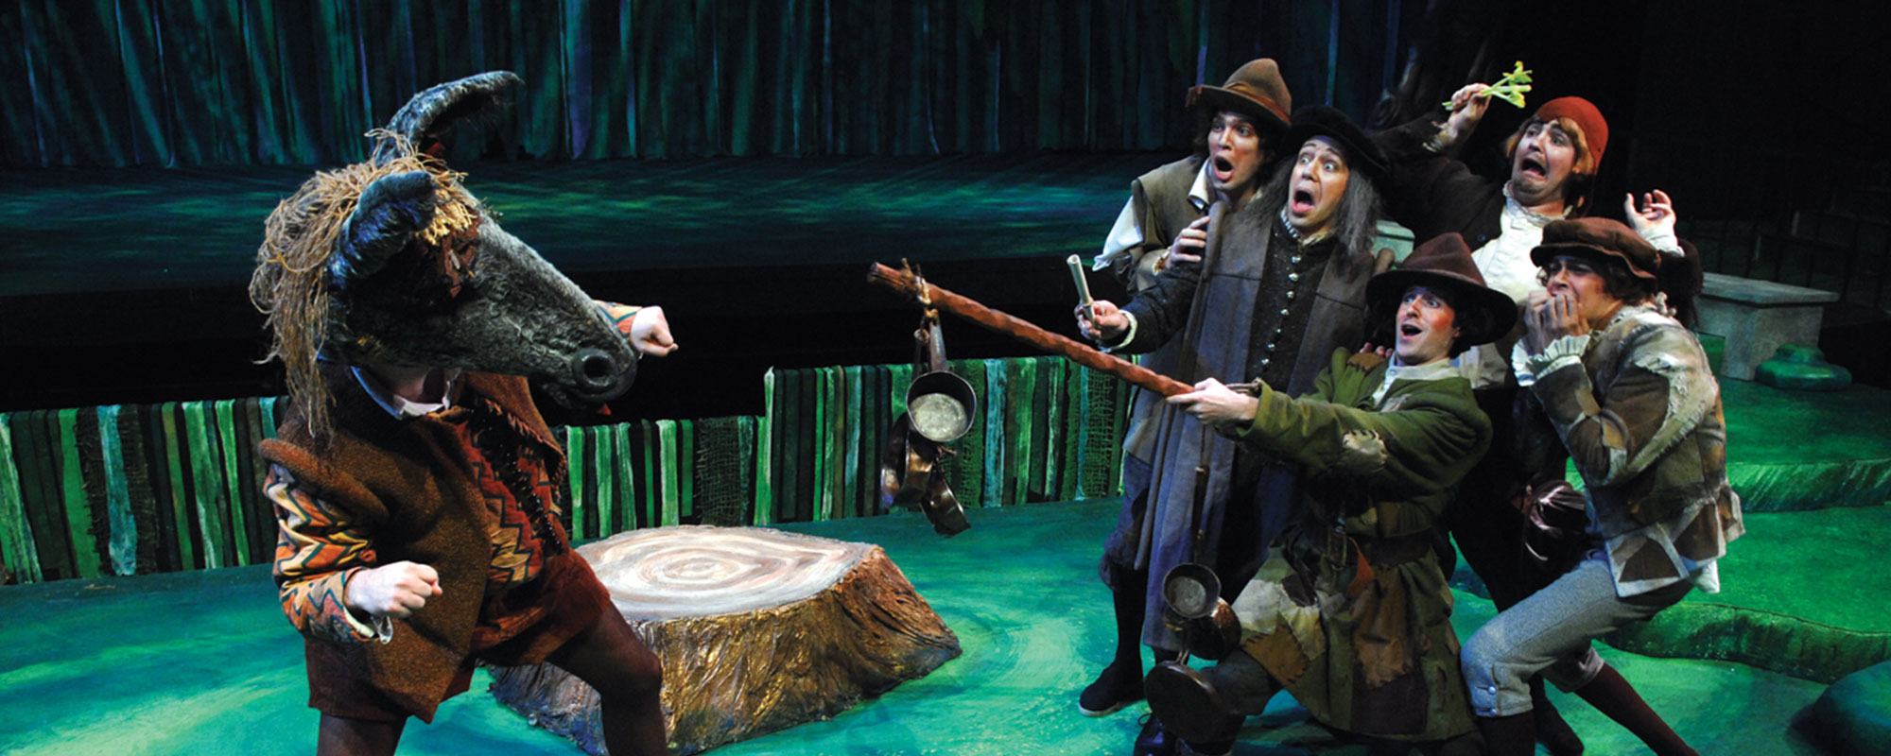
Key Scene #1: Act II, Scene 1: Puck “makes an ass” of Bottom
The mechanicals rehearse their play. Puck transforms Bottom by giving him the head of a donkey (an "ass").
A Midsummer Night’s Dream, Des Moines Metro Opera (photo courtesy of Des Moines Metro Opera)

Slide 8
Key Scene #1 continued
06:19 – 8:50
Notes:
https://youtu.be/28Xz6P6k2p0?si=TZdM7SqVJVLWOR0F

Slide 9
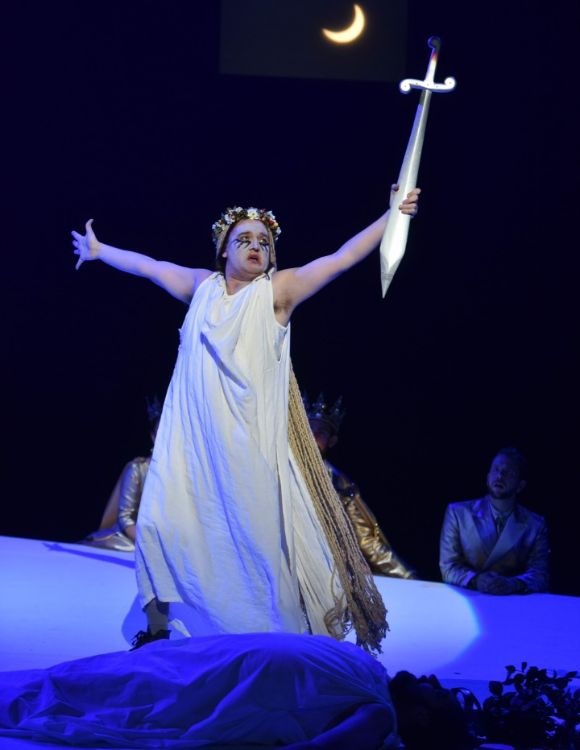
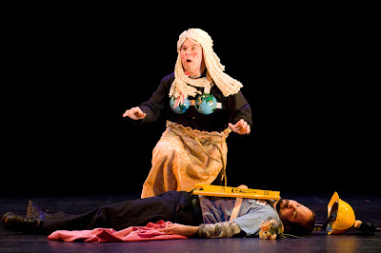
Key Scene #2: Act III, Scene 2: Pyramus and Thisbe
The mock-tragic play-within-the-play, Thisbe, portrayed by Flute, discovers the lifeless Pyramus (portrayed by Bottom), who believed Thisbe to have been killed by a lion. Thisbe sings the aria “Asleep, my Love?” as a lament and stabs herself.
A Midsummer Night’s Dream, Opera Philadelphia (photo: Kelly & Massa)
A Midsummer Night’s Dream, Seattle Opera (photo: Rozarii Lynch)

Slide 10
Key Scene #2 continued
00:06 – 2:01
Notes:
https://youtu.be/5SeeMubn94I?si=O3Up8VsyCO3yReqE

Slide 11
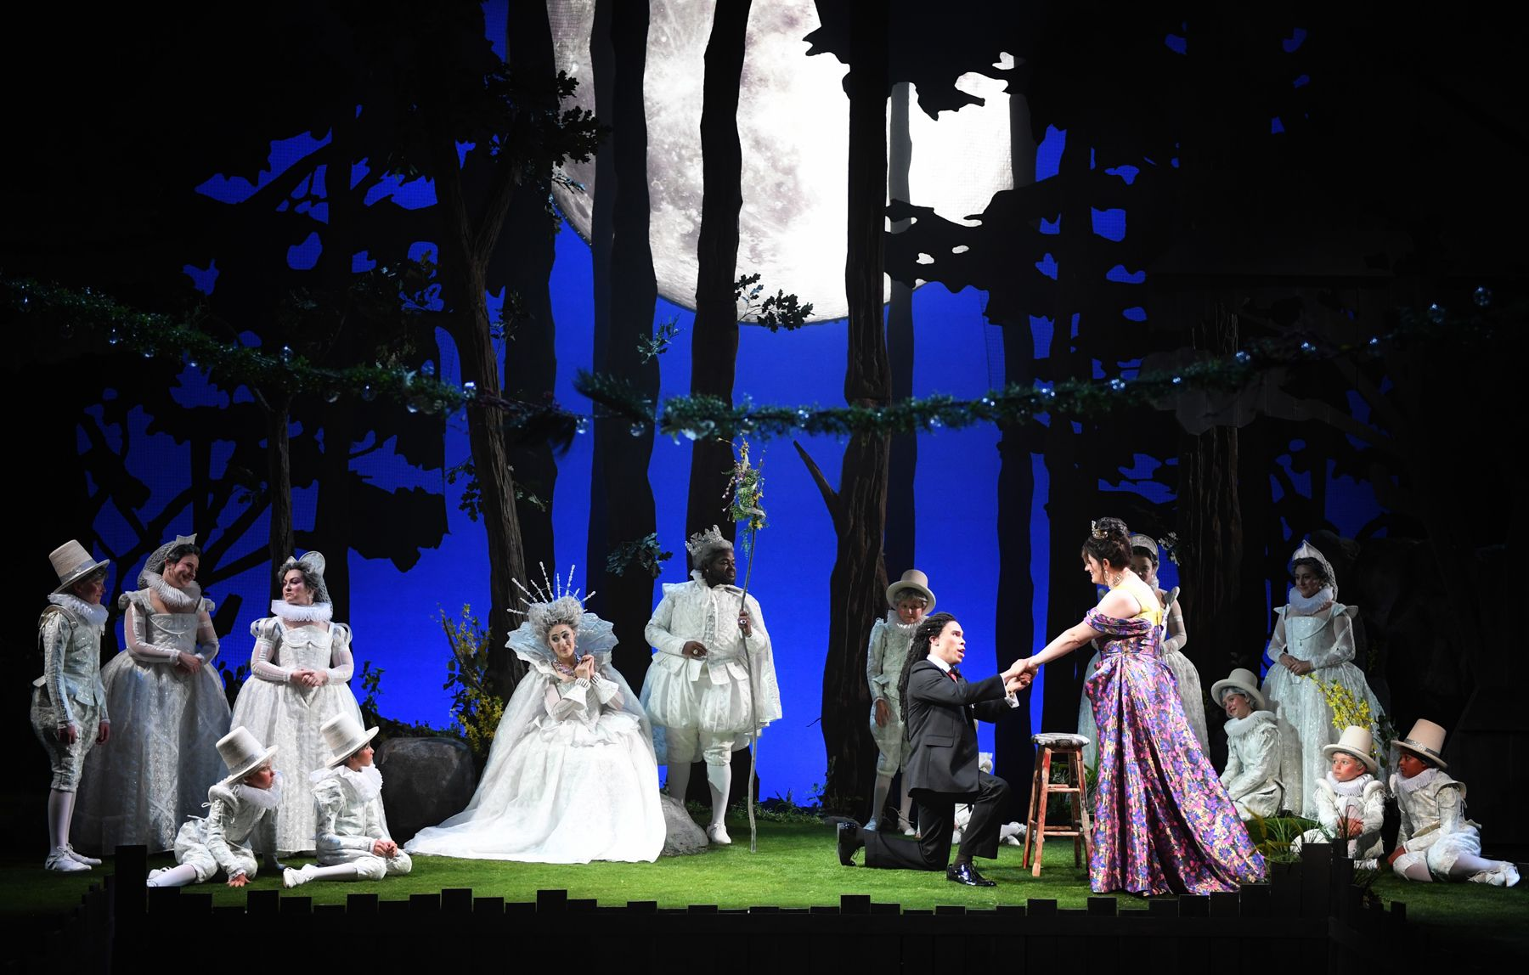
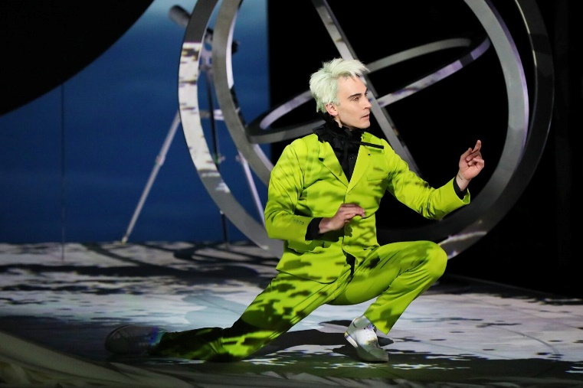
Key Scene #3: Act III, Finale & Puck’s Epilogue
The various stories have been resolved: the lovers are united, the mechanicals presented their play, and the fairies have restored order. Puck then breaks the "fourth wall" and talks openly to the audience, apologizing if the performance has offended anyone.
A Midsummer Night’s Dream, Des Moines Metro Opera (photo: Duane Tinkey)
A Midsummer Night’s Dream, Santa Fe Opera (photo: Curtis Brown)

Slide 12
Key Scene #3 continued
0:03 – 3:02
Notes:
https://www.youtube.com/watch?v=BEgafzaxS98

Slide 13
Why do we adapt stories?

Slide 14
Adaptation Guidelines
Adapting the Who, What, When, and Where.
Who: character/character identity
Note: character identity can be adapted, but characters may not be eliminated or added.
What: key scene, action in the story - what is happening?
When: time period, time of day, year, etc.
Where: location and setting

Slide 15
Adaptation Pitch
Who (characters in the scene):
What (scene action):
When (time period, time of year/day):
Where (location/setting):
Why did you choose to adapt the opera this way?
How will these changes affect the rest of the story?

Slide 16
Present

Slide 17
Reflection
Share thoughts on the story adaptation pitch process.
How did your understanding of the story change as you adapted it?
Were there any new insights or perspectives that emerged?

