Slide 1
Production Design Adaptation
Enriching the Humanities Through Opera
Made possible by the generous support from the

Slide 2
How does production and visual design aid in storytelling?
Today’s Objectives:
Respond to the musical and storytelling elements of opera to develop criteria for visual artistic choices.
Refine an adaptation pitch to demonstrate critical understanding of the visual elements of production design and opera to tell a story.
Create visual representations of set and costume designs based on opera adaptation pitches.

Slide 3
Listening Activity
As you listen to the music, write down any colors, mood, spaces/places, textures, foods, etc. you can associate with the music. (start at 1:16)
Notes:
https://www.youtube.com/watch?v=VDEaEu1IYWs

Slide 4
X: The Life and Times of Malcolm X Synopsis
The opera presents 12 vignettes from the life of Malcolm X, from youth to his death: abject poverty in Depression-era Lansing to adolescence in Boston to Mecca (the site of his pivotal hajj, the traditional Muslim pilgrimage), as well as a number of places in New York City, including a mosque, the streets of Harlem, and, finally, the site of his assassination in 1965, the Audubon Ballroom and West 165th Street.

Slide 5
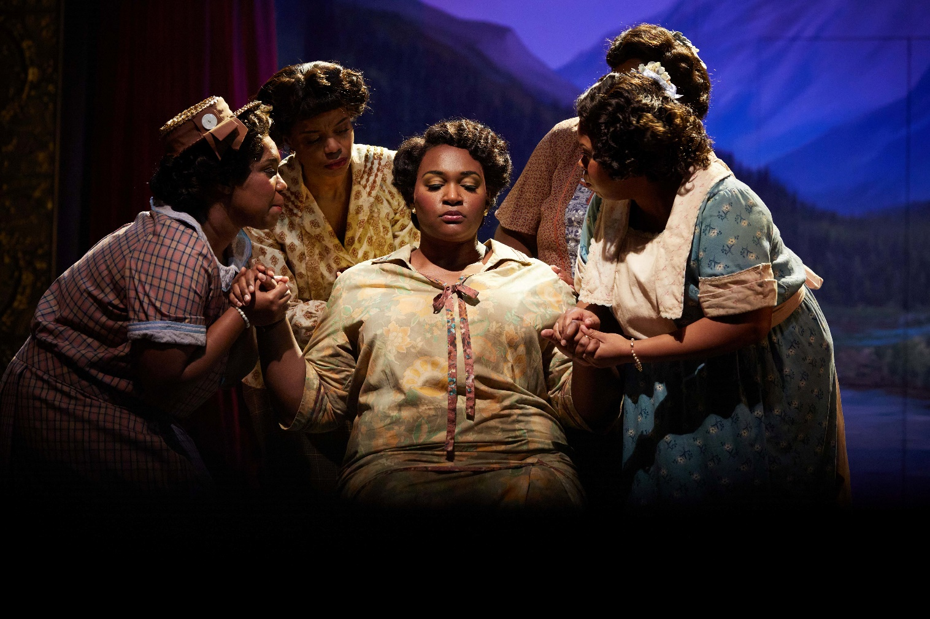
Key Scene #1: Act I, Scene 1: A man was on the tracks (Reverand Little is Dead)
The police arrive at the Little family home with news that Reverend Little, Malcolm’s father, was found dead on the train tracks. A family friend breaks the news to Louise Little.
X: The Life and Times of Malcolm X, Seattle Opera (photo: Philip Newton)
Notes:
https://ondemand.metopera.org/performance/detail/d15c1abe-32a4-598b-a775-8c419741e411

Slide 6
Key Scene #1 continued
Met Opera on Demand: Track #6. Act I: A man was on the tracks (Reverand Little is Dead)
00:00 – 02:43
Notes:
https://ondemand.metopera.org/performance/detail/d15c1abe-32a4-598b-a775-8c419741e411

Slide 7
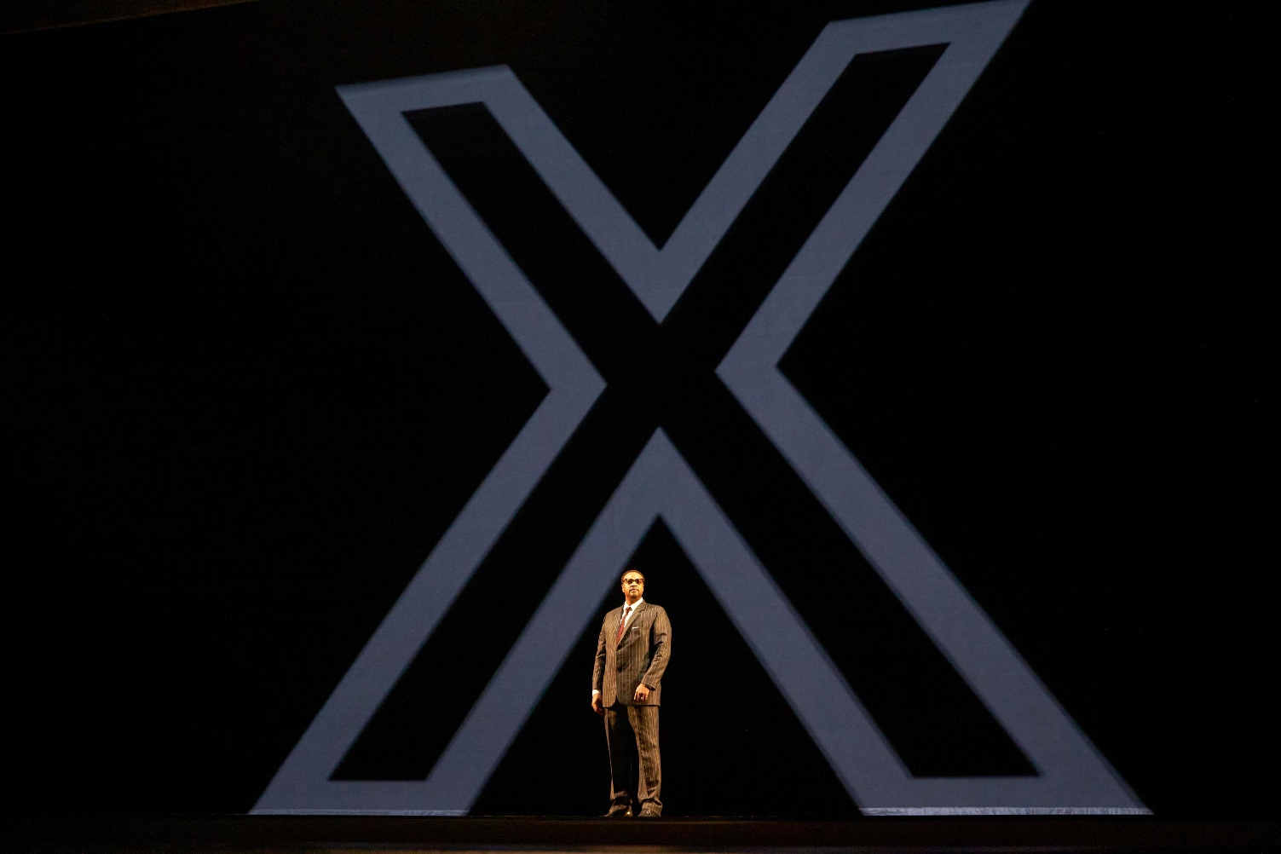
Key Scene #2: Act II, Scene 2: You are not empty
After studying the Koran and the teachings of the Nation of Islam during his time in prison, Malcolm leaves and meets with the leader of the Nation, Elijah Muhammed. Elijah tells Malcolm to denounce his last name inherited from a history of enslavement and replace it with an X. Thus, Malcolm X is born.
X: The Life and Times of Malcolm X, Seattle Opera (photo: Philip Newton)

Slide 8
Key Scene #2 continued
Met Opera on Demand: Track #16. ACT II: You are not empty
00:00 – 5:45
Notes:
https://ondemand.metopera.org/performance/detail/d15c1abe-32a4-598b-a775-8c419741e411

Slide 9
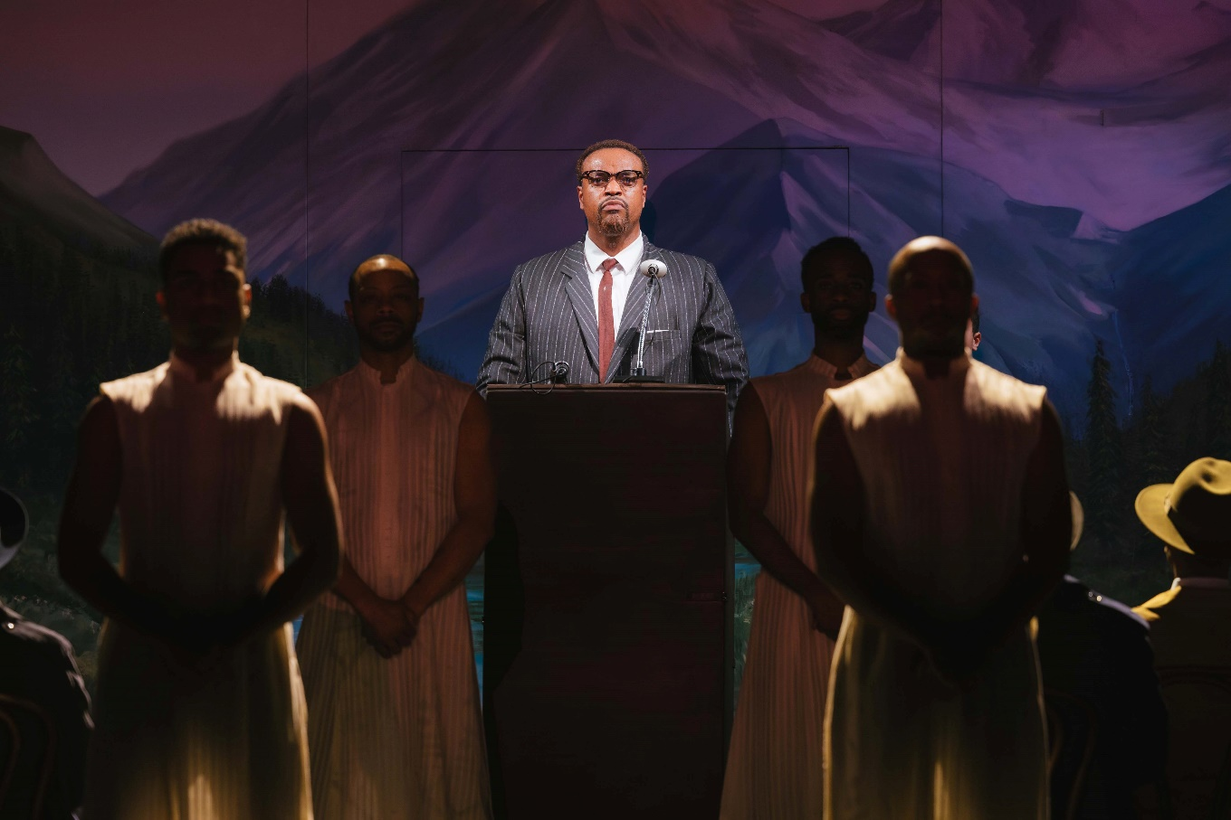
Key Scene #3: Act III, Scene 4: I have learned so much in Africa
Not long before his assassination, Malcolm X speaks to his newly founded Organization of Afro-American Unity. He shares what he learned in Africa—that their struggle connects to a larger, global fight against colonialism and racism. Though he’s warned of threats against his life, Malcolm stands firm, unaffected by the fear surrounding him.
Production photos courtesy of Seattle Opera
X: The Life and Times of Malcolm X, Seattle Opera (photo: Sunny Martini)

Slide 10
Key Scene #3 continued
Met Opera on Demand: Track #30. ACT III: I have learned so much in Africa
00:00 – 5:39
Notes:
https://ondemand.metopera.org/performance/detail/d15c1abe-32a4-598b-a775-8c419741e411

Slide 11
Production Design Definitions
Production Design: The process of creating the visual aesthetic and environment for a film, television show, commercial, or other forms of media. It involves creating sets, props, as well as costumes, projections, and other visual elements that help bring the story to life and immerse the audience in the narrative. The Production Designer is responsible for overseeing the creation of these elements, working closely with the director, producers, and other key creatives to ensure that the visual style of the production aligns with the overall vision and tone of the project.

Slide 12
Production Design Definitions
Stage/Set Design: The art and practice of creating the physical environment in a theatrical production, film, television show, or other visual medium. This includes scenic elements and design layout for sets, lighting, props, and furniture to bring the story or concept to life. It involves arranging these elements in a way that enhances the audience's visual and aesthetic experience. Stage design may also involve creating technical elements such as sound systems, special effects, and rigging to support the production. Stage designers work closely with other production team members to create a cohesive and visually appealing environment complementing the production's overall vision.

Slide 13
Production Design Definitions
Props: A term commonly used in live performance and film production to refer to objects or items used on stage or on set to enhance the performance or scene. Props can include anything from furniture, decorations, weapons, hand-held objects, and more. Props are used to add realism and detail to a production and help bring the world of the play or film to life for the audience.

Slide 14
Production Design Definitions
Lighting Design: Refers to the art and practice of creating and controlling the lighting for a performance. This includes designing the placement and intensity of the lights and using different colors and effects to enhance the performance's mood and atmosphere. Lighting designers play a crucial role in enhancing the storytelling and emotional impact of the production, helping to set the stage, highlight performers, create a sense of place and time, and evoke different emotions in the audience. It is an integral part of the overall visual and artistic design of the production.

Slide 15
Production Design Definitions
Projection Design: The art of creating and manipulating projected images and videos to enhance the visual elements of a live event, such as a concert, theater production, dance performance, or installation. It involves using specialized software and hardware to project images, videos, or other visual content onto a surface, such as a screen, wall, or even the audience itself.

Slide 16
Production Design Definitions
Costume Design: The process of creating costumes and outfits for characters in theatre, film, television, or other visual media. It involves researching the time-period, setting, and character traits to develop pieces that help bring the character to life. Costume designers work closely with directors, actors, and other production team members to ensure that the costumes accurately reflect the vision of the production. This can involve sourcing or creating garments, accessories, and props, as well as coordinating fittings and alterations. Costume design plays a crucial role in storytelling and character development, helping to enhance the overall visual and emotional impact of a production.

Slide 17
Production Design Definitions
Hair and Makeup Design: Refers to the planning and execution of hairstyles and makeup looks for performers and actors. This creative process involves analyzing the characters or themes in the performance, researching historical or cultural references, and designing hair and makeup that enhances the overall aesthetic and storytelling of the production. Hair and makeup designers work closely with directors, costume designers, and performers to create a cohesive and visually impactful presentation on stage or screen.

Slide 18
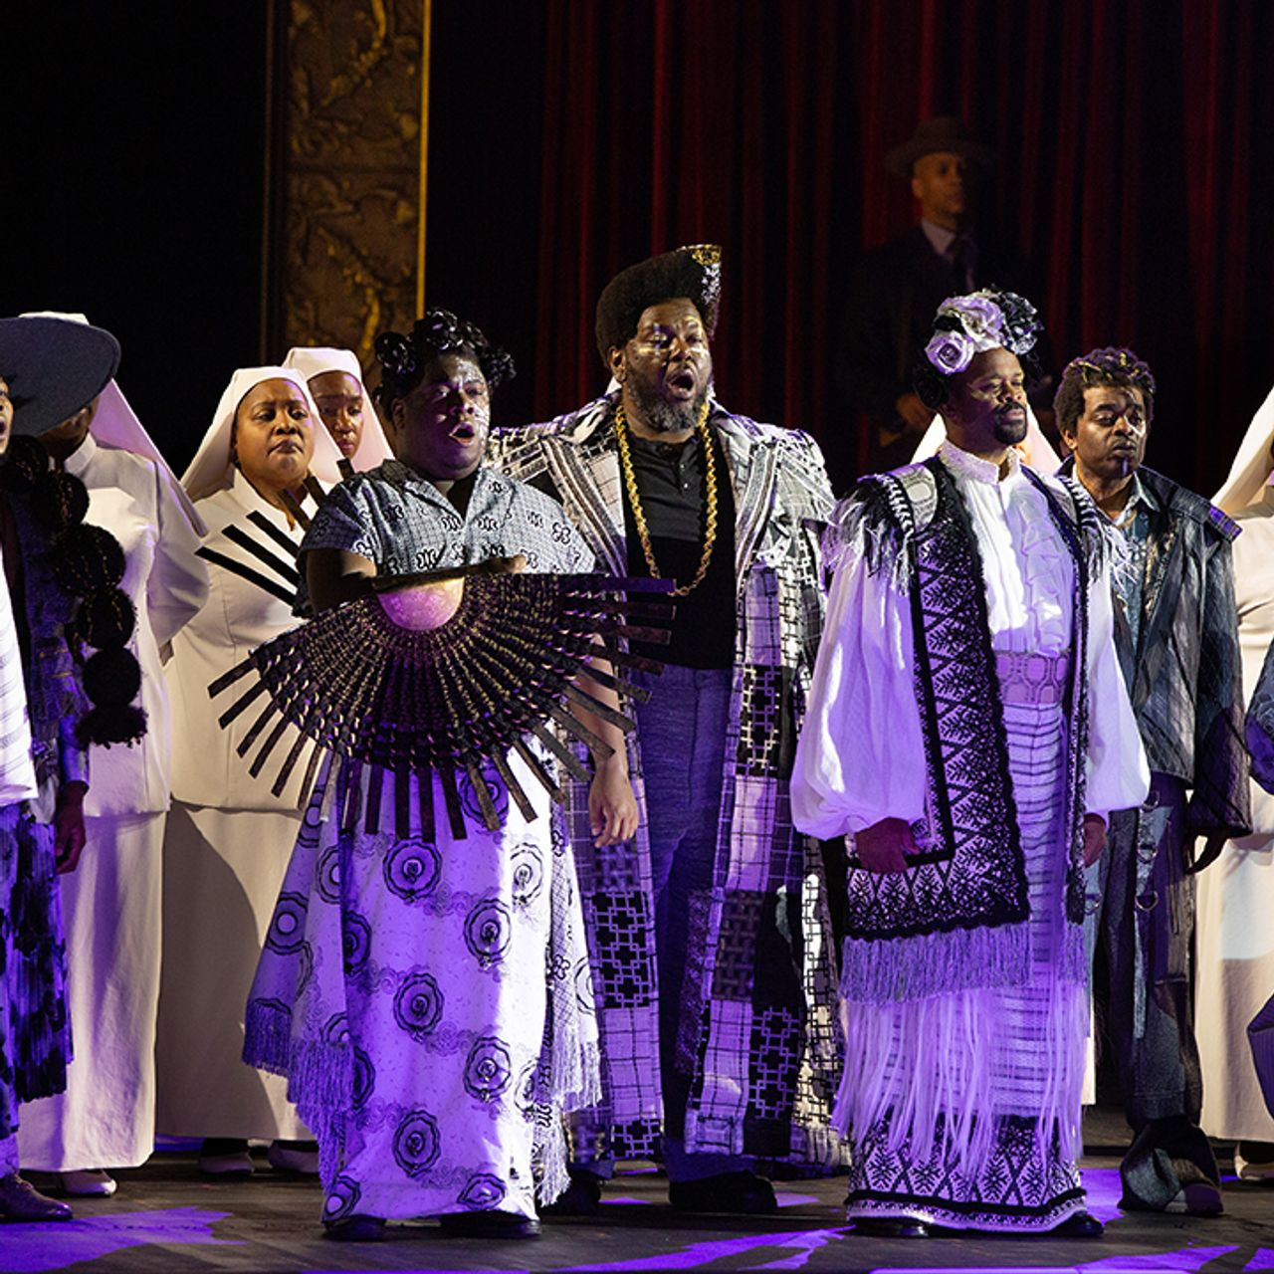
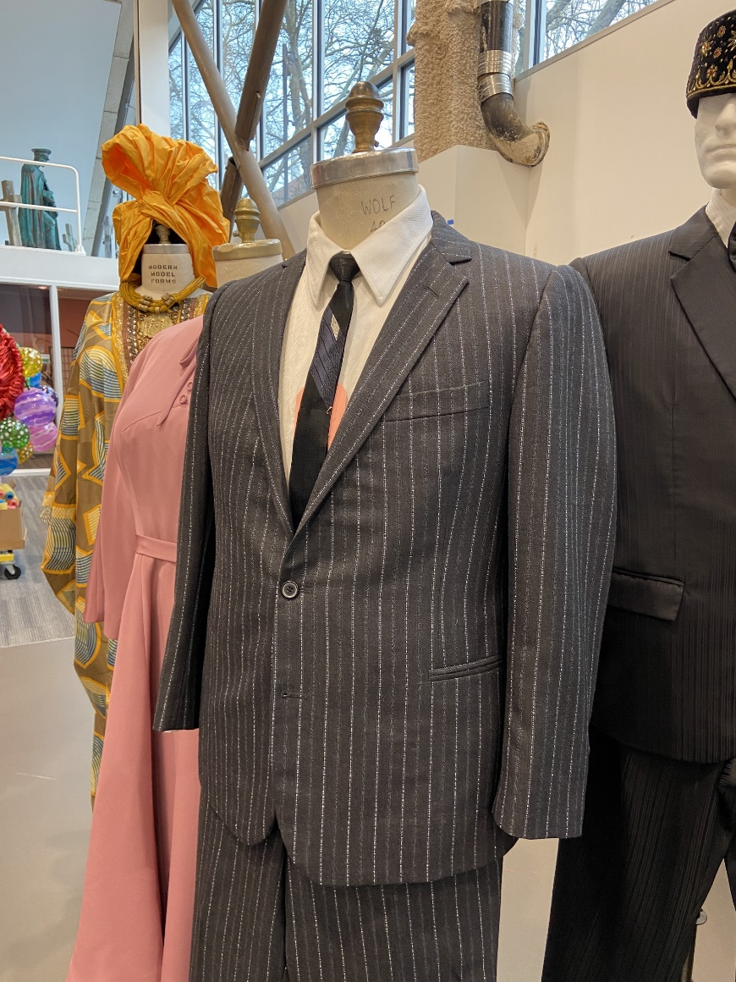
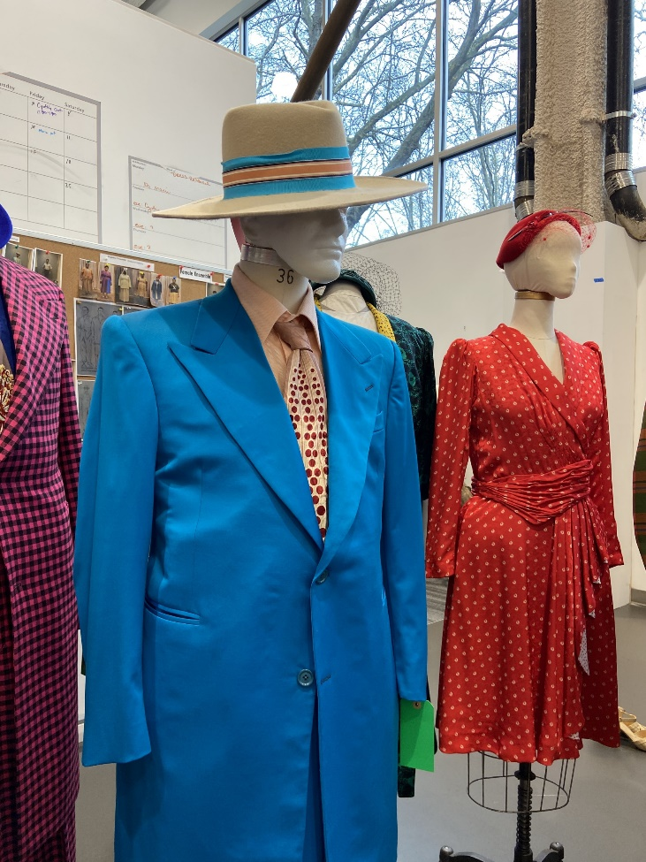
Costume Design
X: The Life and Times of Malcolm X, The Metropolitan Opera (photo: Mary Sohl)
X:, Seattle Opera (photo: courtesy of Seattle Opera)
X:, Seattle Opera (photo: courtesy of Seattle Opera)

Slide 19
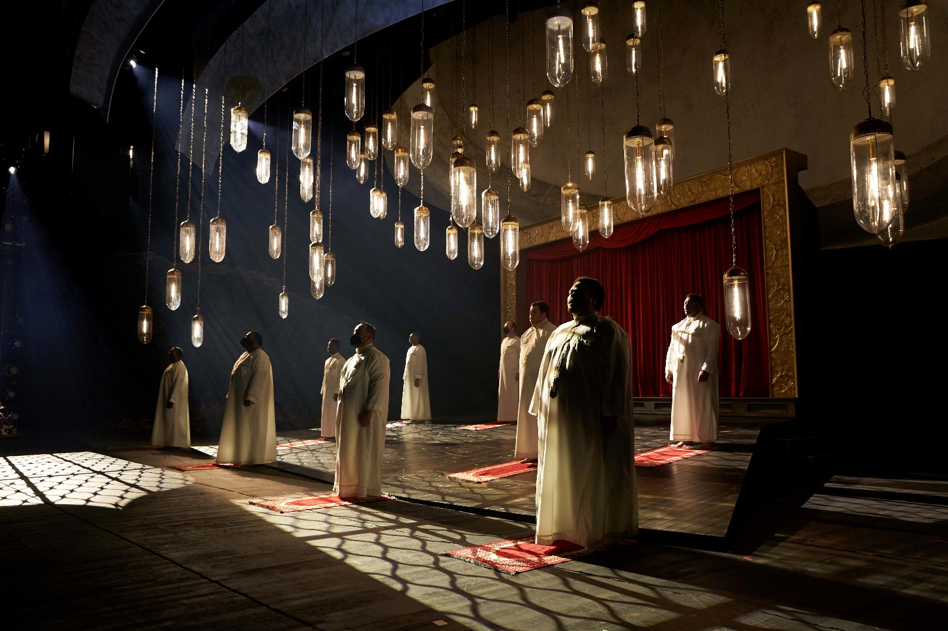
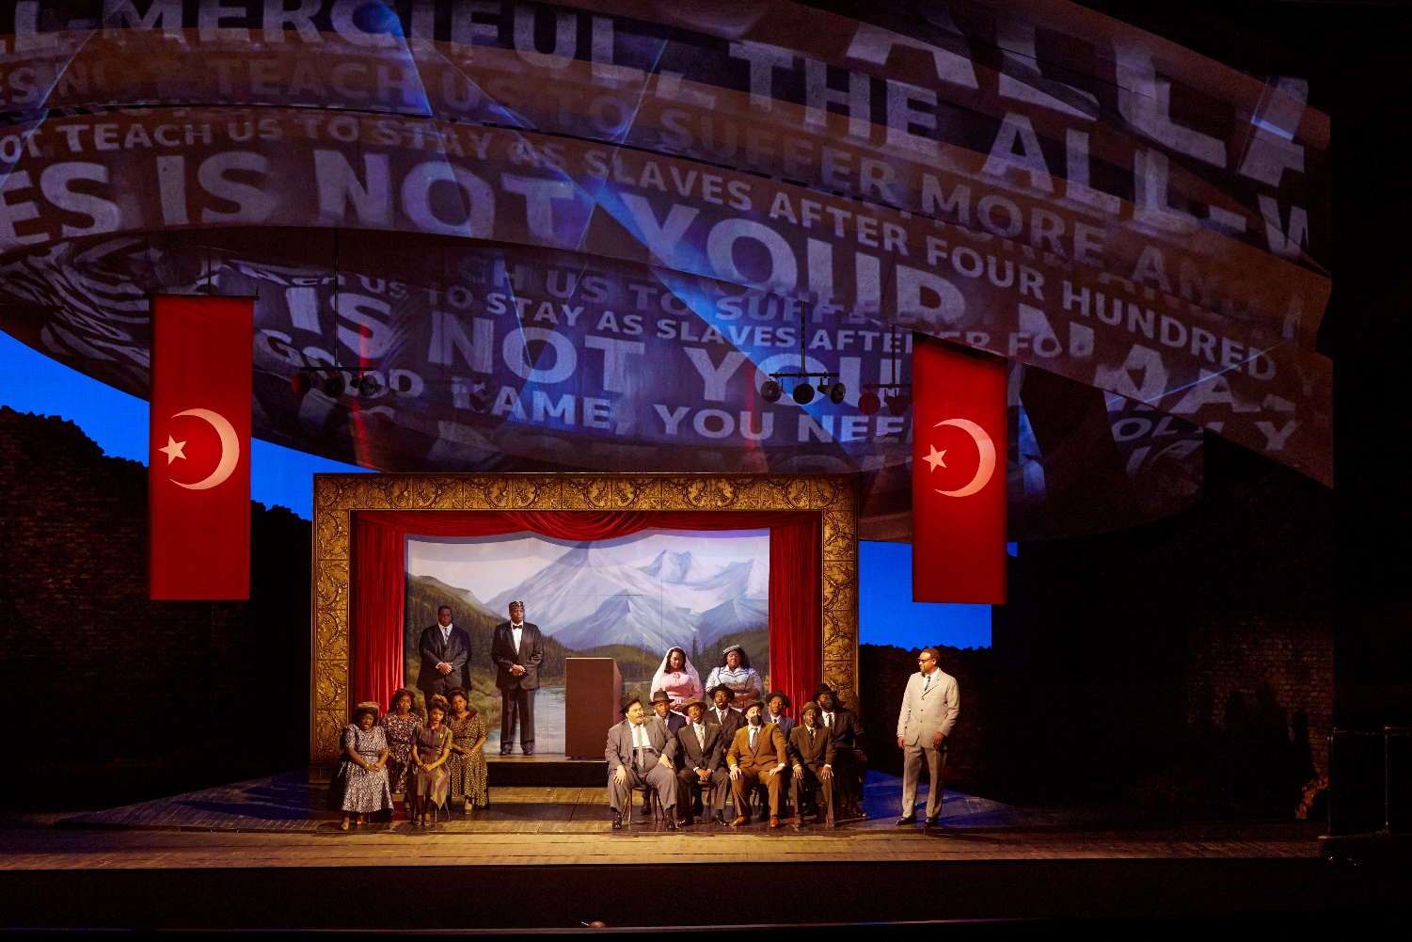
Set Design
X: The Life and Times of Malcolm X, Seattle Opera (photo: Philip Newton)
Costumes featured in Metropolitan Opera production
X: The Life and Times of Malcolm X, Seattle Opera (photo: Philip Newton)
Production photos courtesy of Seattle Opera
Production photos courtesy of Seattle Opera

Slide 20
Elements of Design
Color
Line
Shape
Texture
Form
Space
Value
Pattern

Slide 21
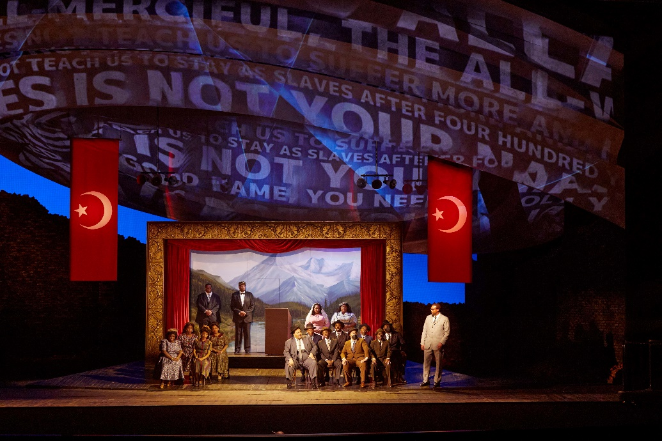
Elements of Design
Line/Space/Value: The many hanging lightbulbs in this scene use lightness and darkness to evoke mood, and create line and space.
Afrofuturism
Texture and Pattern: intricate patterns, circular and linear motifs, checkerboard patterns, and embroidered designs provide visual complexity and reference African textiles..
X: The Life and Times of Malcolm X, Seattle Opera (photo: Philip Newton)
Shape/Form/Color: The giant spaceship structure above the stage used often for projections, calling for liberation from suffering and oppression, resonate with themes of resilience and freedom. The messages appear ethereal, floating over the cast, as if carrying the wisdom of ancestors or future voices. Striking red flags against the otherwise neutral, earthy tones of the set create a powerful visual focal point.
X: The Life and Times of Malcolm X, The Metropolitan Opera (photo: Mary Sohl)
X: The Life and Times of Malcolm X, Seattle Opera (photo: Philip Newton)

Slide 22
Production Design Guidelines
Consider all that was discussed when designing your production: color, mood, textures, spaces/places, etc.
Production design should include:
Set and costume designs based on your opera adaptation pitch
At least 3 elements of design in your work

Slide 23
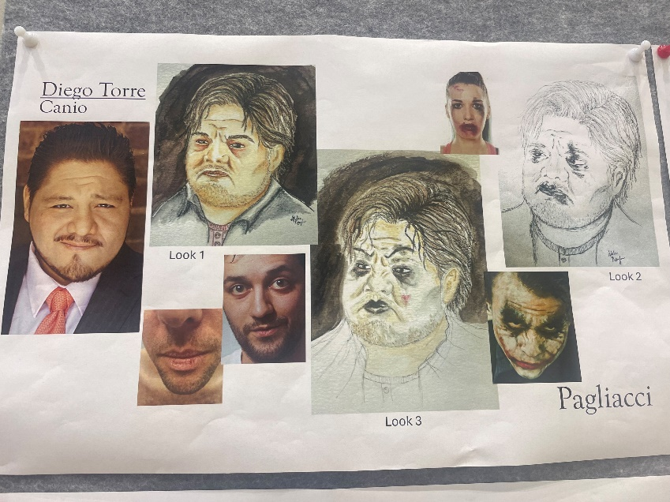
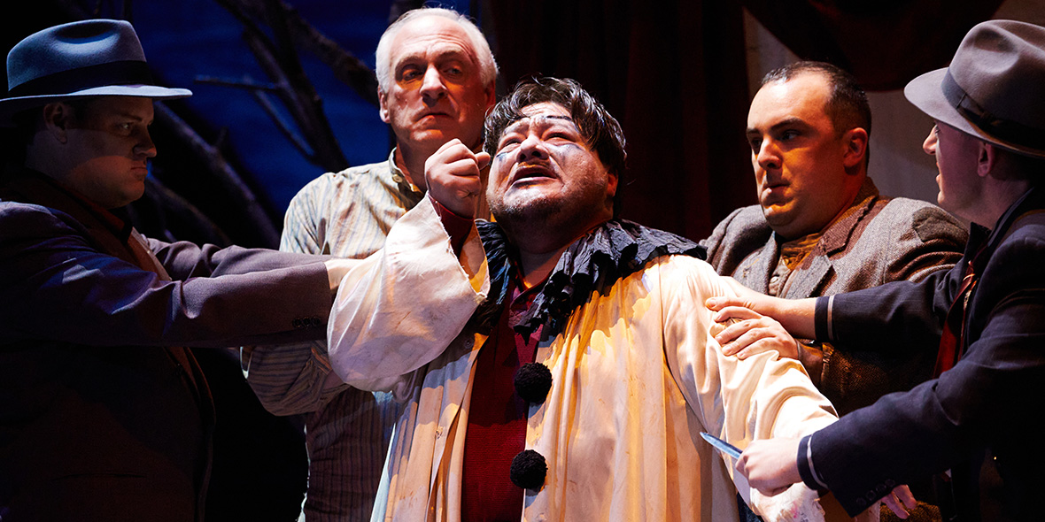
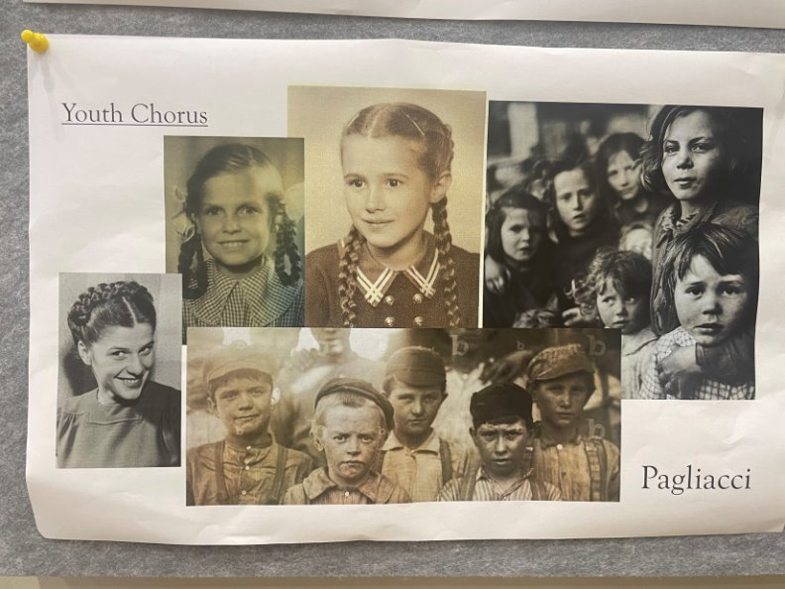
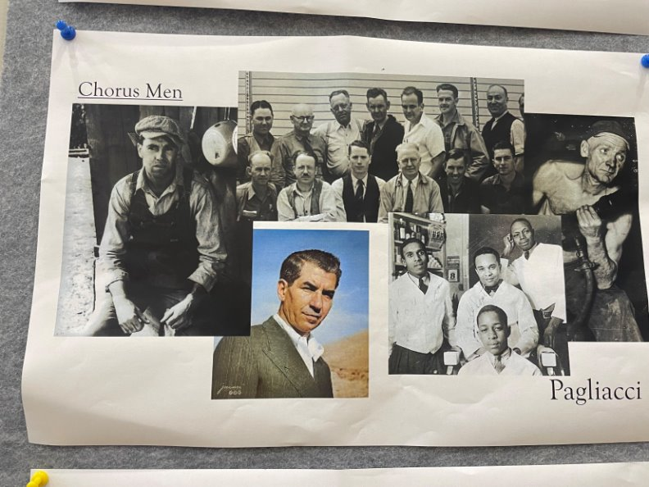
Production Design Examples
Costume design vision boards and production photography from Seattle Opera’s 2024 production of Pagliacci. Makeup for Pagliacci inspired by the Joker. Costumes in this production reflect a simple, everyday style suited to a small-town community, feature subtle details like aprons, shawls, hats and scarves, suggesting a range of ages and personalities within the group. Costume design by Cynthia Savage.
Pagliacci, Seattle Opera (photo: courtesy of Seattle Opera)
Pagliacci, Seattle Opera (photo: Philip Newton)
Pagliacci, Seattle Opera (photo: courtesy of Seattle Opera)
Pagliacci, Seattle Opera (photo: courtesy of Seattle Opera)

Slide 24
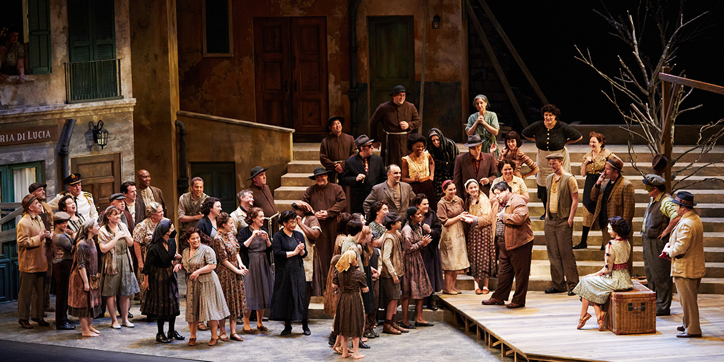
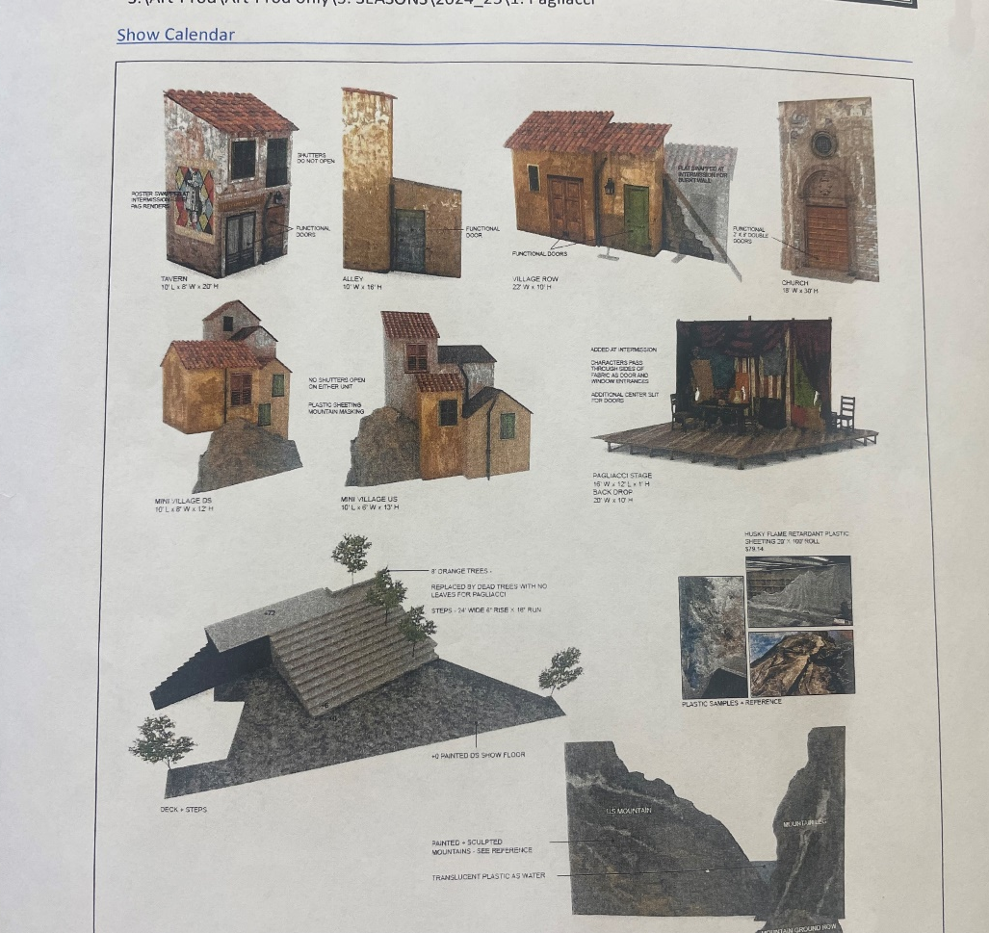
Production Design Examples
Pagliacci, Seattle Opera (photo: Philip Newton)
Set design uses detailed building facades, weathered textures, and signs with muted and earthy, with shades of brown, beige, and faded green to evoke authentic life in an Italian village in the 1940s. Multiple levels and steps create depth, and allow actors to be positioned at different heights, adding visual interest and focusing attention on key characters. An open central area serves as a gathering space, emphasizing community interaction. A bare tree adds a sense of time and emotional contrast, enhancing the scene's atmosphere. Set design by Steven C. Kemp.
Pagliacci, Seattle Opera (photo: courtesy of Seattle Opera)
BONUS: Watch the production design process for the hit Broadway musical, Wicked
Notes:
https://www.youtube.com/watch?v=ytFSehs2Rxw

Slide 25
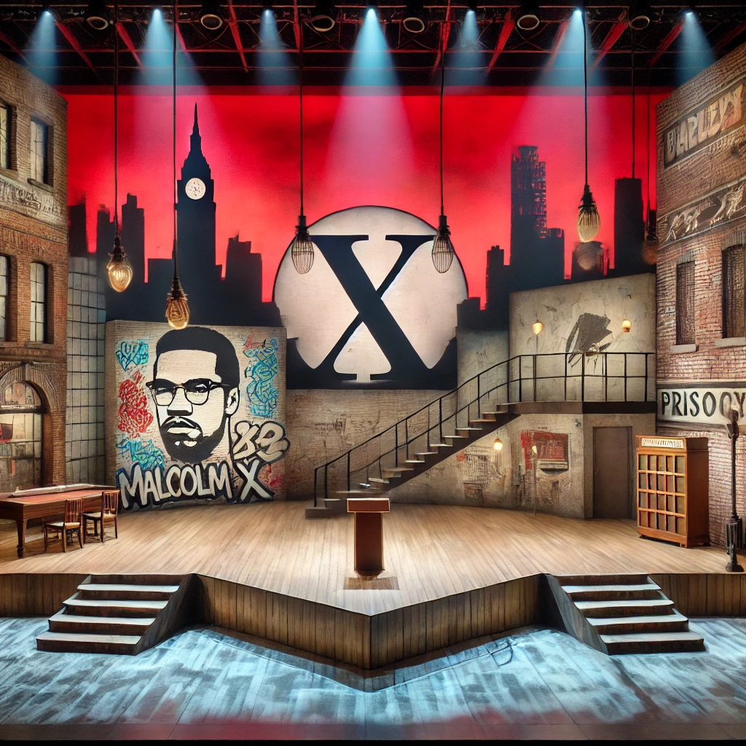
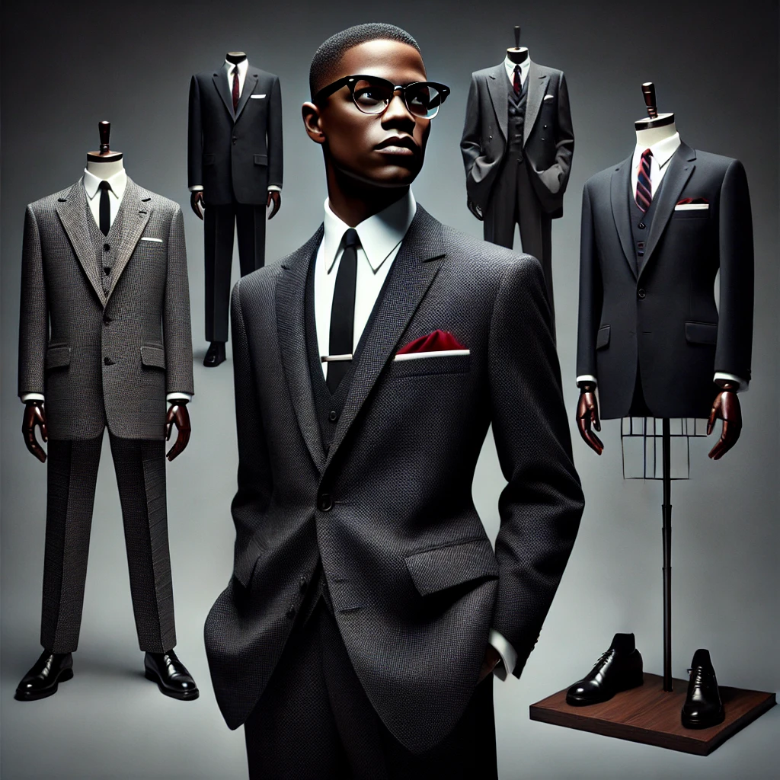
Production Design Examples
Set design mixes realistic and symbolic elements to reflect Malcolm X’s world, both the urban environment he navigated and the transformative moments that defined his life. Red lighting captures the passion of his activism, while blue adds depth for introspective moments. A spotlighted podium at center stage represents his powerful voice and influence.
Costume design inspired by Malcolm X’s iconic look, capturing the dignity and power of his character.
Images generated using AI

Slide 26
Production Design Questionnaire
What are the reasons behind your choices? Are your choices based on the music, story, or libretto, and/or a combination of these?
How are you visually representing the time and location?
How are you visually communicating mood and emotion?

Slide 27
Present

Slide 28
Reflection
Share thoughts on the production design process.
How has your experience with adapting a story visually change your perspective on storytelling or your approach to developing ideas?

