Slide 1
Exploring Story Adaptation
Enriching the Humanities Through Opera
Made possible by the generous support from the

Slide 2
What is story adaptation and how is it relevant to opera?
Today’s Objectives:
Analyze an opera synopsis based on a literary work.
Compare a literary work with the opera adaptation synopsis.
Identify elements of adaptation across multiple versions of the same key scene present in the literary source and opera.
Collaboratively brainstorm a pitch for an opera adaptation of the literary work.

Slide 3
Write down the first word that comes to mind.
Opera
One Hundred Years of Solitude
Adaptation

Slide 4
Write down the first word that comes to mind.
Opera
Love in the Time of Cholera
Adaptation

Slide 5
Story Arc Review
Climax
Falling Action
Rising Action
Resolution
Exposition

Slide 6
Florencia en el Amazonas Synopsis
The story follows the legendary diva, Florencia Grimaldi, and her fellow passengers on a boat ride down the Amazon. As they travel through the enchanting rainforest toward their destination—the opera house in Manaus, Brazil—each passenger holds a secret hope for what the journey will bring.

Slide 7
Talk & Turn
Compare the story structure of Love in the Time of Cholera and Florencia en el Amazonas.
Is the setting/time period the same for both the opera and literary work?
Is there a difference in point of view? In historical context? In narrative structure?
What else did you notice?

Slide 8
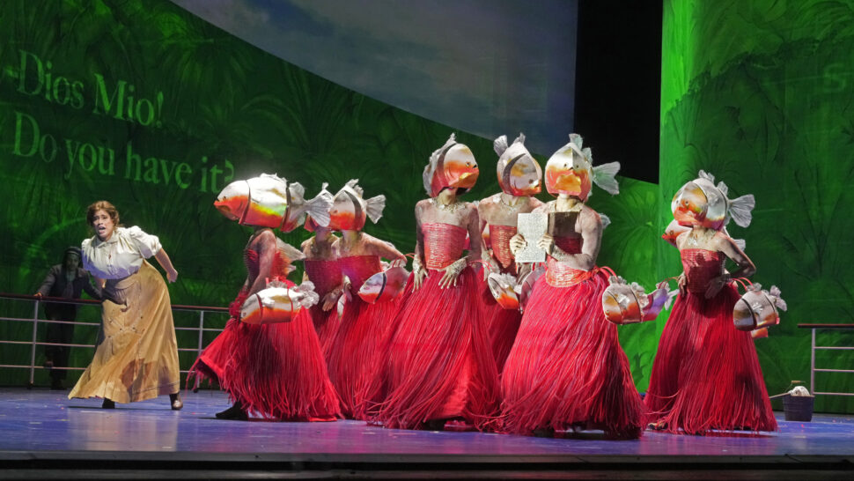
Key Scene #1: Act I, Scene 4: Londres, Tahiti, Sierra Nevada
In this moment Rosalba’s notebook falls into the Amazon. Arcadio warns her not to reach in to grab it due to the piranhas. Will she get it back or will all her work be lost?
Florencia en el Amazonas, Metropolitan Opera (photo: Ken Howard)

Slide 9
Key Scene #1 continued
Met Opera on Demand: Track #7. ACT I: Londres, Tahití, Sierra Nevada
00:28 – 01:23
Notes:
https://ondemand.metopera.org/performance/detail/3762467a-3bab-52d1-8033-e0e16ff1434f

Slide 10
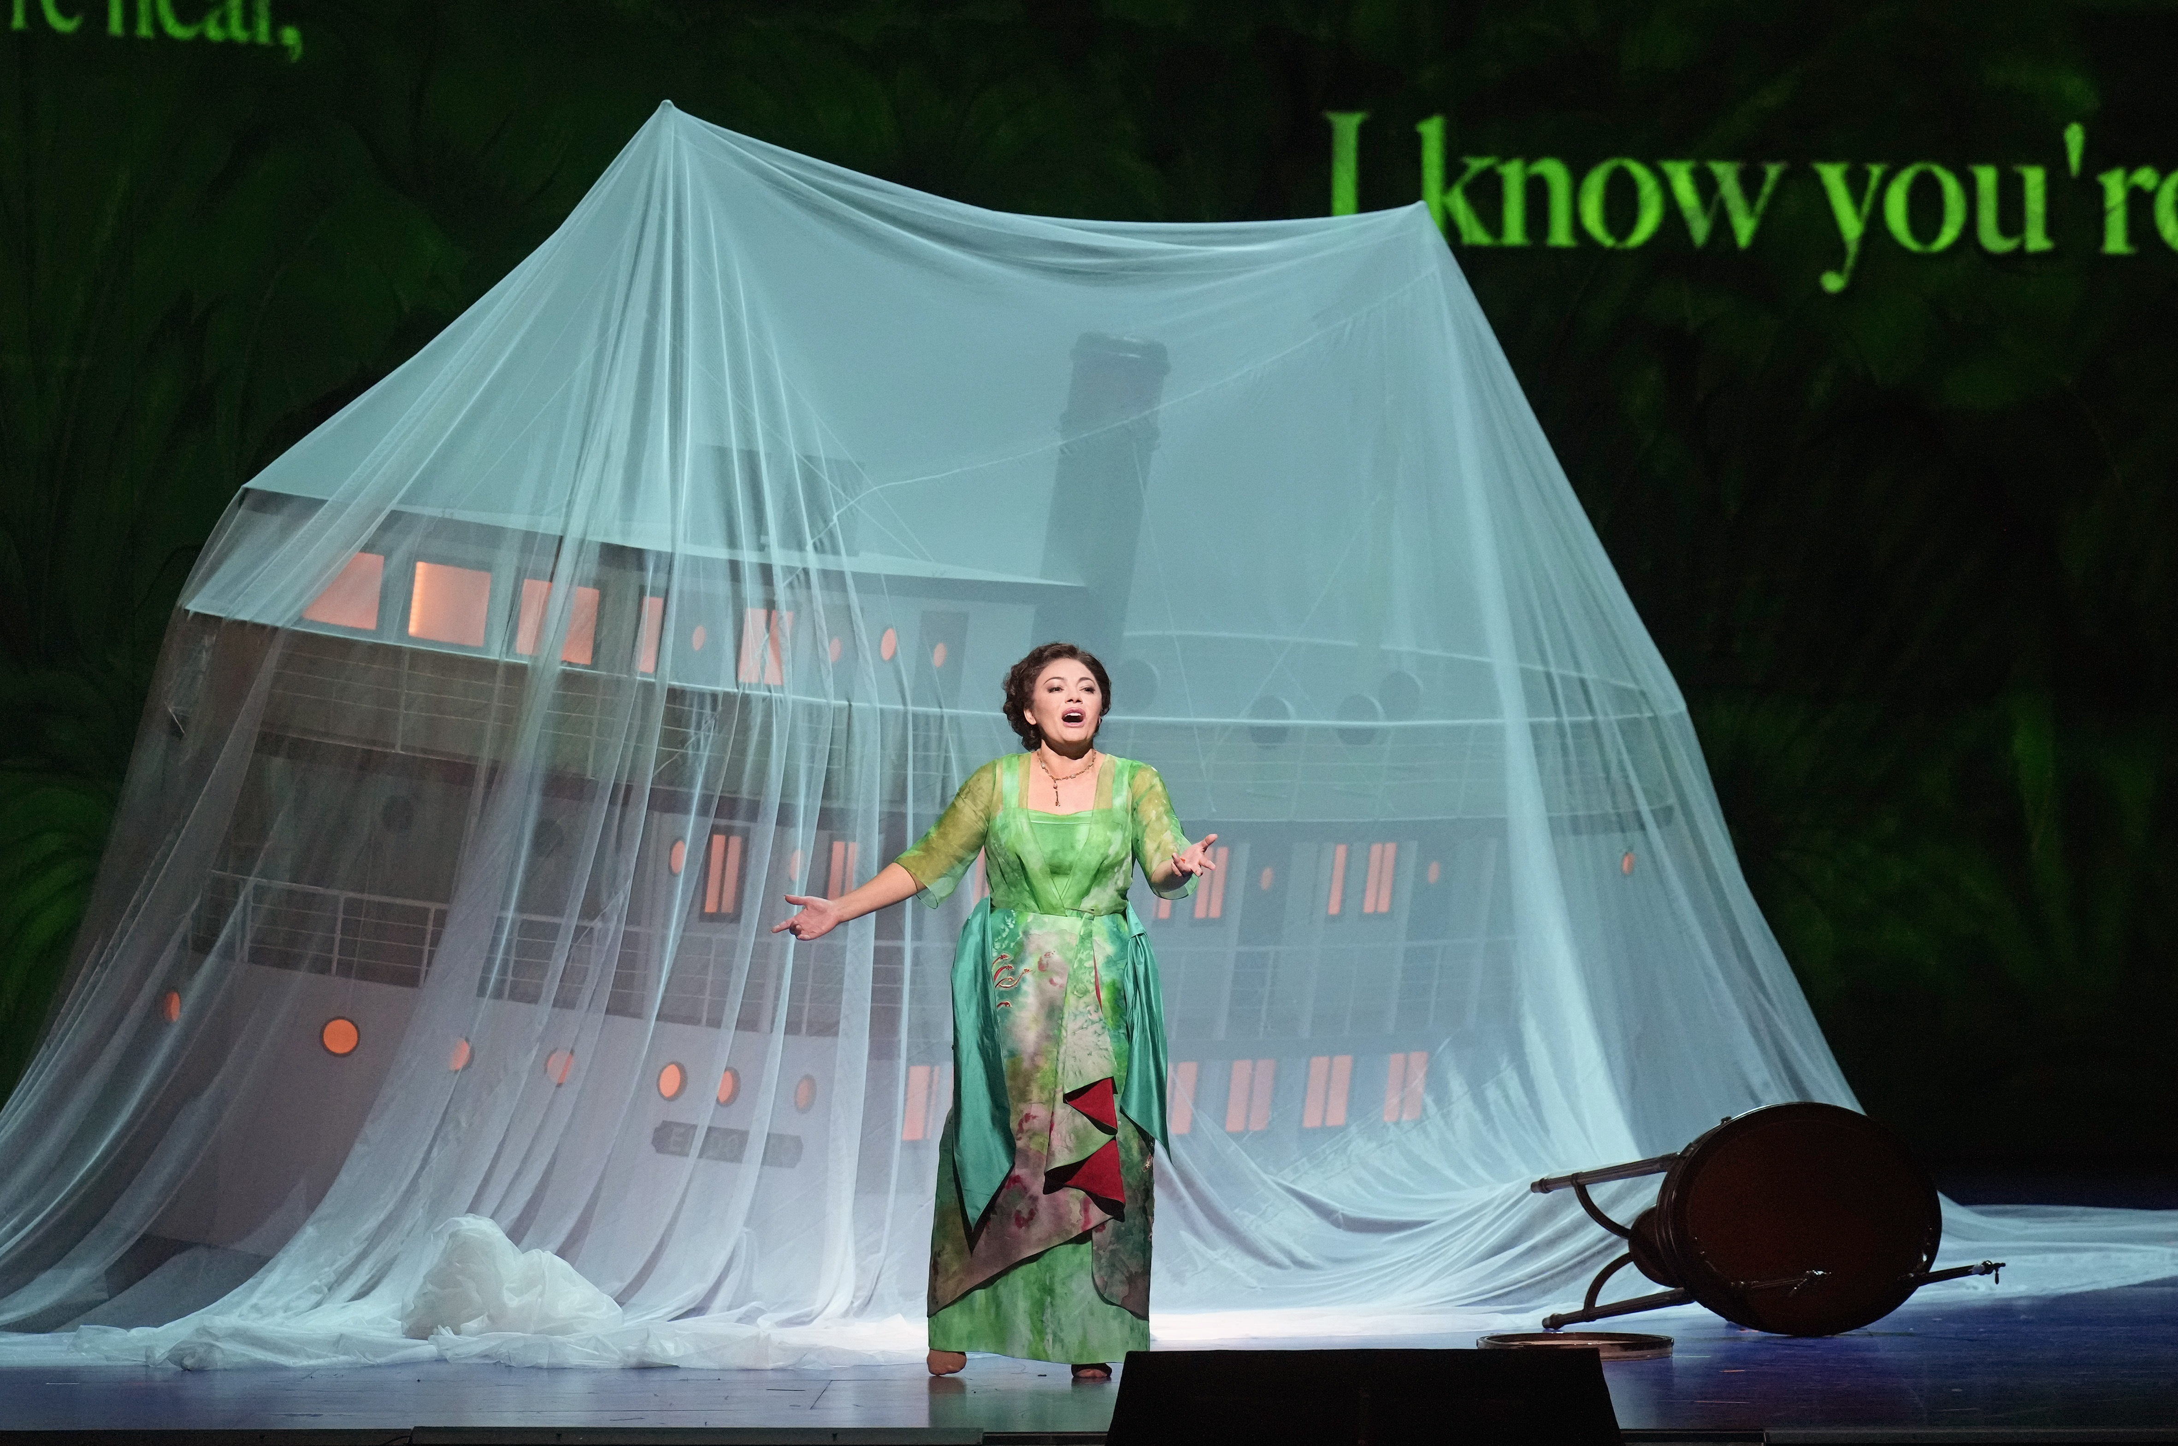
Key Scene #2: Act II, Scene 11: Cristóbal, Cristóbal
A storm has caused the El Dorado to crash. This scene features the aria, “Eschúchame.” Following the storm Florencia wonders if she is dead or alive, can Cristóbal hear her? Is he alive?
Florencia en el Amazonas, Metropolitan Opera (photo: Ken Howard)

Slide 11
Key Scene #2 continued
Met Opera on Demand: Track #15. ACT II: Cristóbal, Cristóbal
03:56 – 05:32
Notes:
https://ondemand.metopera.org/performance/detail/3762467a-3bab-52d1-8033-e0e16ff1434f

Slide 12
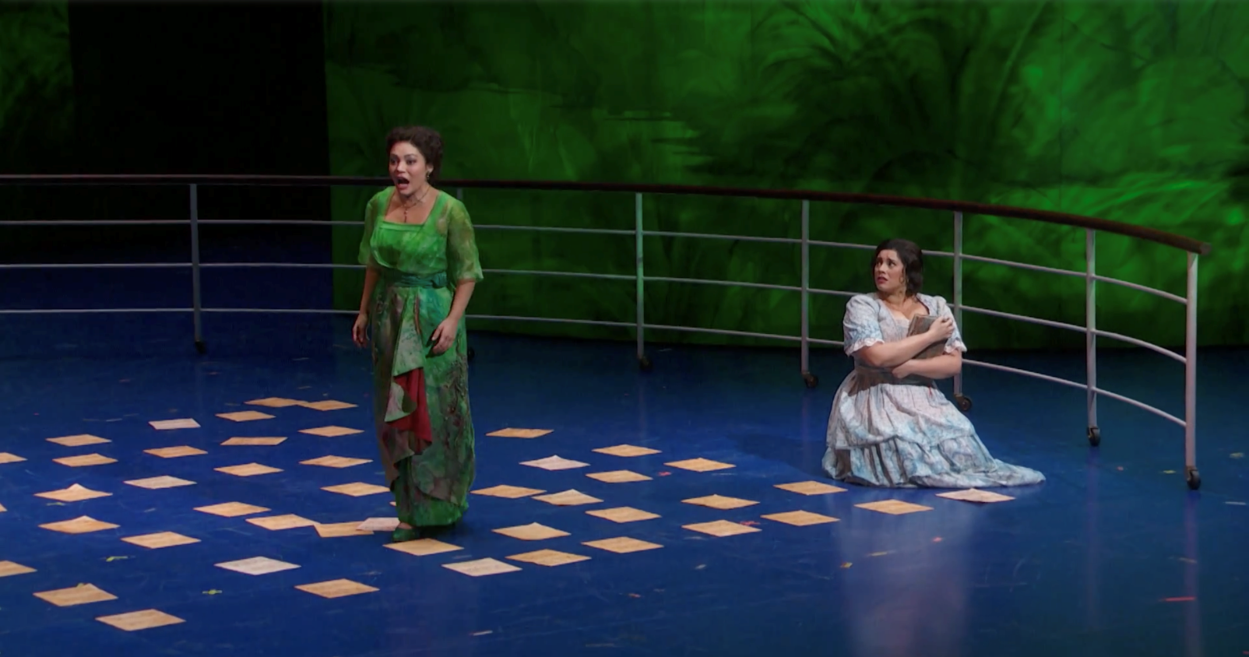
Key Scene #3: Act II, Scene 16: ¡Ya! ¡Quite esa cara! (Now! Take that face off)
Rosalba has given up on love and yet the incognito Florencia explains that it was love that gave La Grimaldi her musical gifts. Has Florencia revealed herself to Rosalba? Will Rosalba realize she is speaking with heroine? Will Rosalba embrace her love for Arcadio?
Florencia en el Amazonas, Metropolitan Opera (photo: Ken Howard)

Slide 13
Key Scene #3 continued
Met Opera on Demand: Track #21. ACT II: ¡Ya! ¡Quite esa cara!
03:01 – 4:54
Notes:
https://ondemand.metopera.org/performance/detail/3762467a-3bab-52d1-8033-e0e16ff1434f

Slide 14
Why do we adapt stories?

Slide 15
Adaptation Guidelines
Adapting the Who, What, When, and Where.
Who: character/character identity
Note: character identity can be adapted, but characters may not be eliminated or added.
What: key scene, action in the story - what is happening?
When: time period, time of day, year, etc.
Where: location and setting

Slide 16
Adaptation Pitch
Who (characters in the scene):
What (scene action):
When (time period, time of year/day):
Where (location/setting):
Why did you choose to adapt the opera this way?
How will these changes affect the rest of the story?

Slide 17
Present

Slide 18
Reflection
Share thoughts on the story adaptation pitch process.
How did your understanding of the story change as you adapted it?
Were there any new insights or perspectives that emerged?

