Slide 1
Production Design Adaptation
Enriching the Humanities Through Opera
Made possible by the generous support from the

Slide 2
How does production and visual design aid in storytelling?
Today’s Objectives:
Respond to the musical and storytelling elements of opera to develop criteria for visual artistic choices.
Refine an adaptation pitch to demonstrate critical understanding of the visual elements of production design and opera to tell a story.
Create visual representations of set and costume designs based on opera adaptation pitches.

Slide 3
Listening Activity
As you listen to the music, write down any colors, mood, spaces/places, textures, foods, etc. you can associate with the music.
Track #45
00:00 – 01:36
Notes:
https://ondemand.metopera.org/performance/detail/a8ba44f0-b86e-539e-8ef6-8006e70d9eab

Slide 4
Champion Synopsis
The powerful and deeply personal story of Emile Griffith, a six-time world champion boxer, whose life was shaped by triumph and tragedy. Griffith rose from a hat factory worker to a boxing legend, culminating in his infamous 1962 fight with Benny "Kid" Paret, which resulted in Paret’s death. Haunted by this event and grappling with his identity, Griffith seeks forgiveness and reconciliation in his later years.

Slide 5
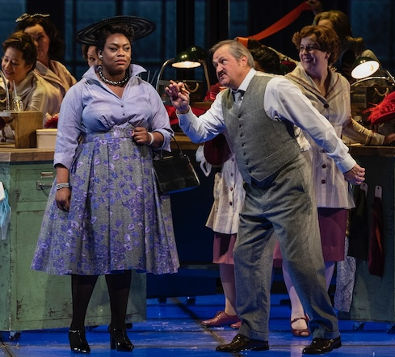
Key Scene #1: Act I, Scene 8: Hey, Mr. Albert
Emile relocates to New York from the U.S. Virgin Islands in search of his mother, Emelda. When he finally finds her. Determined to help Emile find work, she introduces him to Howie Albert, a hat manufacturer. Howie quickly notices Emile’s athletic build and, seeing potential, decides to train him as a boxer.
Champion, Lyric Opera of Chicago (photo: Michael Brosilow)

Slide 6
Key Scene #1 continued
Met Opera on Demand: Track #12. ACT I: Hey Mr. Albert
00:00 – 3:43
Notes:
https://ondemand.metopera.org/performance/detail/a8ba44f0-b86e-539e-8ef6-8006e70d9eab

Slide 7
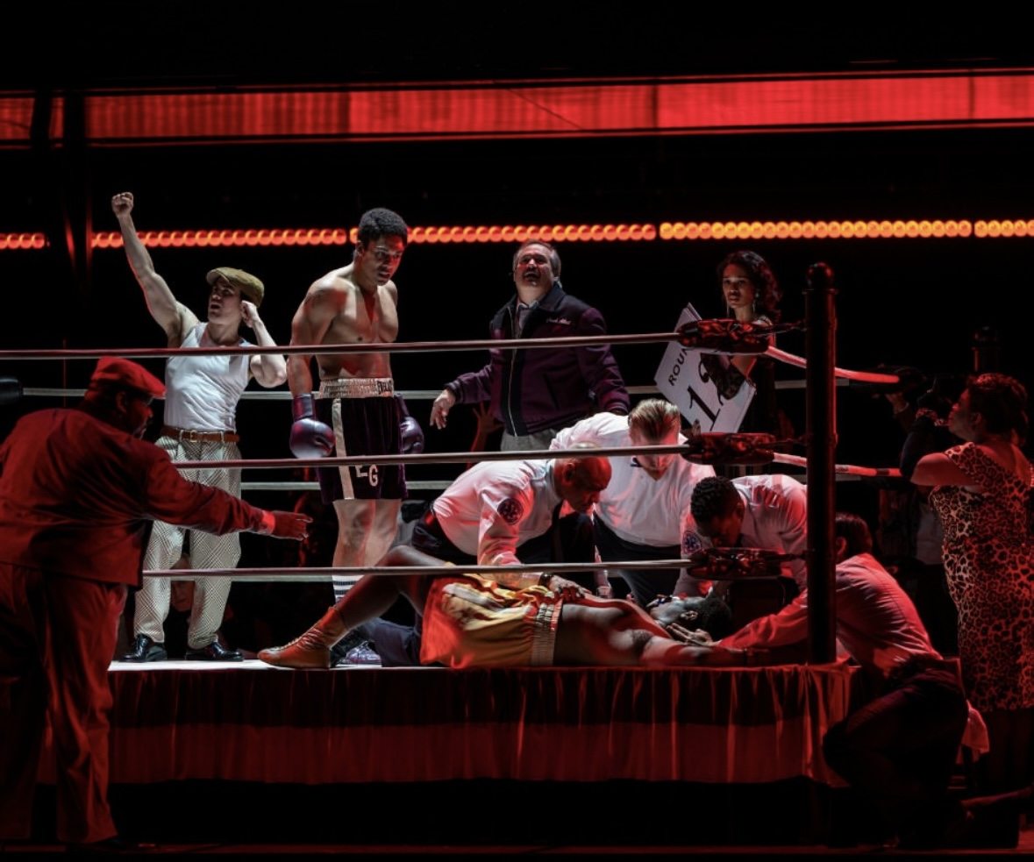
Key Scene #2: Act I, Scene 22-23: Don’t listen, Emile. Don’t think–In my head it happens fast
During the weigh-in, Benny “Kid” Paret taunts Emile about his sexual orientation, provoking tension between the two fighters. Once in the ring, Paret continues to antagonize Emile. In a burst of fury, further encouraged by Howie’s coaching, Emile delivers seventeen blows in less than seven seconds, knocking Paret into a coma.
Champion, Lyric Opera of Chicago (photo: Michael Brosilow)

Slide 8
Key Scene #2 continued
Met Opera on Demand: Track #27. ACT I: Don't listen, Emile. Don't think—In my head it happens fast
04:56 – 07:03
Notes:
https://ondemand.metopera.org/performance/detail/a8ba44f0-b86e-539e-8ef6-8006e70d9eab

Slide 9
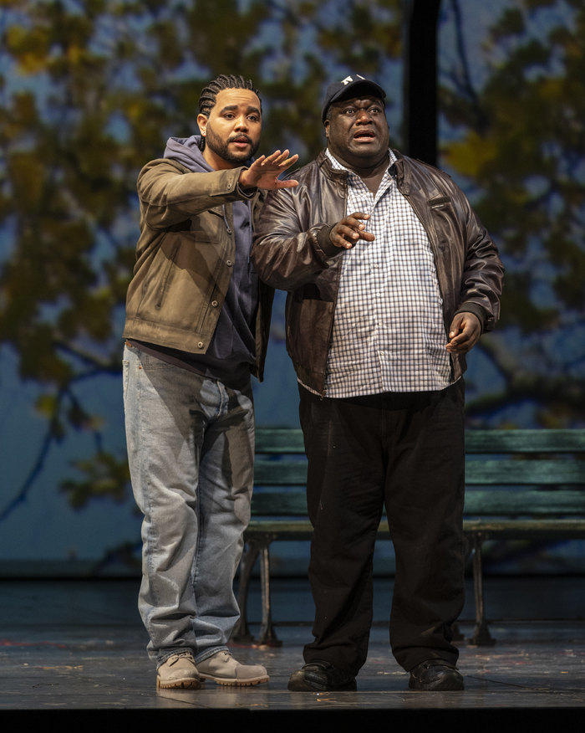
Key Scene #3: Act II, Scene 20: What is it you want from me? (I’m sorry)
Emile, suffering from brain trauma from his boxing career and haunted by his past, faces Benny Paret Jr. seeking forgiveness for the fatal fight that took the now young man’s father.
Champion, Lyric Opera of Chicago (photo: Michael Brosilow)

Slide 10
Key Scene #3 continued
Met Opera on Demand: Track #47. ACT II: What is it you want from me?
00:00 – 03:02
Notes:
https://ondemand.metopera.org/performance/detail/a8ba44f0-b86e-539e-8ef6-8006e70d9eab

Slide 11
Production Design Definitions
Production Design: The process of creating the visual aesthetic and environment for a film, television show, commercial, or other forms of media. It involves creating sets, props, as well as costumes, projections, and other visual elements that help bring the story to life and immerse the audience in the narrative. The Production Designer is responsible for overseeing the creation of these elements, working closely with the director, producers, and other key creatives to ensure that the visual style of the production aligns with the overall vision and tone of the project.

Slide 12
Production Design Definitions
Stage/Set Design: The art and practice of creating the physical environment in a theatrical production, film, television show, or other visual medium. This includes scenic elements and design layout for sets, lighting, props, and furniture to bring the story or concept to life. It involves arranging these elements in a way that enhances the audience's visual and aesthetic experience. Stage design may also involve creating technical elements such as sound systems, special effects, and rigging to support the production. Stage designers work closely with other production team members to create a cohesive and visually appealing environment complementing the production's overall vision.

Slide 13
Production Design Definitions
Props: A term commonly used in live performance and film production to refer to objects or items used on stage or on set to enhance the performance or scene. Props can include anything from furniture, decorations, weapons, hand-held objects, and more. Props are used to add realism and detail to a production and help bring the world of the play or film to life for the audience.

Slide 14
Production Design Definitions
Lighting Design: Refers to the art and practice of creating and controlling the lighting for a performance. This includes designing the placement and intensity of the lights and using different colors and effects to enhance the performance's mood and atmosphere. Lighting designers play a crucial role in enhancing the storytelling and emotional impact of the production, helping to set the stage, highlight performers, create a sense of place and time, and evoke different emotions in the audience. It is an integral part of the overall visual and artistic design of the production.

Slide 15
Production Design Definitions
Projection Design: The art of creating and manipulating projected images and videos to enhance the visual elements of a live event, such as a concert, theater production, dance performance, or installation. It involves using specialized software and hardware to project images, videos, or other visual content onto a surface, such as a screen, wall, or even the audience itself.

Slide 16
Production Design Definitions
Costume Design: The process of creating costumes and outfits for characters in theatre, film, television, or other visual media. It involves researching the time-period, setting, and character traits to develop pieces that help bring the character to life. Costume designers work closely with directors, actors, and other production team members to ensure that the costumes accurately reflect the vision of the production. This can involve sourcing or creating garments, accessories, and props, as well as coordinating fittings and alterations. Costume design plays a crucial role in storytelling and character development, helping to enhance the overall visual and emotional impact of a production.

Slide 17
Production Design Definitions
Hair and Makeup Design: Refers to the planning and execution of hairstyles and makeup looks for performers and actors. This creative process involves analyzing the characters or themes in the performance, researching historical or cultural references, and designing hair and makeup that enhances the overall aesthetic and storytelling of the production. Hair and makeup designers work closely with directors, costume designers, and performers to create a cohesive and visually impactful presentation on stage or screen.

Slide 18
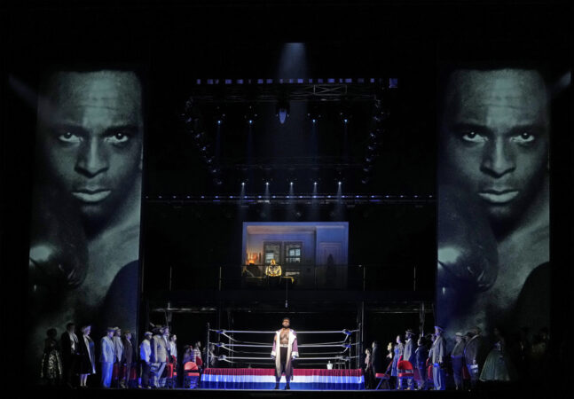
Production Design
Champion, Opera Parallèle (photo: courtesy of Opera Parallèlel)
Champion, Metropolitan Opera (photo: Ken Howard)

Slide 19
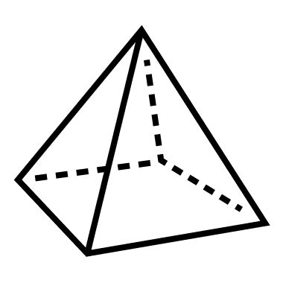
Elements of Design
Color
Line
Shape
Texture
Form
Space
Value
Pattern

Slide 20
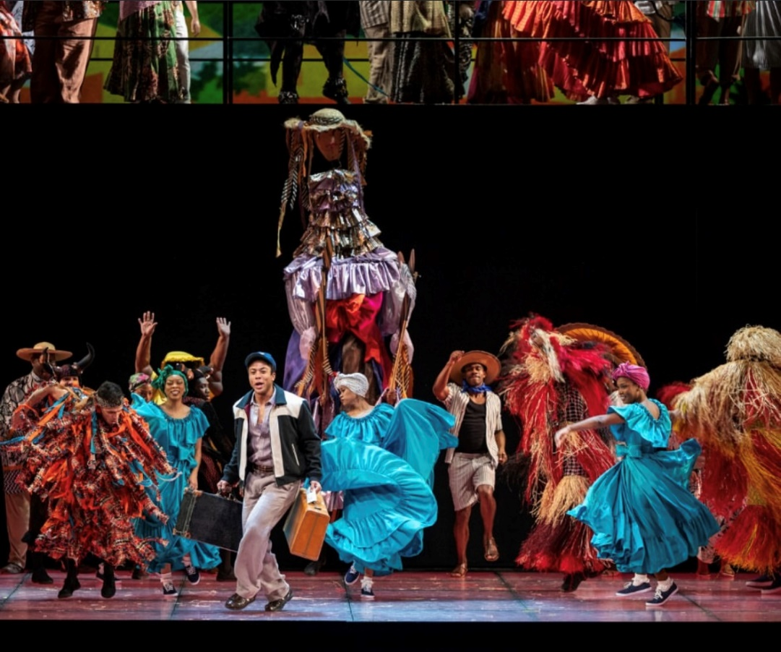
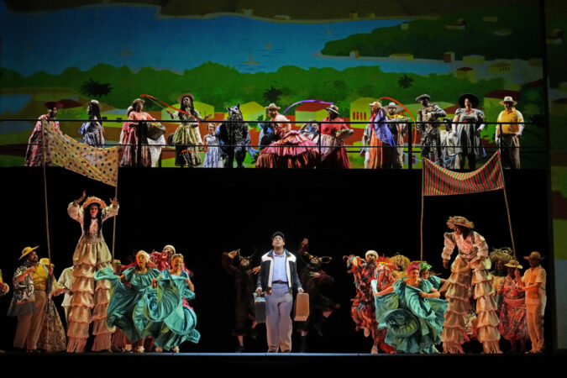
Elements of Design
Champion, Metropolitan Opera (photo: Ken Howard)
Champion, Lyric Opera of Chicago (photo: Michael Brosilow)
Space and Line: The separation of the upper and lower levels also frames the central figure on the ground, ensuring focus while maintaining the energy of the ensemble. This use of space and line creates a sense of balance while highlighting both individual and group dynamics, emphasizing vertical space and creating a layered composition.
Color/Patterns/Texture: Bold colors like bright blues, fiery reds, and warm yellows dominate the palette, creating an energetic and celebratory atmosphere. Patterns and textures add depth, with intricate multicolored fabrics and straw-like materials evoking cultural folk-inspired themes of the Caribbean.

Slide 21
Production Design Guidelines
Consider all that was discussed when designing your production: color, mood, textures, spaces/places, etc.
Production design should include:
Set and costume designs based on your opera adaptation pitch
At least 3 elements of design in your work

Slide 22
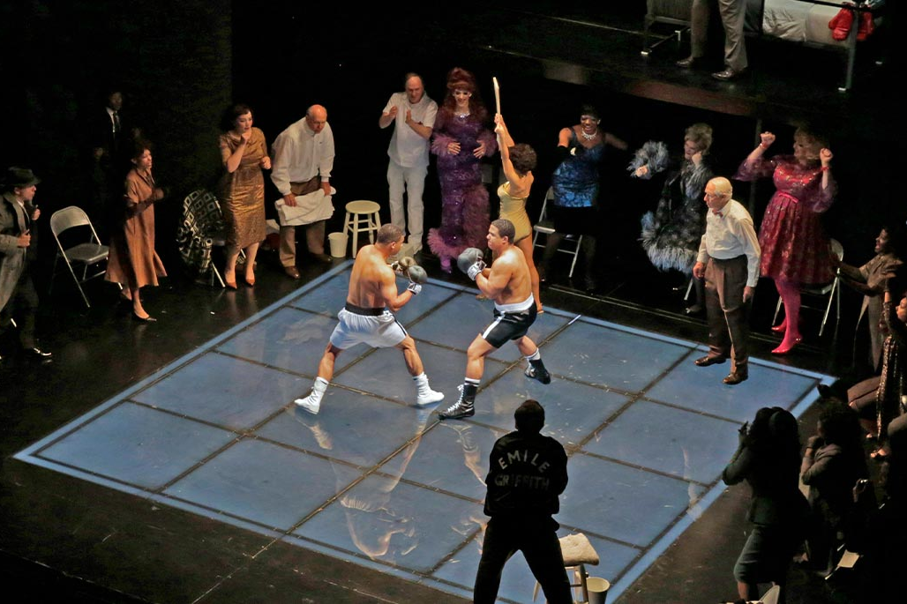
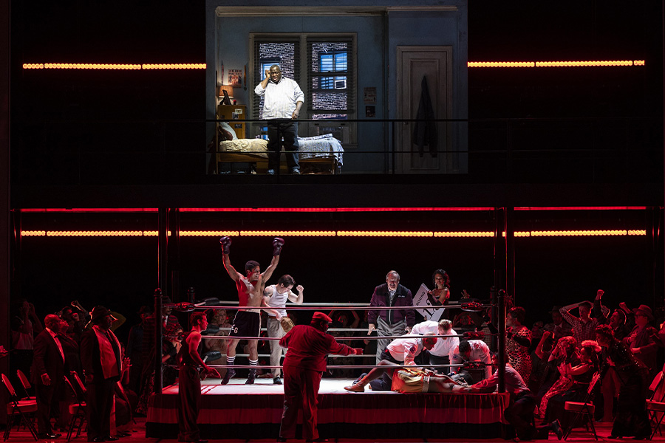
Production Design Examples
Act I, Scene 22-23: Don’t listen, Emile. Don’t think–In my head it happens fast
Champion, Opera Theatre of Saint Louis (photo: Ken Howard)
Champion, Lyric Opera of Chicago (photo: Michael Brosilow)

Slide 23
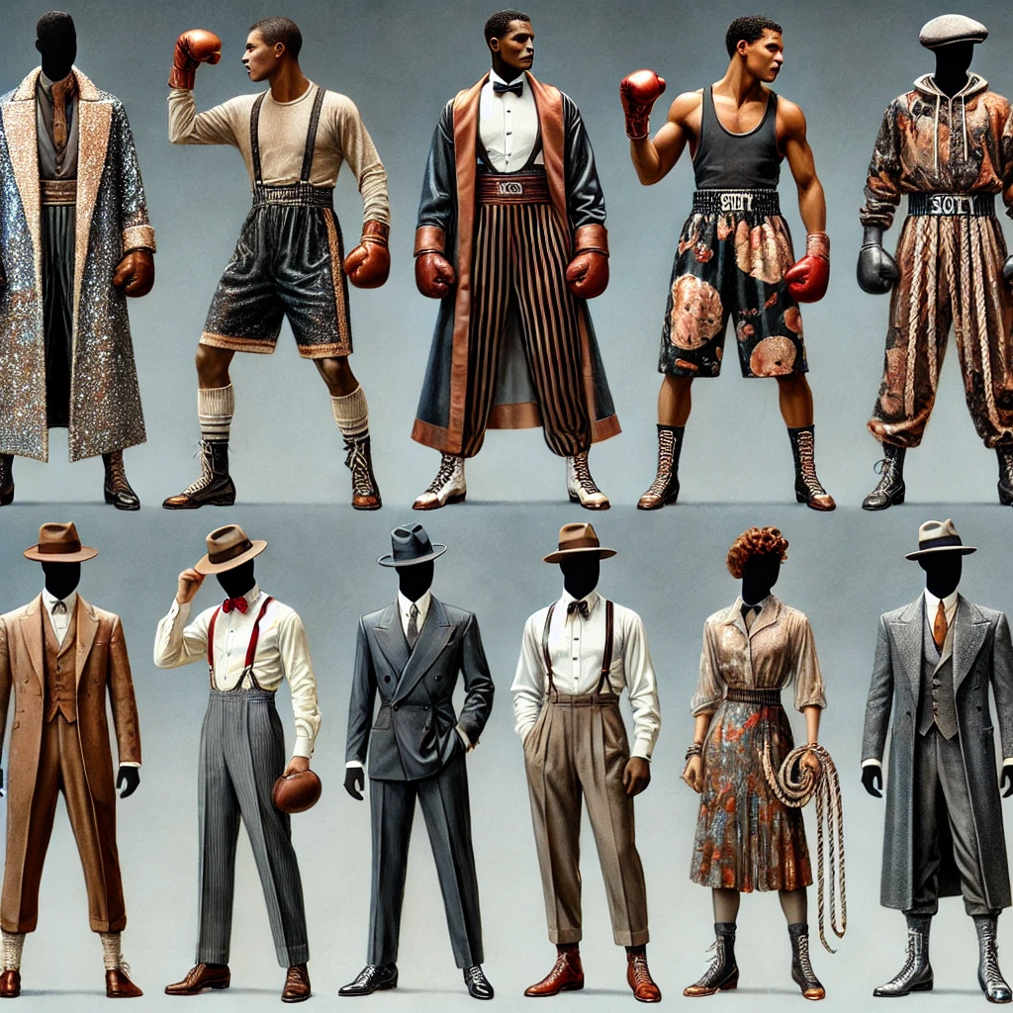
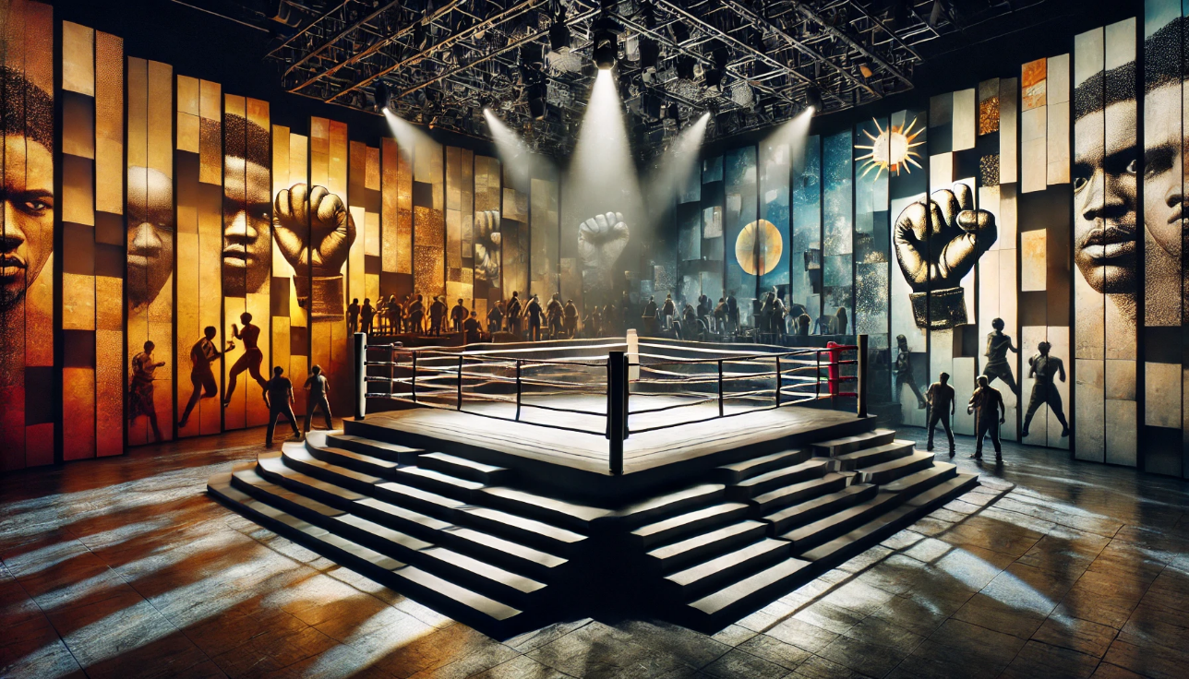
Production Design Examples
Costume design blends period-specific boxing attire, 1950s streetwear, and symbolic elements, with gold accents symbolizing ambition and success, contrasted by darker tones like black or burgundy to reflect internal struggles.
Set design features a central boxing ring, dramatic lighting, and layered backdrops evoke themes of identity, struggle, and resilience in a modern theatrical style. Arena-style seating, parts of the audience sit on platforms close to the action or even onstage, representing a "crowd" around the ring, enhancing the visceral energy of the performance.
Images generated using AI

Slide 24
Production Design Questionnaire
What are the reasons behind your choices? Are your choices based on the music, story, or libretto, and/or a combination of these?
How are you visually representing the time and location?
How are you visually communicating mood and emotion?

Slide 25
Present

Slide 26
Reflection
Share thoughts on the production design process.
How has your experience with adapting a story visually change your perspective on storytelling or your approach to developing ideas?

