Slide 1
Production Design Adaptation
Enriching the Humanities Through Opera
Made possible by the generous support from the

Slide 2
How does production and visual design aid in storytelling?
Today’s Objectives:
Respond to the musical and storytelling elements of opera to develop criteria for visual artistic choices.
Refine an adaptation pitch to demonstrate critical understanding of the visual elements of production design and opera to tell a story.
Create visual representations of set and costume designs based on opera adaptation pitches.

Slide 3
Listening Activity
As you listen to the music, write down any colors, mood, spaces/places, textures, foods, etc. you can associate with the music.
00:04 – 1:35
Notes:
https://www.youtube.com/watch?v=3xSczGQtvQg

Slide 4
A Midsummer Night’s Dream Synopsis
In the woods outside Athens, Oberon, King of the Fairies, quarrels with his queen, Tytania, over a boy she refuses to give up. Oberon sends his servant, Puck, to retrieve a magic flower to enchant her and distract her. Meanwhile, Lysander and Hermia flee into the forest to escape a forced marriage, pursued by Demetrius and Helena. Puck accidentally enchants Lysander instead of Demetrius, creating chaos. A group of workers also enters the forest to rehearse a play, and Puck further complicates matters by turning one of them, Bottom, into an ass, causing Tytania to fall in love with him. In the end, the enchantments are undone, the lovers are reconciled, and they all return to Athens for Theseus’s wedding, where the workers perform their play.

Slide 5
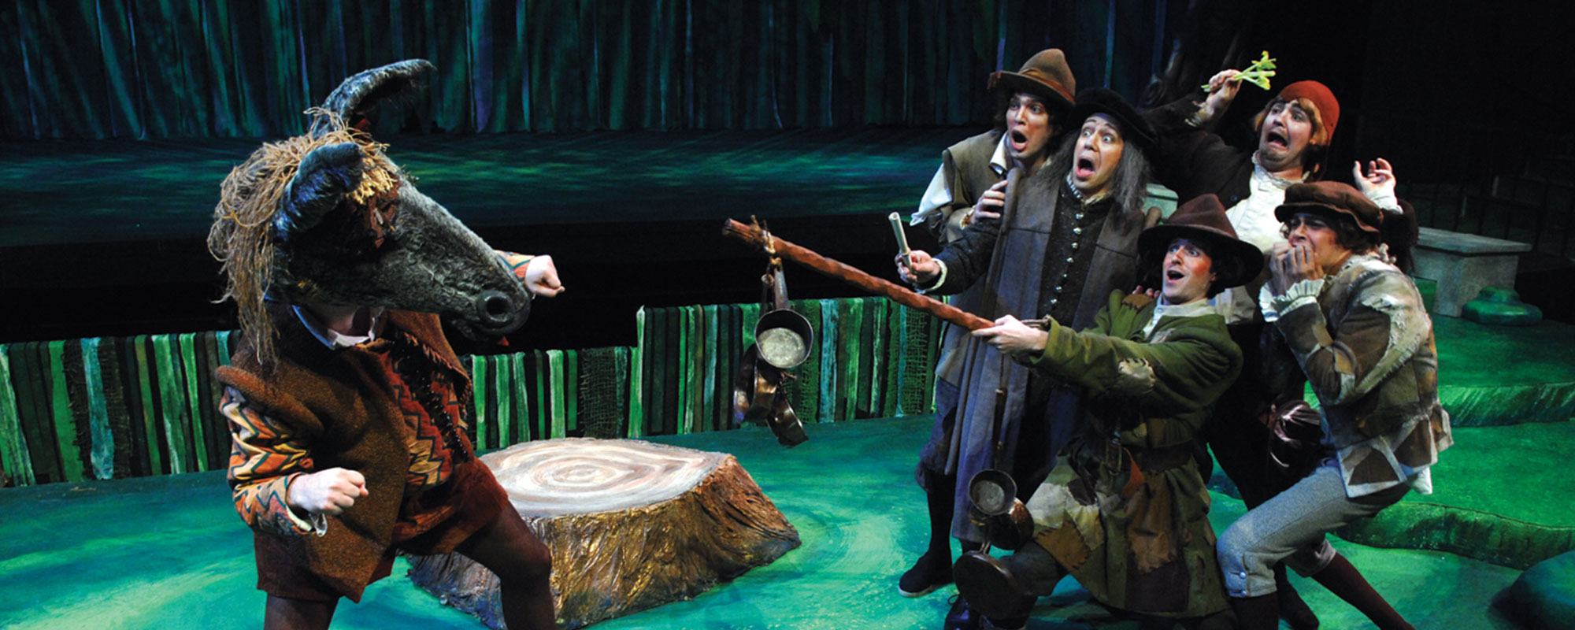
Key Scene #1: Act II, Scene 1: Puck “makes an ass” of Bottom
The mechanicals rehearse their play. Puck transforms Bottom by giving him the head of a donkey (an "ass").
A Midsummer Night’s Dream, Des Moines Metro Opera (photo courtesy of Des Moines Metro Opera)

Slide 6
Key Scene #1 continued
06:19 – 8:50
Notes:
https://youtu.be/28Xz6P6k2p0?si=TZdM7SqVJVLWOR0F

Slide 7
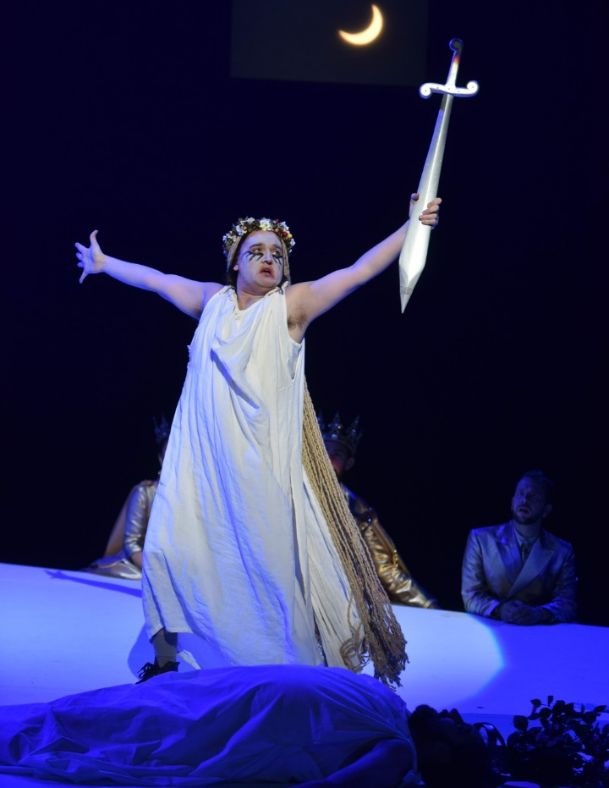
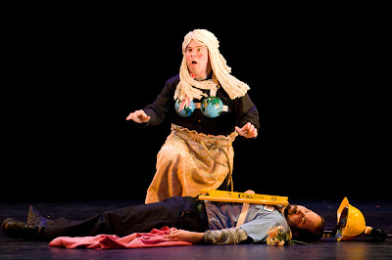
Key Scene #2: Act III, Scene 2: Pyramus and Thisbe
The mock-tragic play-within-the-play, Thisbe, portrayed by Flute, discovers the lifeless Pyramus (portrayed by Bottom), who believed Thisbe to have been killed by a lion. Thisbe sings the aria “Asleep, my Love?” as a lament and stabs herself.
A Midsummer Night’s Dream, Opera Philadelphia (photo: Kelly & Massa)
A Midsummer Night’s Dream, Seattle Opera (photo: Rozarii Lynch)

Slide 8
Key Scene #2 continued
00:06 – 2:01
Notes:
https://youtu.be/5SeeMubn94I?si=O3Up8VsyCO3yReqE

Slide 9
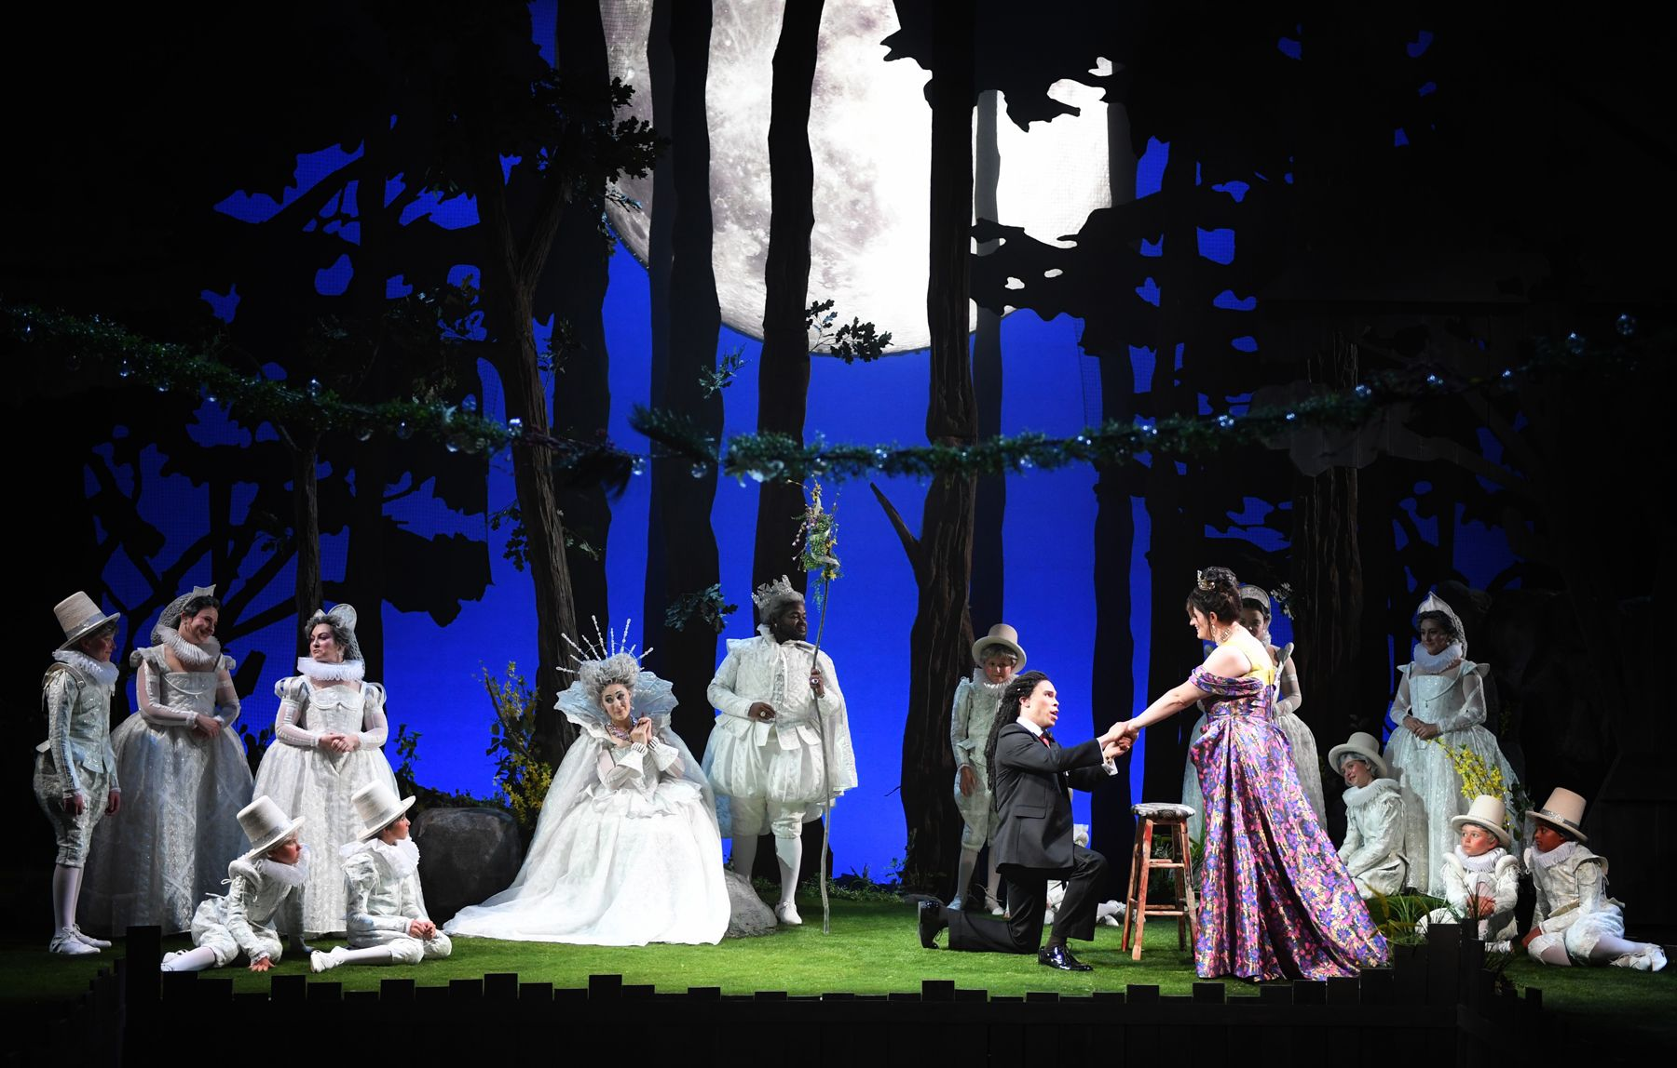
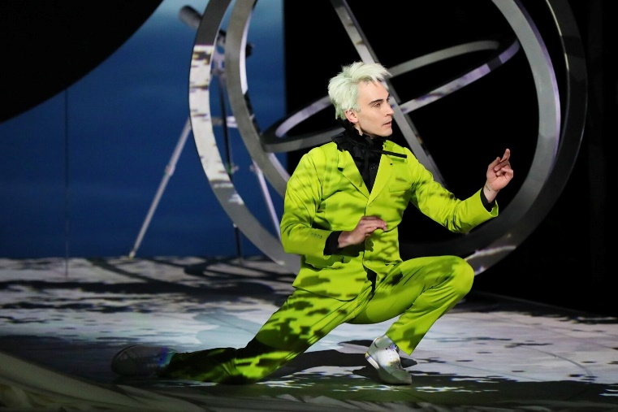
Key Scene #3: Act III, Finale & Puck’s Epilogue
The various stories have been resolved: the lovers are united, the mechanicals presented their play, and the fairies have restored order. Puck then breaks the "fourth wall" and talks openly to the audience, apologizing if the performance has offended anyone.
A Midsummer Night’s Dream, Des Moines Metro Opera (photo: Duane Tinkey)
A Midsummer Night’s Dream, Santa Fe Opera (photo: Curtis Brown)

Slide 10
Key Scene #3 continued
0:03 – 3:02
Notes:
https://www.youtube.com/watch?v=BEgafzaxS98

Slide 11
Production Design Definitions
Production Design: The process of creating the visual aesthetic and environment for a film, television show, commercial, or other forms of media. It involves creating sets, props, as well as costumes, projections, and other visual elements that help bring the story to life and immerse the audience in the narrative. The Production Designer is responsible for overseeing the creation of these elements, working closely with the director, producers, and other key creatives to ensure that the visual style of the production aligns with the overall vision and tone of the project.

Slide 12
Production Design Definitions
Stage/Set Design: The art and practice of creating the physical environment in a theatrical production, film, television show, or other visual medium. This includes scenic elements and design layout for sets, lighting, props, and furniture to bring the story or concept to life. It involves arranging these elements in a way that enhances the audience's visual and aesthetic experience. Stage design may also involve creating technical elements such as sound systems, special effects, and rigging to support the production. Stage designers work closely with other production team members to create a cohesive and visually appealing environment complementing the production's overall vision.

Slide 13
Production Design Definitions
Props: A term commonly used in live performance and film production to refer to objects or items used on stage or on set to enhance the performance or scene. Props can include anything from furniture, decorations, weapons, hand-held objects, and more. Props are used to add realism and detail to a production and help bring the world of the play or film to life for the audience.

Slide 14
Production Design Definitions
Lighting Design: Refers to the art and practice of creating and controlling the lighting for a performance. This includes designing the placement and intensity of the lights and using different colors and effects to enhance the performance's mood and atmosphere. Lighting designers play a crucial role in enhancing the storytelling and emotional impact of the production, helping to set the stage, highlight performers, create a sense of place and time, and evoke different emotions in the audience. It is an integral part of the overall visual and artistic design of the production.

Slide 15
Production Design Definitions
Projection Design: The art of creating and manipulating projected images and videos to enhance the visual elements of a live event, such as a concert, theater production, dance performance, or installation. It involves using specialized software and hardware to project images, videos, or other visual content onto a surface, such as a screen, wall, or even the audience itself.

Slide 16
Production Design Definitions
Costume Design: The process of creating costumes and outfits for characters in theatre, film, television, or other visual media. It involves researching the time-period, setting, and character traits to develop pieces that help bring the character to life. Costume designers work closely with directors, actors, and other production team members to ensure that the costumes accurately reflect the vision of the production. This can involve sourcing or creating garments, accessories, and props, as well as coordinating fittings and alterations. Costume design plays a crucial role in storytelling and character development, helping to enhance the overall visual and emotional impact of a production.

Slide 17
Production Design Definitions
Hair and Makeup Design: Refers to the planning and execution of hairstyles and makeup looks for performers and actors. This creative process involves analyzing the characters or themes in the performance, researching historical or cultural references, and designing hair and makeup that enhances the overall aesthetic and storytelling of the production. Hair and makeup designers work closely with directors, costume designers, and performers to create a cohesive and visually impactful presentation on stage or screen.

Slide 18
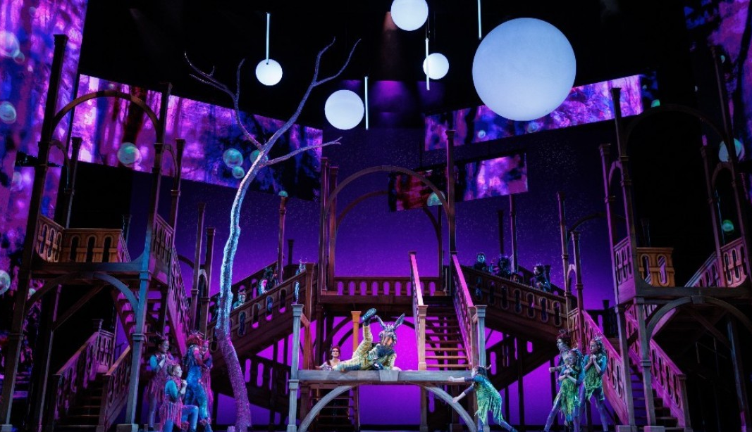
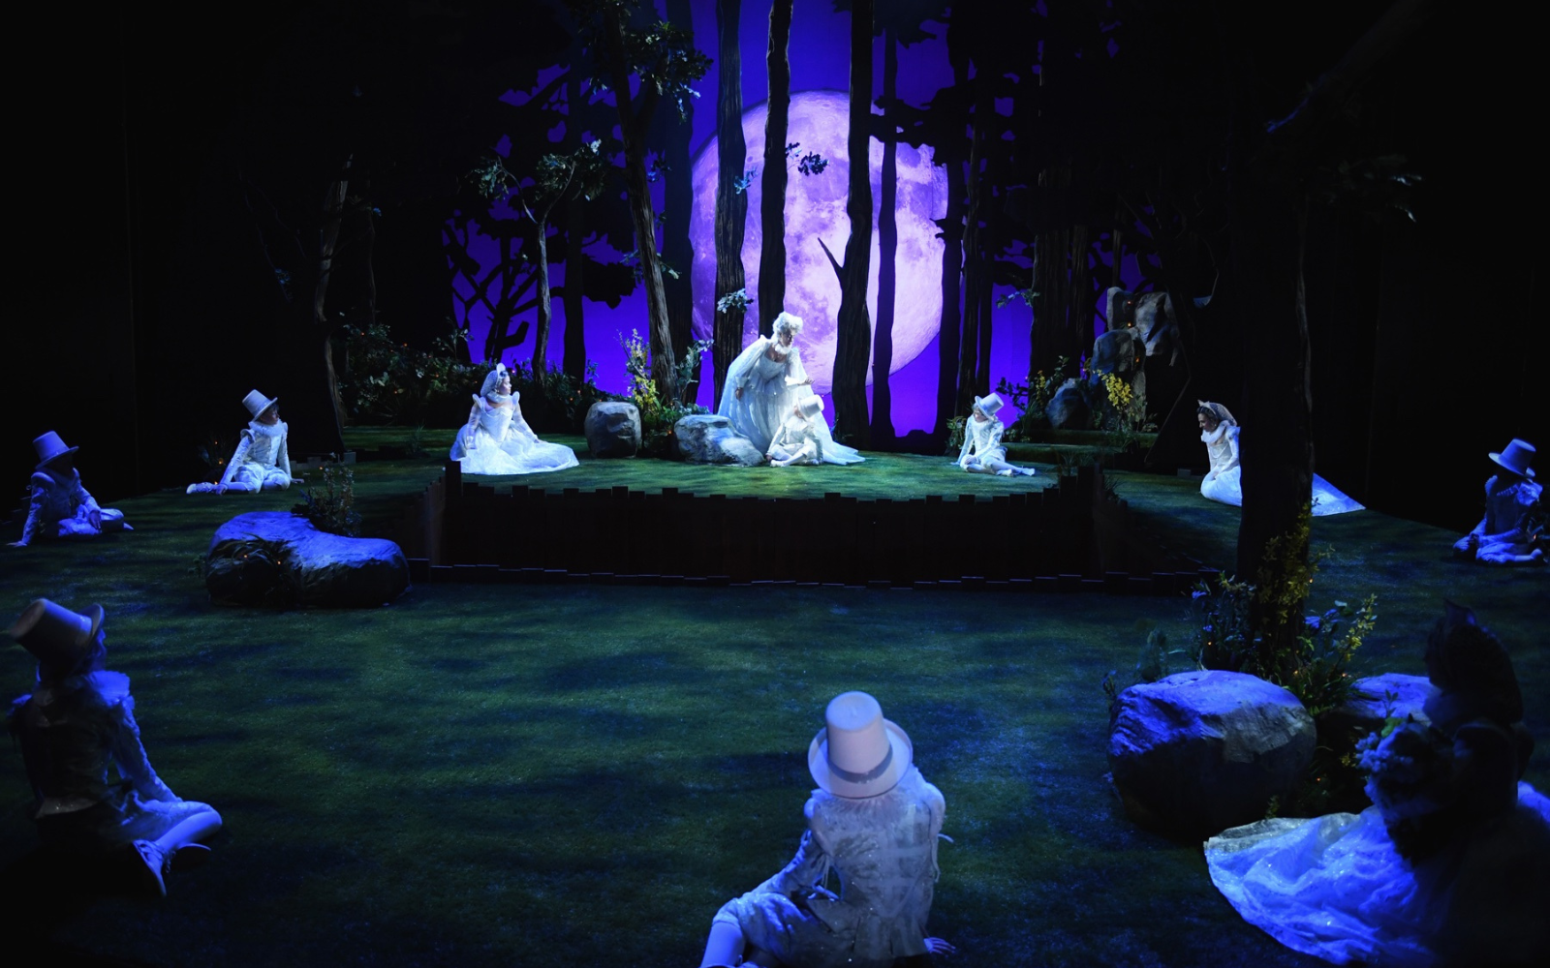
Production Design
A Midsummer Night’s Dream, The Atlanta Opera (photo courtesy of The Atlanta Opera)
A Midsummer Night’s Dream, Des Moines Metro Opera (photo: Duane Tinkey)

Slide 19
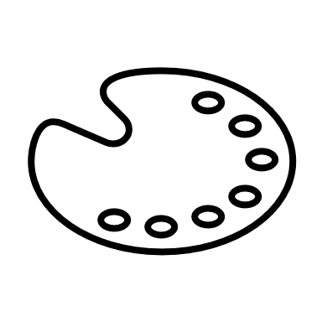
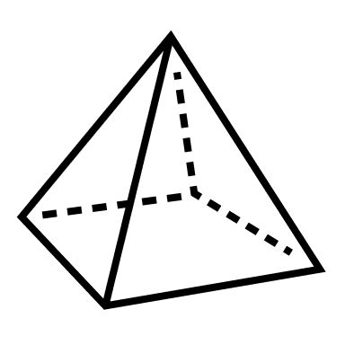
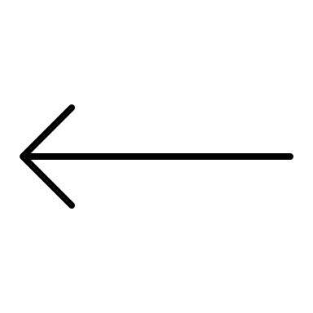
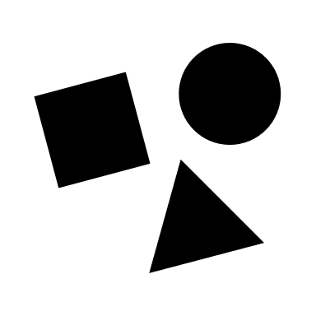
Elements of Design
Color
Line
Shape
Texture
Form
Space
Value
Pattern

Slide 20
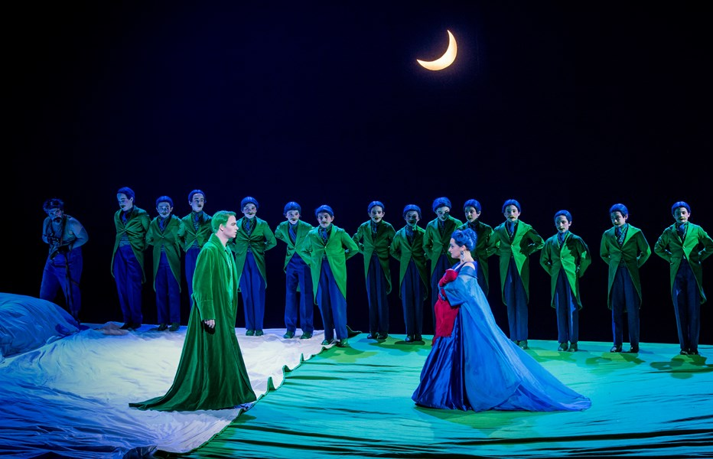
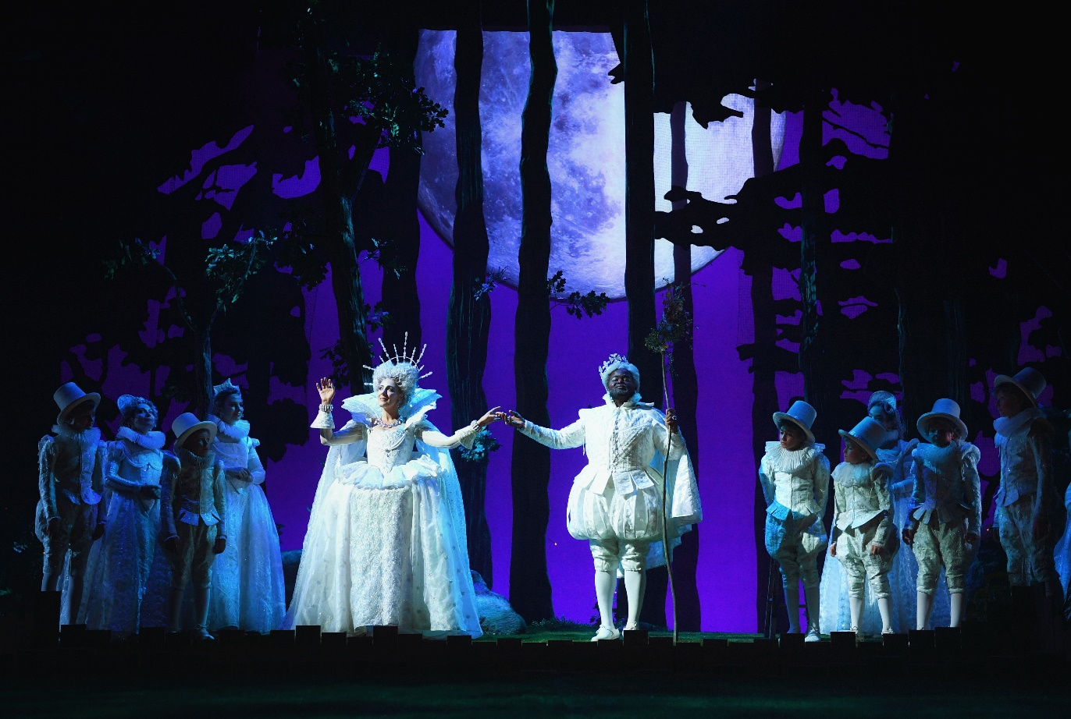
Elements of Design
Shape and Texture: The trees in the background are irregular and asymmetrical, suggesting a natural, untamed forest. These organic shapes help create a fluid, dreamlike atmosphere that contrasts with the geometric precision of the characters’ costumes. The voluminous skirts and puffed pants with the use of lace, ruffles, and intricate embroidery adds layers of texture to the costumes. These delicate fabrics suggest elegance and grandeur, reinforcing the idea that these characters are noble and supernatural beings.
A Midsummer Night’s Dream, Opera Philadelphia (photo: Kelly & Massa)
Color and Space: Green and blue dominate the scene, creating a surreal, dreamlike atmosphere. Flowing fabric on the floor evokes natural landscapes, like waves or hills, suggesting movement and fluidity. Instead of complex backdrops, the design relies on lighting and costumes to convey meaning, allowing the audience to focus on the interaction between the characters. The costumes use bold colors, note the use of red, which contrasts sharply, and structure to convey the characters' roles.
A Midsummer Night’s Dream, Des Moines Metro Opera (photo: Duane Tinkey)

Slide 21
Production Design Guidelines
Consider all that was discussed when designing your production: color, mood, textures, spaces/places, etc.
Production design should include:
Set and costume designs based on your opera adaptation pitch
At least 3 elements of design in your work

Slide 22
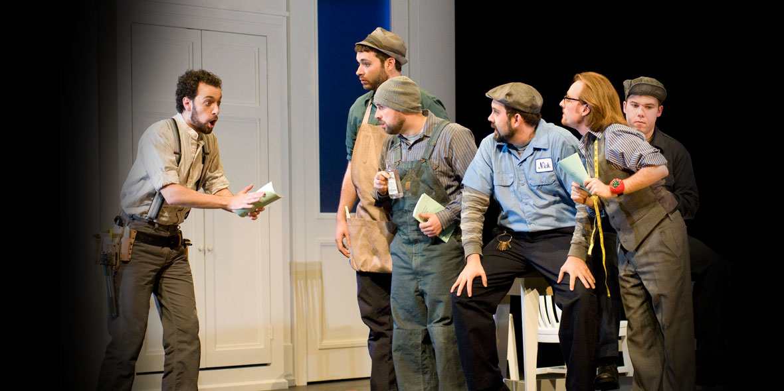
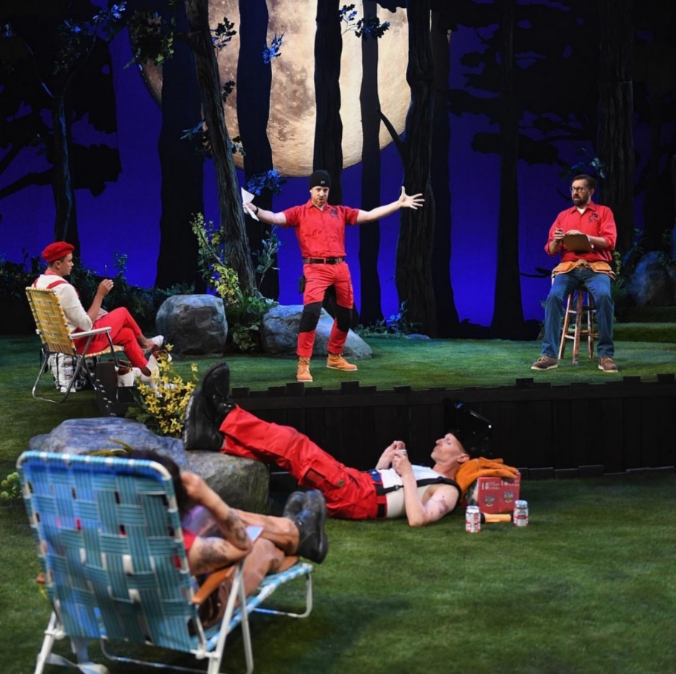
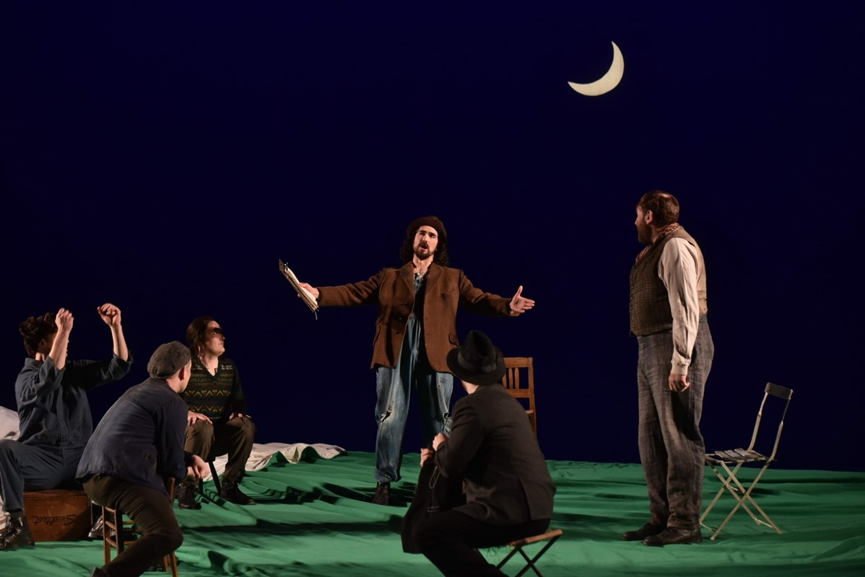
Production Design Examples
A Midsummer Night’s Dream, Seattle Opera (photo: Rozarii Lynch)
Act II, Scene 1: Puck “makes an ass” of Bottom
A Midsummer Night’s Dream, Des Moines Metro Opera (photo: Duane Tinkey)
A Midsummer Night’s Dream, Opera Philadelphia (photo: Kelly & Massa)

Slide 23
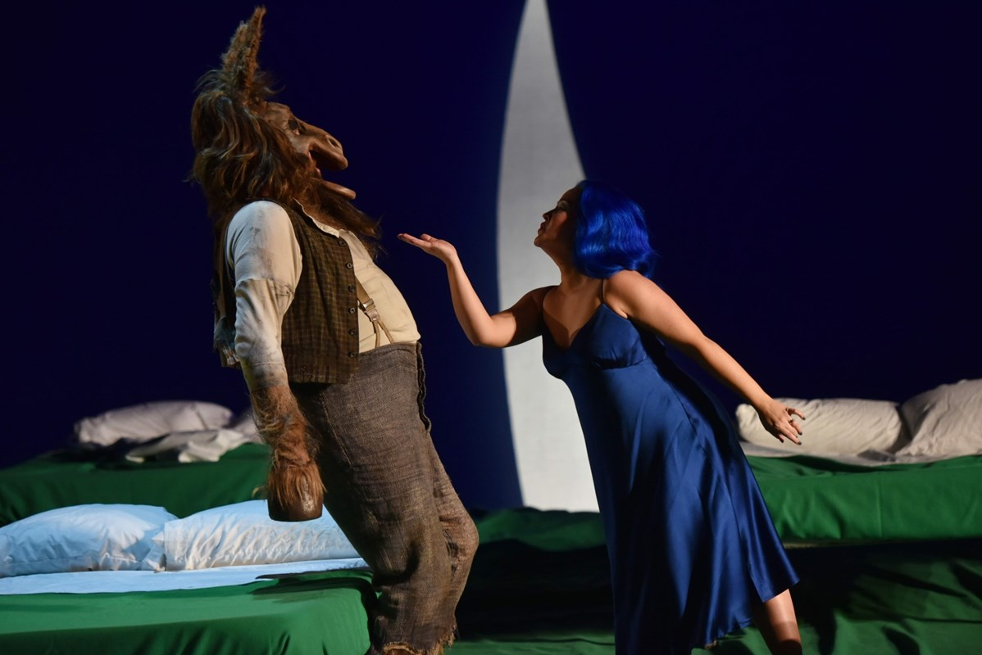
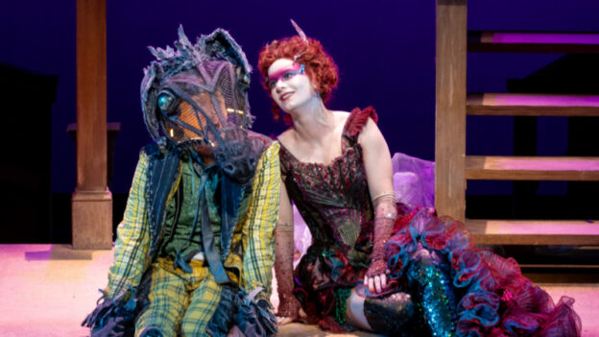
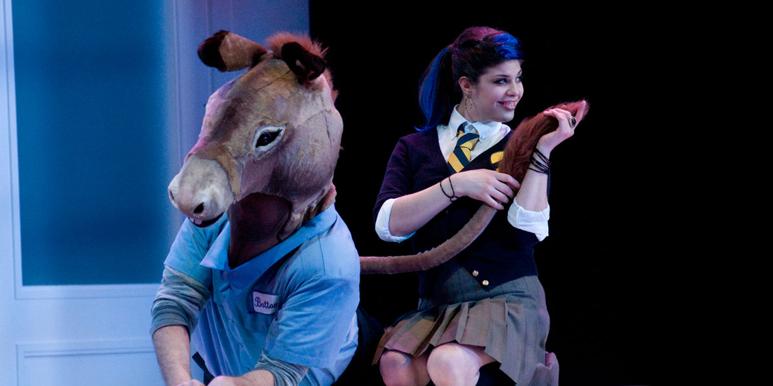
Production Design Examples
Various designs for Bottom’s transformation, featuring Tytania.
A Midsummer Night’s Dream, The Atlanta Opera (photo courtesy of The Atlanta Opera)
A Midsummer Night’s Dream, Seattle Opera (photo: Rozarii Lynch)
A Midsummer Night’s Dream, The Atlanta Opera (photo courtesy of The Atlanta Opera)

Slide 24
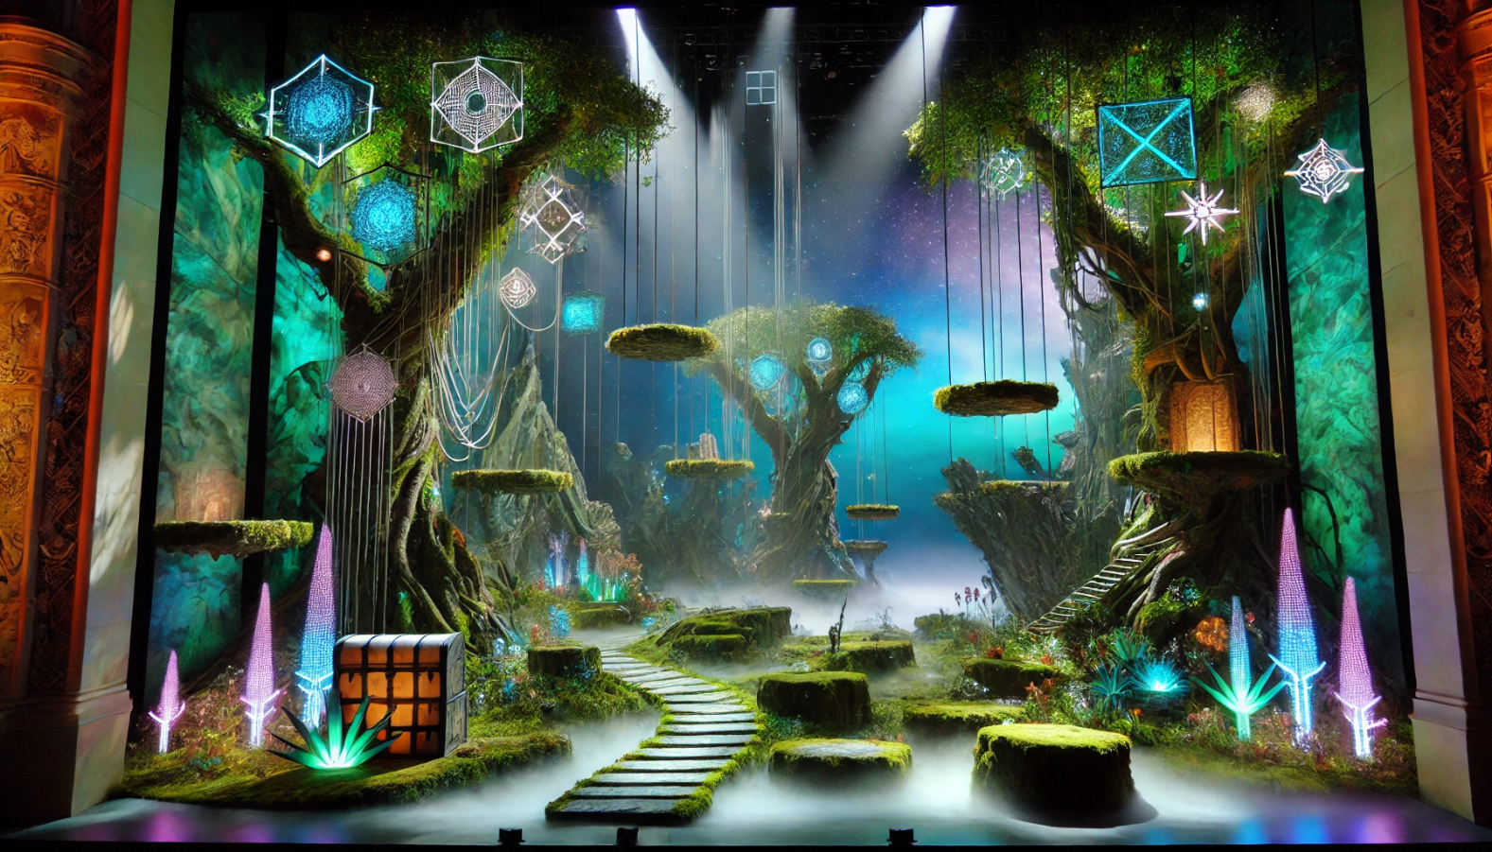
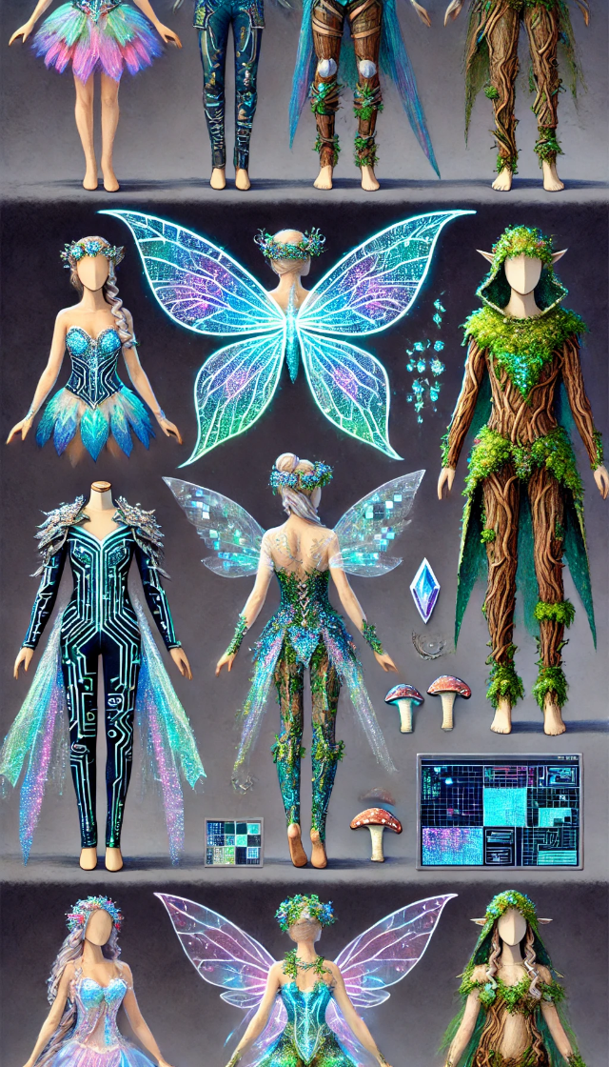
Production Design Examples
Costume designs, inspired by an enchanted woodland setting, magical themes, and Britten's ethereal score, blend nature, technology, and fantasy to reimagine characters as video game avatars – creating a mystical and futuristic aesthetic with bodysuits adorned with circuits and digital patterns, glowing neon wings, and designs incorporating flowers, moss, leaves, and bark-like textures.
Set design features a winding dirt path bordered by floating platforms made from stone that mimic a video game aesthetic, and positioned at varying heights, creating verticality on the stage. There are designated areas for each group of characters to interact, such as the fairy kingdom, with shimmering fabric and soft twinkling lights of purples and blues, contrasting with the more robust areas of the forest for the human characters with warm yellows and greens.
Images generated using AI

Slide 25
Production Design Questionnaire
What are the reasons behind your choices? Are your choices based on the music, story, or libretto, and/or a combination of these?
How are you visually representing the time and location?
How are you visually communicating mood and emotion?

Slide 26
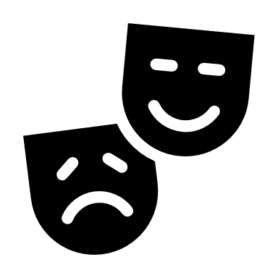
Present

Slide 27
Reflection
Share thoughts on the production design process.
How has your experience with adapting a story visually change your perspective on storytelling or your approach to developing ideas?

