Slide 1
Production Design Adaptation
Enriching the Humanities Through Opera
Made possible by the generous support from the

Slide 2
How does production and visual design aid in storytelling?
Today’s Objectives:
Respond to the musical and storytelling elements of opera to develop criteria for visual artistic choices.
Refine an adaptation pitch to demonstrate critical understanding of the visual elements of production design and opera to tell a story.
Create visual representations of set and costume designs based on opera adaptation pitches.

Slide 3
Listening Activity
As you listen to the music, write down any colors, mood, spaces/places, textures, foods, etc. you can associate with the music.
00:57 – 03:14
Notes:
https://www.youtube.com/watch?v=Yy-DTtJ5q-A

Slide 4
Le nozze di Figaro Synopsis
Set within a single day, the story is a comedic exploration of love, deception, and social class. It follows Figaro and his fiancée Susanna as they navigate the scheming intentions of Count Almaviva, who wishes to seduce Susanna before her marriage. Through a series of clever disguises, misunderstandings, and unexpected alliances, the characters ultimately triumph over the Count’s advances, celebrating love and the spirit of equality in the end.

Slide 5
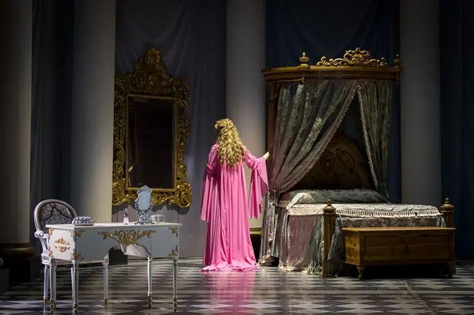
Key Scene #1
Act II, Scene 1: Porgi, amor, qualche ristoro (Grant, love, some relief)
Countess is longing for the love of her husband, Count Almaviva, who has grown distant and unfaithful.
Le nozze di Figaro, Washington National Opera (photo: Scott Suchman)

Slide 6
Key Scene #1 continued
Met Opera on Demand: Track #16. ACT II: Porgi, amor, qualche ristoro
01:07 – 04:01
Act II, Scene 1: Porgi, amor, qualche ristoro
48:08 – 51:26
Notes:
https://ondemand.metopera.org/performance/detail/e8174902-82fb-5e94-b1ef-54dd3387dbe9
https://www.youtube.com/watch?v=Yy-DTtJ5q-A

Slide 7
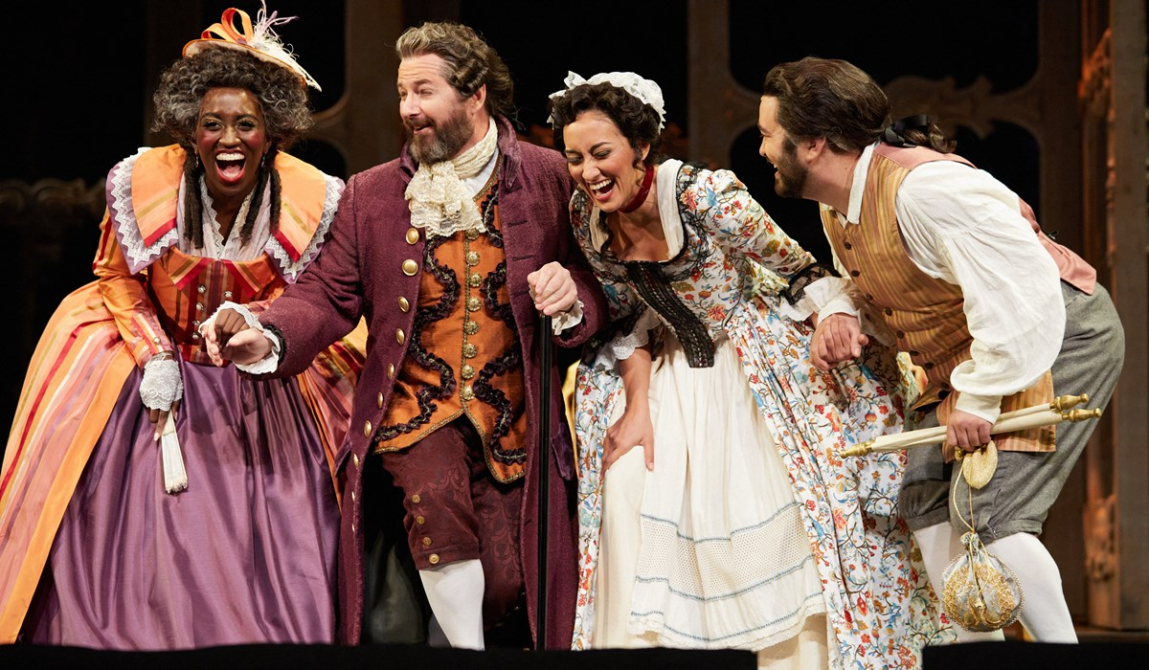
Key Scene #2
Act II, Scene 5: Riconosci in questo amplesso (Recognize in this embrace)
Figaro is brought to court over a broken marriage contract with Marcellina. During the proceedings, it is revealed through a birthmark that Figaro is Marcellina’s long-lost son, and Bartolo is his father, turning into a joyful family reunion. Susanna enters and, misunderstanding the embrace between Figaro and Marcellina, initially reacts with anger but is soon relieved when the truth is explained.
Le nozze di Figaro, Portland Opera (photo: Philip Newton)

Slide 8
Key Scene #2 continued
Met Opera on Demand: Track #36. ACT III: Riconosci in questo amplesso — Eccovi — Io vi dico
00:48 – 06:27
Act #, Scene #
2:01:22 – 2:06:57
Notes:
https://ondemand.metopera.org/performance/detail/e8174902-82fb-5e94-b1ef-54dd3387dbe9
https://www.youtube.com/watch?v=Yy-DTtJ5q-A

Slide 9
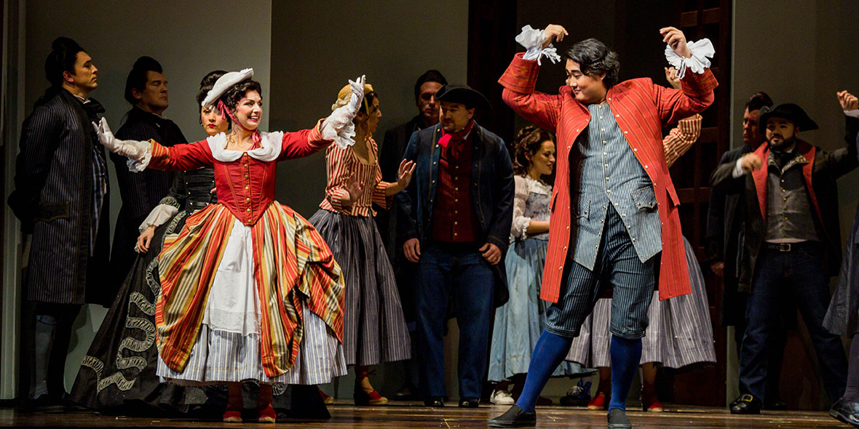
Key Scene #3
Act IV, Finale: Gente, gente, all'armi, all'armi!... Questo giorno di tormenti (Gentlemen, to arms!... This day of torments)
Chaos erupts as the elaborate disguises and misunderstandings reach their peak. Figaro, Susanna, the Count, and the Countess become entangled in a whirlwind of mistaken identities, culminating in the Count mistakenly accusing the disguised Countess of infidelity. The commotion attracts others, who rush in, adding to the confusion.
Le nozze di Figaro, Seattle Opera (photo: Tuffer)

Slide 10
Key Scene #3 continued
Met Opera on Demand: Track #47. ACT IV: Gente, gente, all'armi — Questo giorno di tormenti
00:00 – 05:24
Act IV, Scene 14: Gente, gente, all'armi, all'armi!... Questo giorno di tormenti
2:59:50 – 3:05:28
Notes:
https://ondemand.metopera.org/performance/detail/e8174902-82fb-5e94-b1ef-54dd3387dbe9
https://www.youtube.com/watch?v=Yy-DTtJ5q-A

Slide 11
Production Design Definitions
Production Design: The process of creating the visual aesthetic and environment for a film, television show, commercial, or other forms of media. It involves creating sets, props, as well as costumes, projections, and other visual elements that help bring the story to life and immerse the audience in the narrative. The Production Designer is responsible for overseeing the creation of these elements, working closely with the director, producers, and other key creatives to ensure that the visual style of the production aligns with the overall vision and tone of the project.

Slide 12
Production Design Definitions
Stage/Set Design: The art and practice of creating the physical environment in a theatrical production, film, television show, or other visual medium. This includes scenic elements and design layout for sets, lighting, props, and furniture to bring the story or concept to life. It involves arranging these elements in a way that enhances the audience's visual and aesthetic experience. Stage design may also involve creating technical elements such as sound systems, special effects, and rigging to support the production. Stage designers work closely with other production team members to create a cohesive and visually appealing environment complementing the production's overall vision.

Slide 13
Production Design Definitions
Props: A term commonly used in live performance and film production to refer to objects or items used on stage or on set to enhance the performance or scene. Props can include anything from furniture, decorations, weapons, hand-held objects, and more. Props are used to add realism and detail to a production and help bring the world of the play or film to life for the audience.

Slide 14
Production Design Definitions
Lighting Design: Refers to the art and practice of creating and controlling the lighting for a performance. This includes designing the placement and intensity of the lights and using different colors and effects to enhance the performance's mood and atmosphere. Lighting designers play a crucial role in enhancing the storytelling and emotional impact of the production, helping to set the stage, highlight performers, create a sense of place and time, and evoke different emotions in the audience. It is an integral part of the overall visual and artistic design of the production.

Slide 15
Production Design Definitions
Projection Design: The art of creating and manipulating projected images and videos to enhance the visual elements of a live event, such as a concert, theater production, dance performance, or installation. It involves using specialized software and hardware to project images, videos, or other visual content onto a surface, such as a screen, wall, or even the audience itself.

Slide 16
Production Design Definitions
Costume Design: The process of creating costumes and outfits for characters in theatre, film, television, or other visual media. It involves researching the time-period, setting, and character traits to develop pieces that help bring the character to life. Costume designers work closely with directors, actors, and other production team members to ensure that the costumes accurately reflect the vision of the production. This can involve sourcing or creating garments, accessories, and props, as well as coordinating fittings and alterations. Costume design plays a crucial role in storytelling and character development, helping to enhance the overall visual and emotional impact of a production.

Slide 17
Production Design Definitions
Hair and Makeup Design: Refers to the planning and execution of hairstyles and makeup looks for performers and actors. This creative process involves analyzing the characters or themes in the performance, researching historical or cultural references, and designing hair and makeup that enhances the overall aesthetic and storytelling of the production. Hair and makeup designers work closely with directors, costume designers, and performers to create a cohesive and visually impactful presentation on stage or screen.

Slide 18
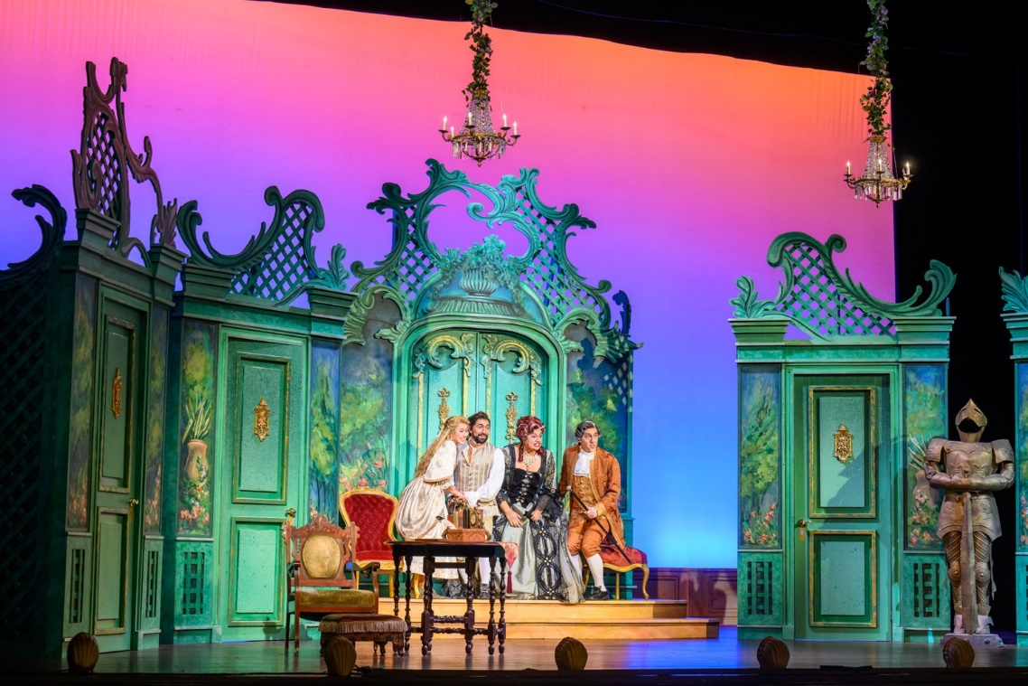
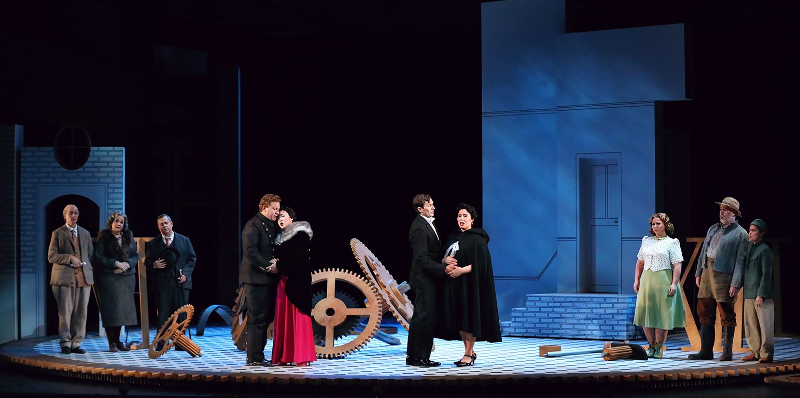
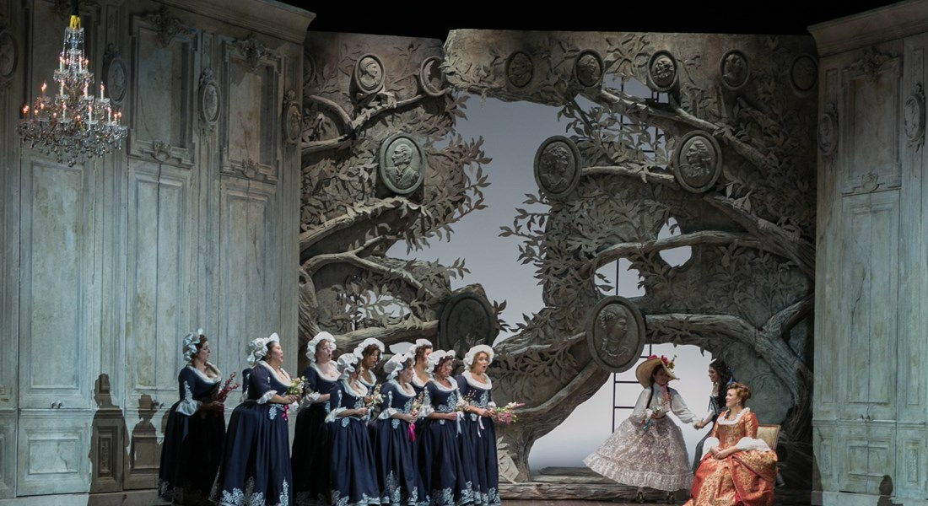
Production Design
Le nozze di Figaro, Opera Delaware (photo: Joe del Tufo & Jim Coarse / Moonloop Photography)
Le nozze di Figaro, Santa Fe Opera (photo: Curtis Brown)
Le nozze di Figaro, Lyric Opera of Kansas City (photo: Dana Sohm)

Slide 19
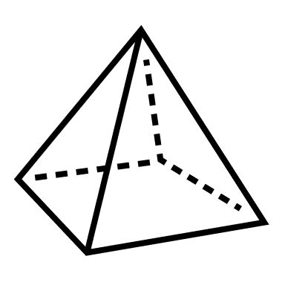
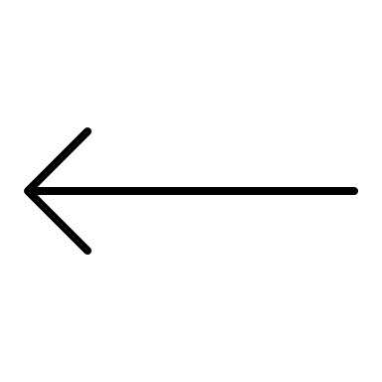
Elements of Design
Color
Line
Shape
Texture
Form
Space
Value
Pattern

Slide 20
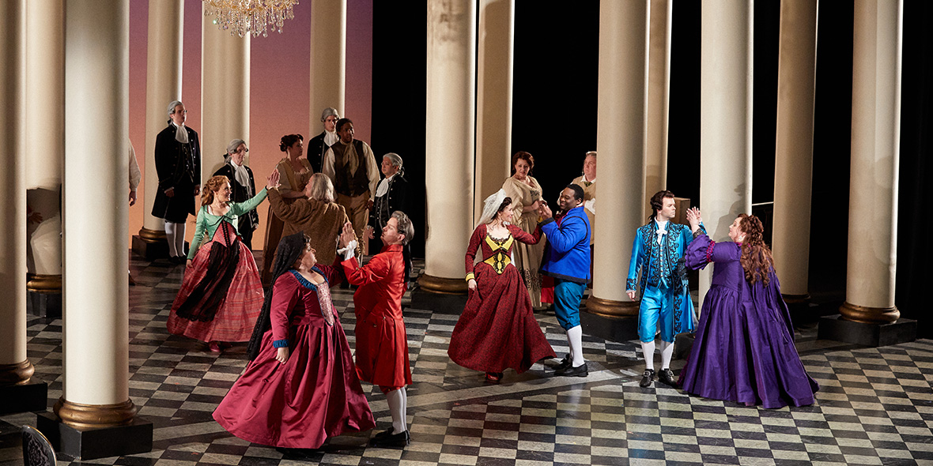
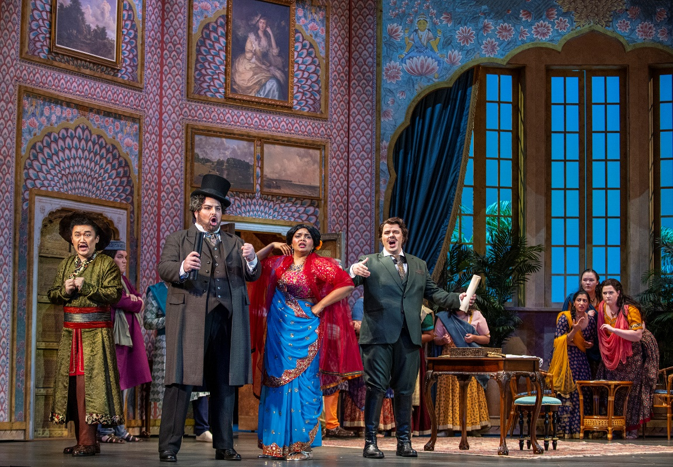
Elements of Design
Color and Pattern: Bold, warm hues such as reds, golds, and pinks, contrasted with cool tones of blue in the drapery and windows, create a balanced and dynamic atmosphere. Geometric and floral patterns on the walls and costumes evoke a sense of wealth and cultural fusion, while the layered textures give depth to the scene.
Le nozze di Figaro, Seattle Opera (photo: Philip Newton)
Line and Space: Vertical lines of the tall columns dominate the composition, drawing the eye upward and adding grandeur to the space. Negative space between the columns allows light and shadow to interact, emphasizing depth and scale. Checkered floor adds to this perception of depth, leading the eye through the scene, while the wide, open foreground highlights the figures, making them the focal point within the expansive architectural setting.
Le nozze di Figaro, Opera San José (photo: David Allen)

Slide 21
Production Design Guidelines
Consider all that was discussed when designing your production: color, mood, textures, spaces/places, etc.
Production design should include:
Set and costume designs based on your opera adaptation pitch
At least 3 elements of design in your work

Slide 22
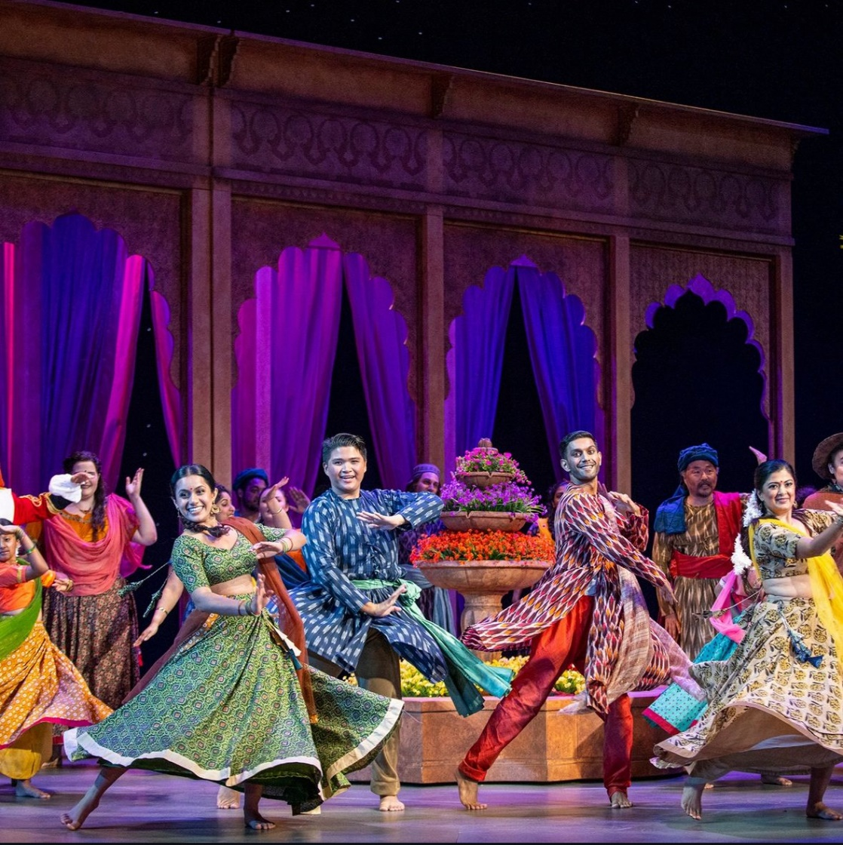
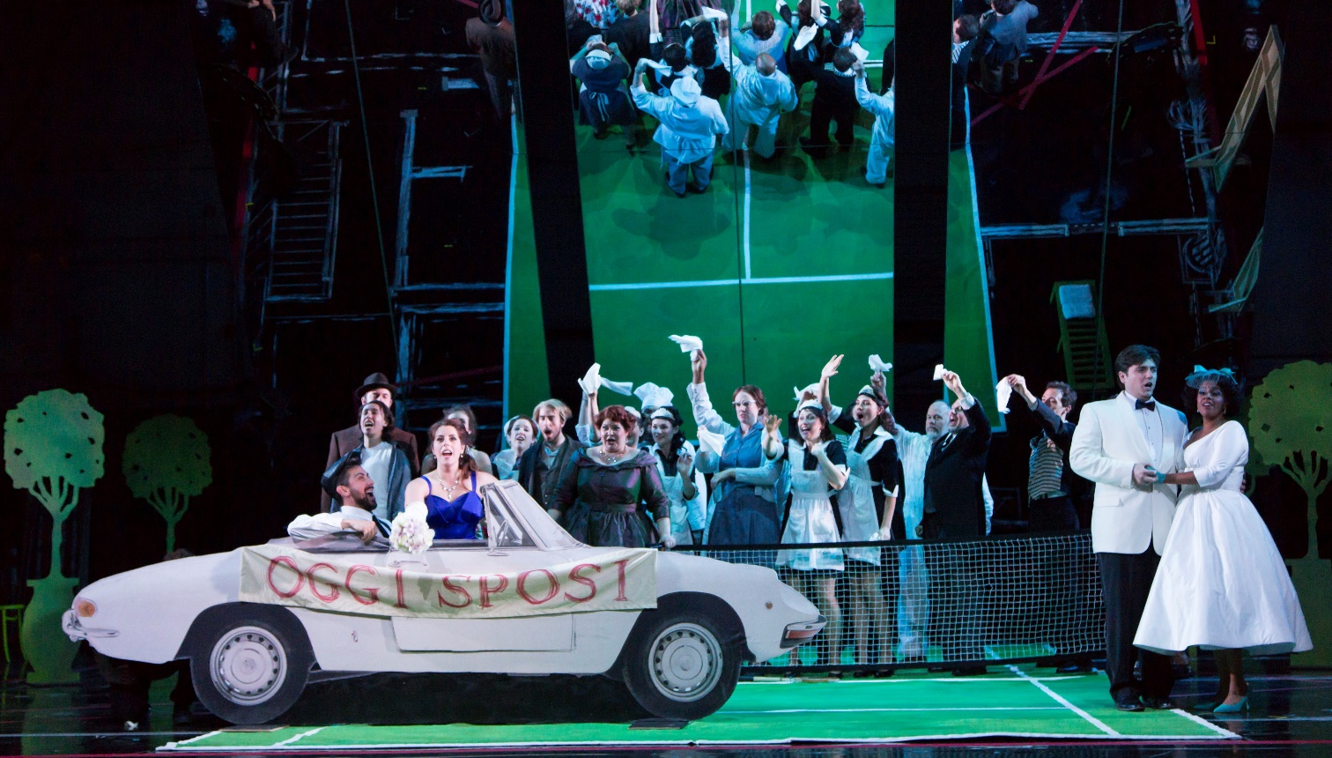
Production Design Examples
Act IV, Finale
Le nozze di Figaro, Boston Lyric Opera (photo: T. Charles Erickson)
Le nozze di Figaro, Opera San José (photo: David Allen)

Slide 23
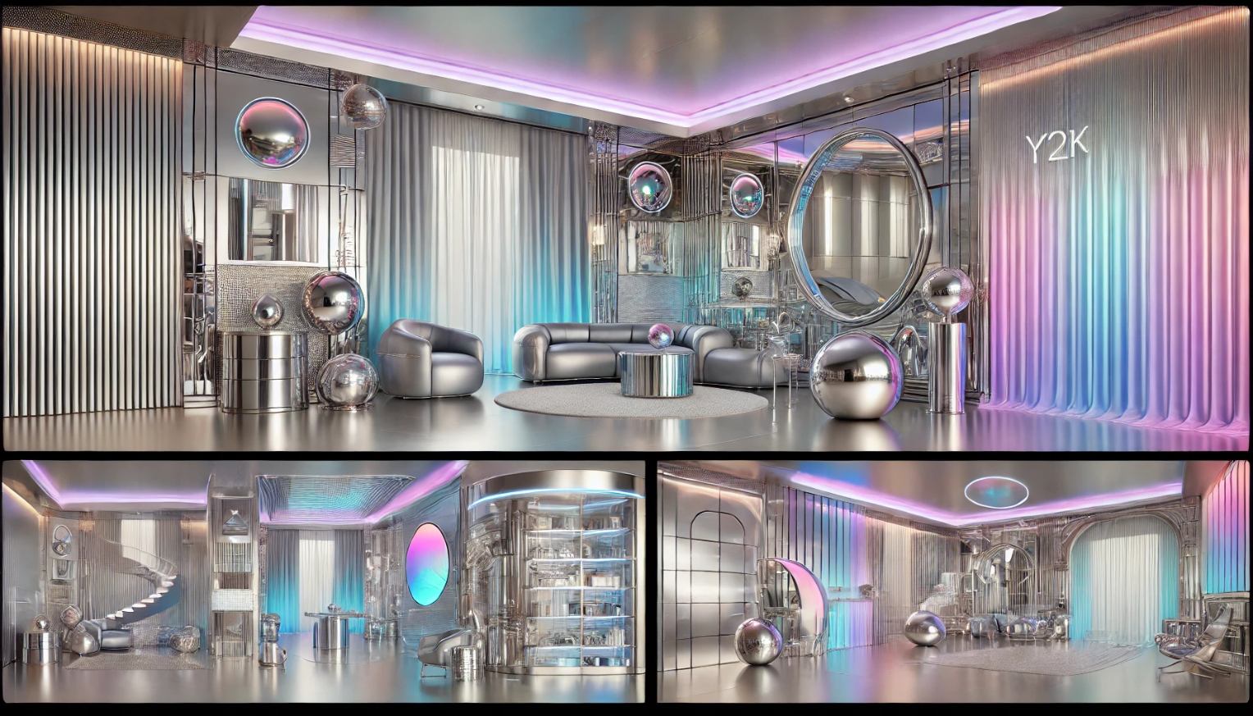
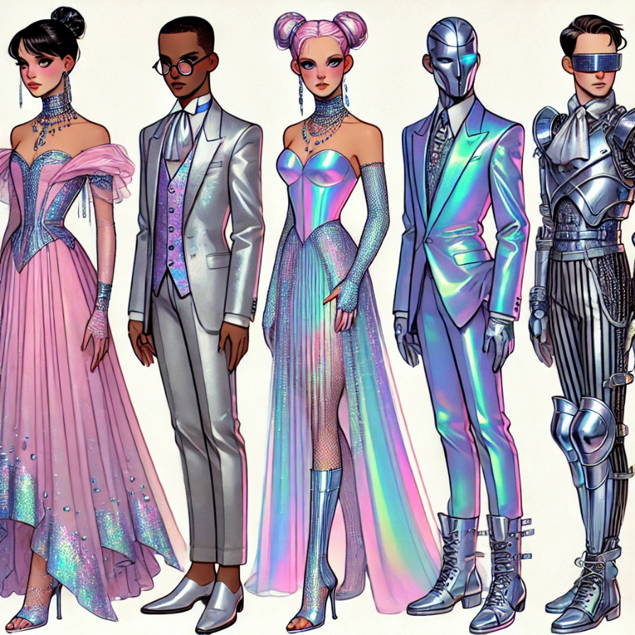
Production Design Examples
Costume design captures the characteristics of Susanna, Figaro, the Countess, and the Count, while combining sleek, futuristic elements with early 2000s glam, embracing the playful and bold fashion of the era.
Set design is Y2K-inspired futurism, blending metallics and reflective materials, neon, and holographic pastels, creating a visually striking and dynamic environment that mirrors the bold, digital-era aesthetics of the early 2000s.
Images generated using AI

Slide 24
Production Design Questionnaire
What are the reasons behind your choices? Are your choices based on the music, story, or libretto, and/or a combination of these?
How are you visually representing the time and location?
How are you visually communicating mood and emotion?

Slide 25
Present

Slide 26
Reflection
Share thoughts on the production design process.
How has your experience with adapting a story visually change your perspective on storytelling or your approach to developing ideas?

