Slide 1
Production Design Adaptation
Enriching the Humanities Through Opera
Made possible by the generous support from the

Slide 2
How does production and visual design aid in storytelling?
Today’s Objectives:
Respond to the musical and storytelling elements of opera to develop criteria for visual artistic choices.
Refine an adaptation pitch to demonstrate critical understanding of the visual elements of production design and opera to tell a story.
Create visual representations of set and costume designs based on opera adaptation pitches.

Slide 3
Listening Activity
As you listen to the music, write down any colors, mood, spaces/places, textures, foods, etc. you can associate with the music.
00:03 – 03:16
Notes:
https://www.youtube.com/watch?v=Ztq4oIi8mW8

Slide 4
Il barbiere di Siviglia Synopsis
In the opera Il barbiere di Siviglia, the clever and resourceful barber Figaro helps Count Almaviva win the heart of Rosina, who is closely watched by her overbearing guardian, Dr. Bartolo. The Count, desiring to be loved for who he truly is rather than for his wealth, has assumed the identity of a poor student named Lindoro to win her affection. Through a series of disguises and clever schemes, Count Almaviva reveals his true identity to Rosina, and they plan to marry. Despite Bartolo's attempts to thwart them, Figaro's wit and cunning ultimately ensure a happy ending for the young lovers.

Slide 5
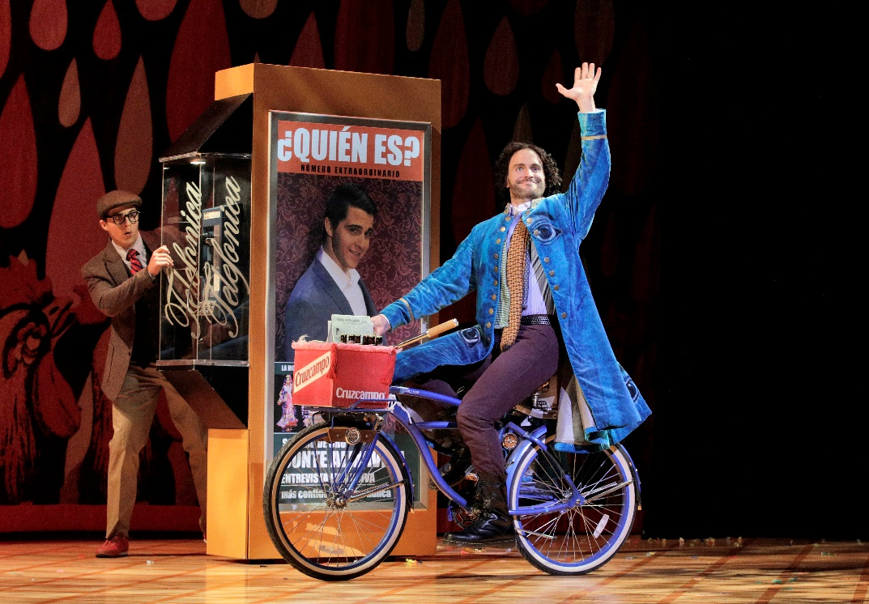
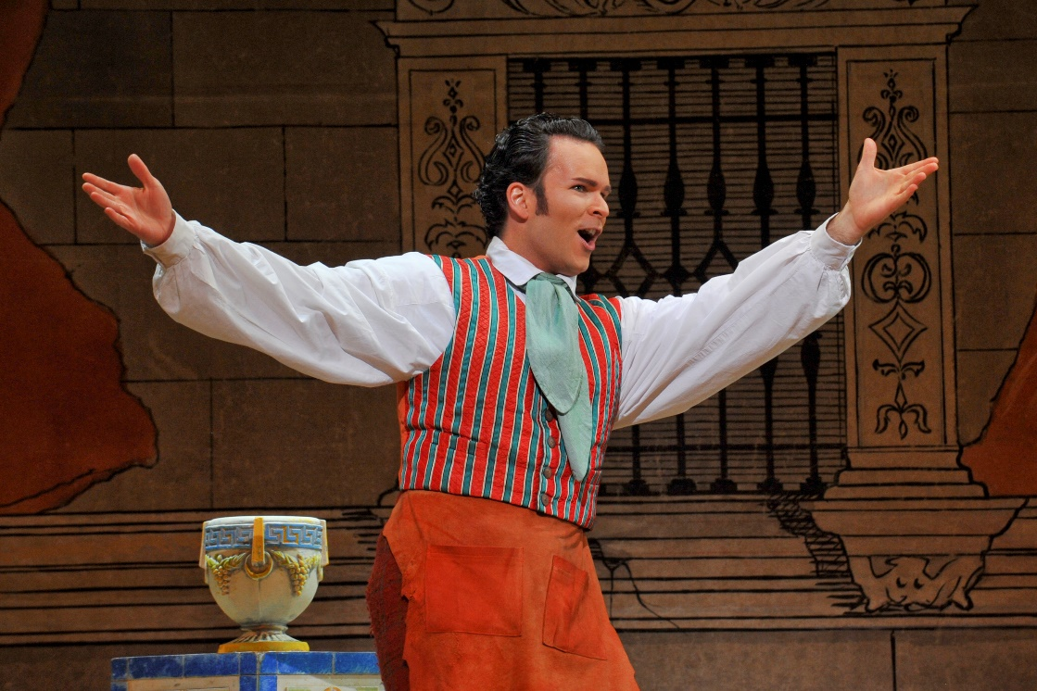
Key Scene #1
Act I, Scene 2: Largo al factotum della città (Make way for the factotum of the city)
Figaro’s entrance, the town's barber, factotum (an employee who does all kinds of work), and general busybody. Figaro proudly sings of his charmed life, where he serves as a go-between, tonsorial expert, matchmaker, and much more, eventually leading to Count Almaviva overhearing him and seeking his assistance.
Il barbiere di Siviglia, Lyric Opera of Kansas City (photo: Cory Weaver)
Il barbiere di Siviglia, Lyric Opera of Kansas City (photo: Karen Almond)

Slide 6
Key Scene #1 continued
Met Opera on Demand: Track #8. ACT I: Largo al factotum & Track # 9. ACT I: Ah, ah! Che bella vita!
#8. 02:37 – 05:02 into #9. 00:00 – 00:43
Act I, Scene 2: Largo al factotum della città
20:39 – 23:32
Notes:
https://ondemand.metopera.org/performance/detail/8cf8263c-5fe8-5160-bd82-543d43648092
https://www.youtube.com/watch?v=Ztq4oIi8mW8

Slide 7
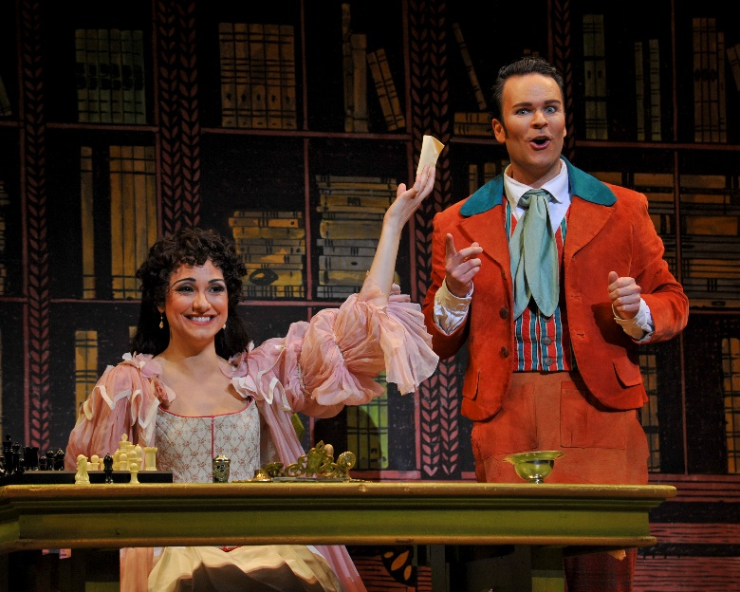
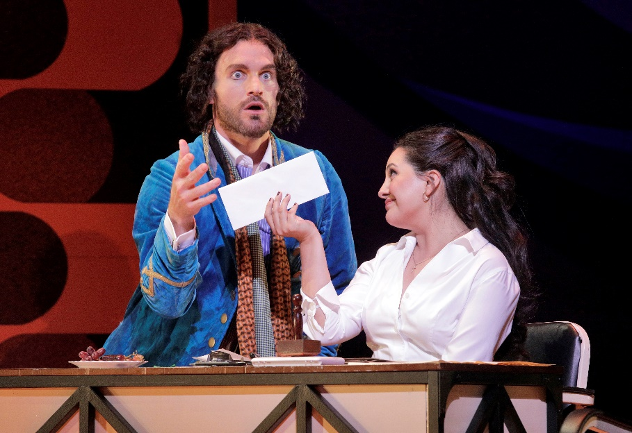
Key Scene #2
Act 1, Scene 7: Dunque io son… tu non m’inganni? (Then I am… you aren’t deceiving me?)
Knowing Count Almaviva only as Lindoro, Rosina writes to him. Dr. Bartolo becomes suspicious of Count Almaviva, and Basilio advises that Count Almaviva be put out of the way by creating false rumors about him. Figaro overhears this plan, warns Rosina, and promises to deliver a note from her to Lindoro—all in the interest of outsmarting Bartolo.
Il barbiere di Siviglia, Lyric Opera of Kansas City (photo: Karen Almond)
Il barbiere di Siviglia, Lyric Opera of Kansas City (photo: Cory Weaver)

Slide 8
Key Scene #2 continued
Met Opera on Demand: Track #17. ACT I: Dunque io son. Tu non m'inganni?
00:00 – 05:09
Act I: Dunque io son… tu non m’inganni?
1:01:23 – 1:06:32
Notes:
https://ondemand.metopera.org/performance/detail/8cf8263c-5fe8-5160-bd82-543d43648092
https://www.youtube.com/watch?v=Ztq4oIi8mW8

Slide 9
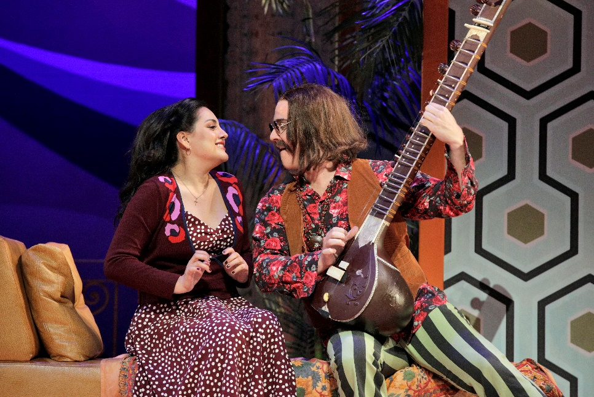
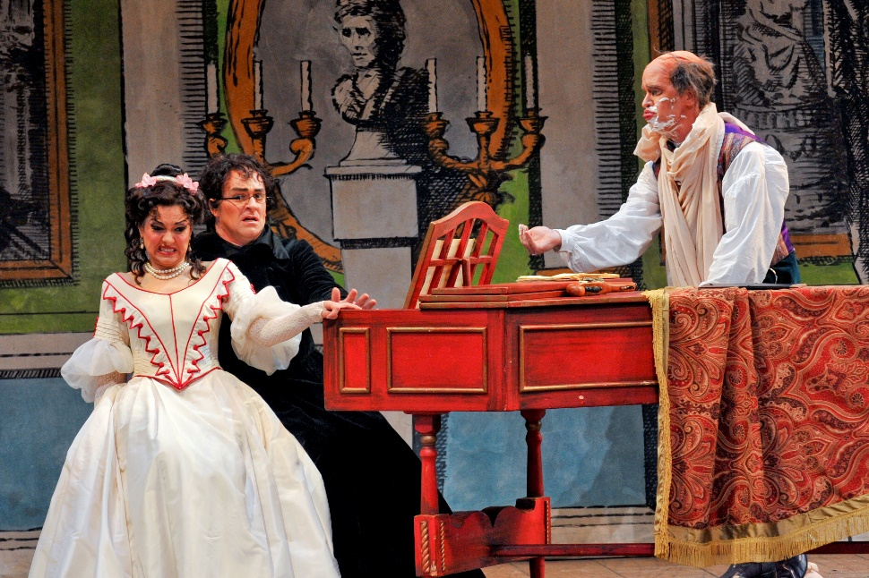
Key Scene #3
Act II, Scene 8: Contro un cor che accende amore (Against a heart inflamed with love)
Count Almaviva returns disguised as Don Alonso, a music teacher and student of Don Basilio, claiming that Basilio is sick at home. This disguise allows the Count to give Rosina her singing lesson, creating an opportunity for them to share a private moment, even with her suspicious guardian, Bartolo, present. Despite Bartolo’s efforts to control the situation, he is continually outwitted.
Il barbiere di Siviglia, Lyric Opera of Kansas City (photo: Cory Weaver)
Il barbiere di Siviglia, Lyric Opera of Kansas City (photo: Karen Almond)

Slide 10
Key Scene #3 continued
Met Opera on Demand: Track #27. ACT II: Contro un cor che accende amore
00:00 – 05:23
Act II: Contro un cor che accende amore
1:42:35 – 1:50:10
Notes:
https://ondemand.metopera.org/performance/detail/8cf8263c-5fe8-5160-bd82-543d43648092
https://www.youtube.com/watch?v=Ztq4oIi8mW8

Slide 11
Production Design Definitions
Production Design: The process of creating the visual aesthetic and environment for a film, television show, commercial, or other forms of media. It involves creating sets, props, as well as costumes, projections, and other visual elements that help bring the story to life and immerse the audience in the narrative. The Production Designer is responsible for overseeing the creation of these elements, working closely with the director, producers, and other key creatives to ensure that the visual style of the production aligns with the overall vision and tone of the project.

Slide 12
Production Design Definitions
Stage/Set Design: The art and practice of creating the physical environment in a theatrical production, film, television show, or other visual medium. This includes scenic elements and design layout for sets, lighting, props, and furniture to bring the story or concept to life. It involves arranging these elements in a way that enhances the audience's visual and aesthetic experience. Stage design may also involve creating technical elements such as sound systems, special effects, and rigging to support the production. Stage designers work closely with other production team members to create a cohesive and visually appealing environment complementing the production's overall vision.

Slide 13
Production Design Definitions
Props: A term commonly used in live performance and film production to refer to objects or items used on stage or on set to enhance the performance or scene. Props can include anything from furniture, decorations, weapons, hand-held objects, and more. Props are used to add realism and detail to a production and help bring the world of the play or film to life for the audience.

Slide 14
Production Design Definitions
Lighting Design: Refers to the art and practice of creating and controlling the lighting for a performance. This includes designing the placement and intensity of the lights and using different colors and effects to enhance the performance's mood and atmosphere. Lighting designers play a crucial role in enhancing the storytelling and emotional impact of the production, helping to set the stage, highlight performers, create a sense of place and time, and evoke different emotions in the audience. It is an integral part of the overall visual and artistic design of the production.

Slide 15
Production Design Definitions
Projection Design: The art of creating and manipulating projected images and videos to enhance the visual elements of a live event, such as a concert, theater production, dance performance, or installation. It involves using specialized software and hardware to project images, videos, or other visual content onto a surface, such as a screen, wall, or even the audience itself.

Slide 16
Production Design Definitions
Costume Design: The process of creating costumes and outfits for characters in theatre, film, television, or other visual media. It involves researching the time-period, setting, and character traits to develop pieces that help bring the character to life. Costume designers work closely with directors, actors, and other production team members to ensure that the costumes accurately reflect the vision of the production. This can involve sourcing or creating garments, accessories, and props, as well as coordinating fittings and alterations. Costume design plays a crucial role in storytelling and character development, helping to enhance the overall visual and emotional impact of a production.

Slide 17
Production Design Definitions
Hair and Makeup Design: Refers to the planning and execution of hairstyles and makeup looks for performers and actors. This creative process involves analyzing the characters or themes in the performance, researching historical or cultural references, and designing hair and makeup that enhances the overall aesthetic and storytelling of the production. Hair and makeup designers work closely with directors, costume designers, and performers to create a cohesive and visually impactful presentation on stage or screen.

Slide 18
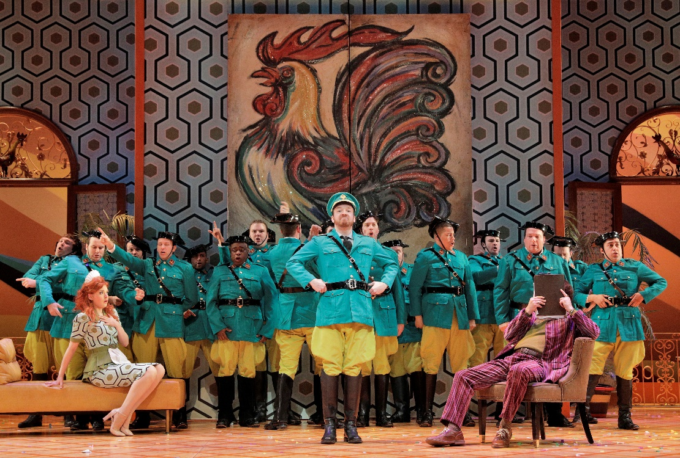
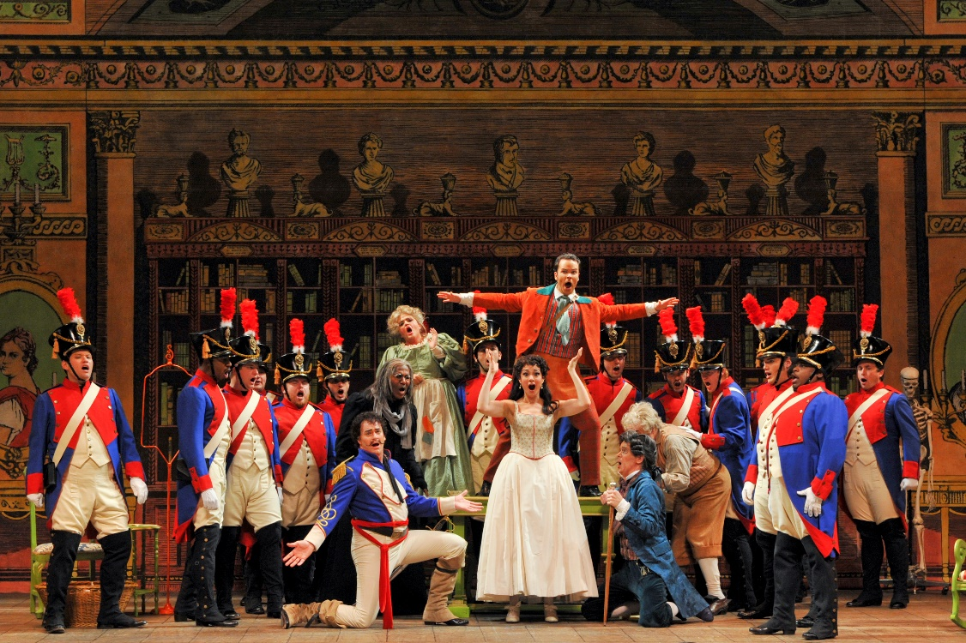
Production Design
Il barbiere di Siviglia, Lyric Opera of Kansas City (photo: Cory Weaver)
Il barbiere di Siviglia, Lyric Opera of Kansas City (photo: Karen Almond)

Slide 19
Elements of Design
Color
Line
Shape
Texture
Form
Space
Value
Pattern

Slide 20
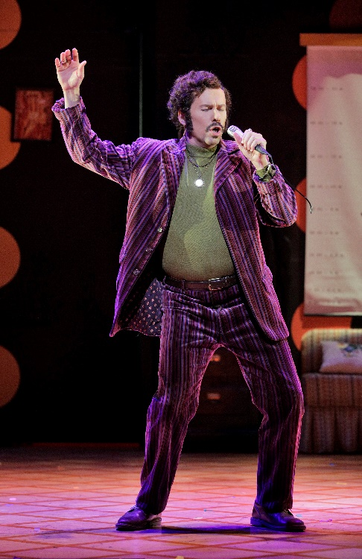
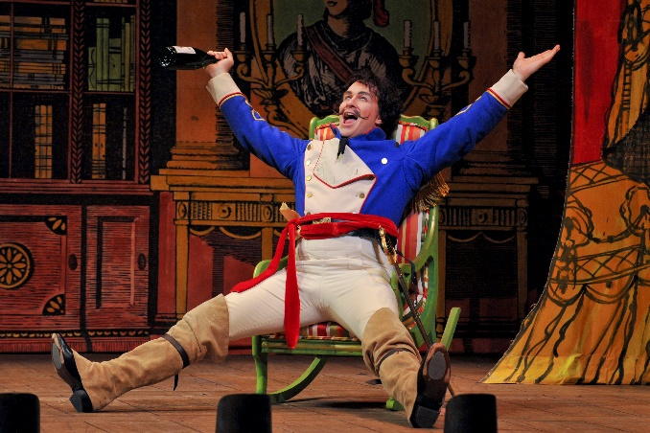
Elements of Design
Il barbiere di Siviglia, Lyric Opera of Kansas City (photos: Karen Almond)
Il barbiere di Siviglia, Lyric Opera of Kansas City (photos: Cory Weaver)
Note the following elements of design:
Color and texture in costumes
Lines, shapes, patterns in background scenery
The space the characters are in

Slide 21
Production Design Guidelines
Consider all that was discussed when designing your production: color, mood, textures, spaces/places, etc.
Production design should include:
Set and costume designs based on your opera adaptation pitch
At least 3 elements of design in your work

Slide 22
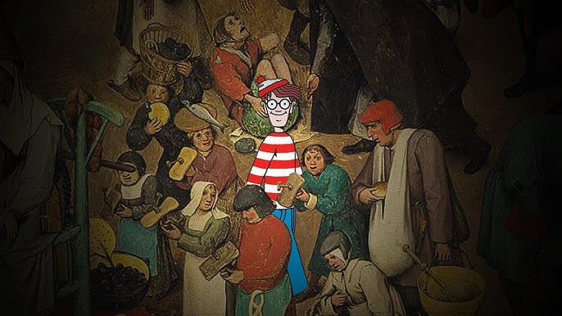
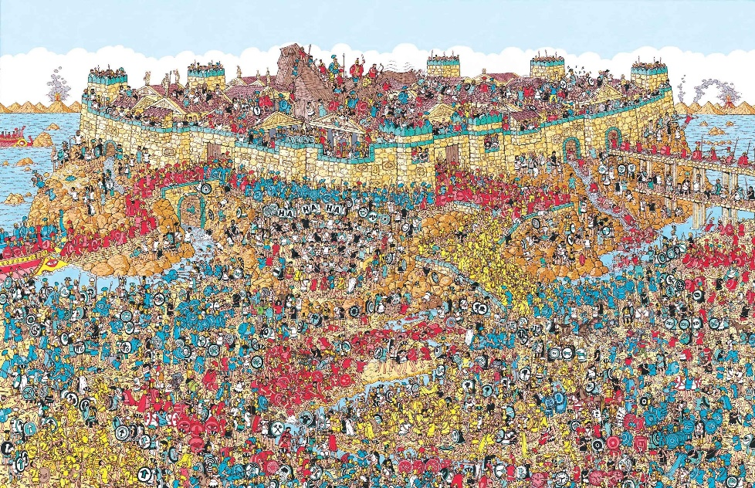
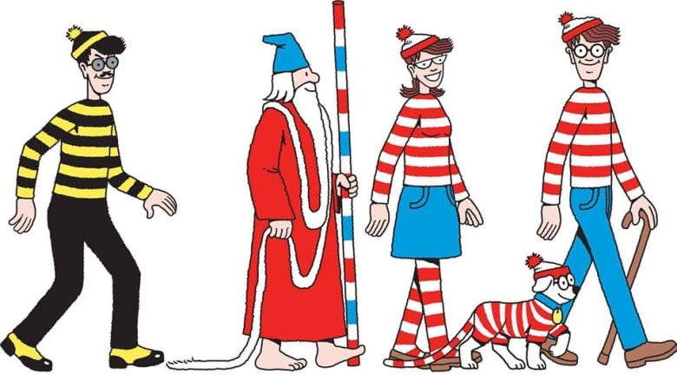
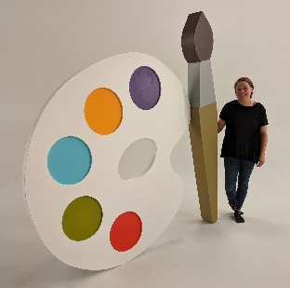
Production Design Examples
Where’s Waldo?-inspired production of The Barber of Seville
Cartoon look juxtaposed against classic interior of Bartolo’s home.
Characters in bright, bold colors and striped costumes; the Count’s disguises achieved by using layers (i.e., mustache, hat, glasses).
Scenic backdrop of square in Seville, heavily-populated and vibrant; projections used to show subtle “bustle” of town.
Oversized, and child-like props.

Slide 23
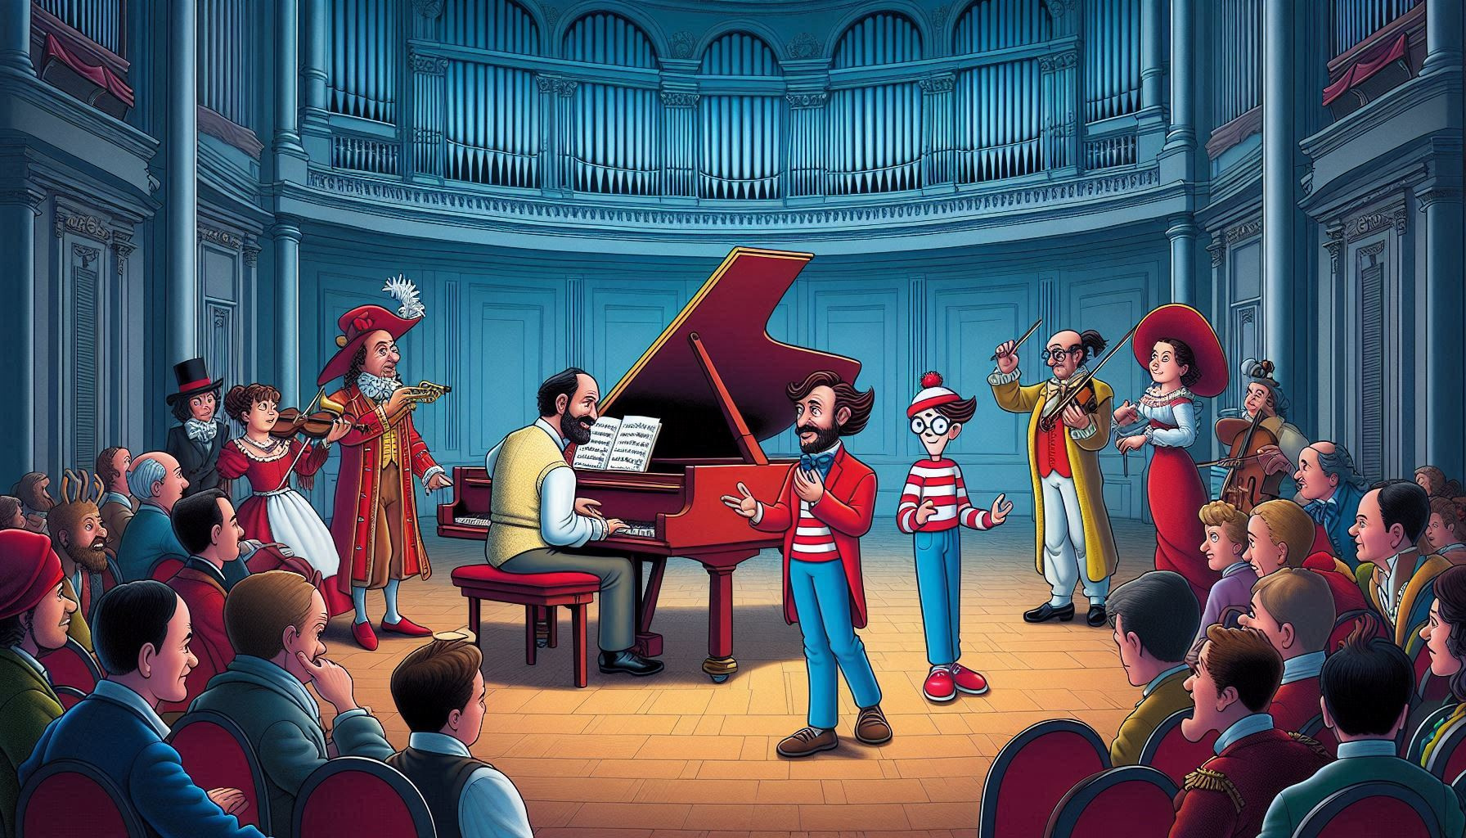
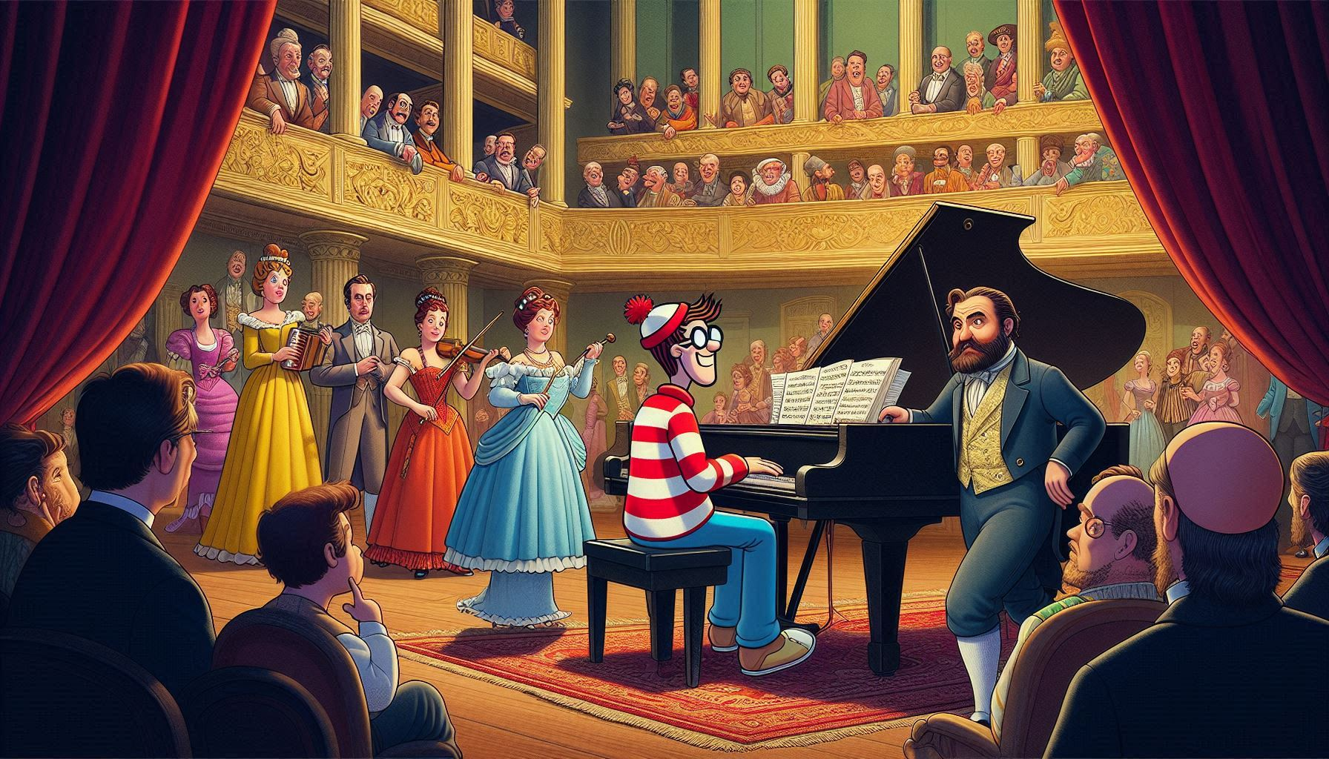
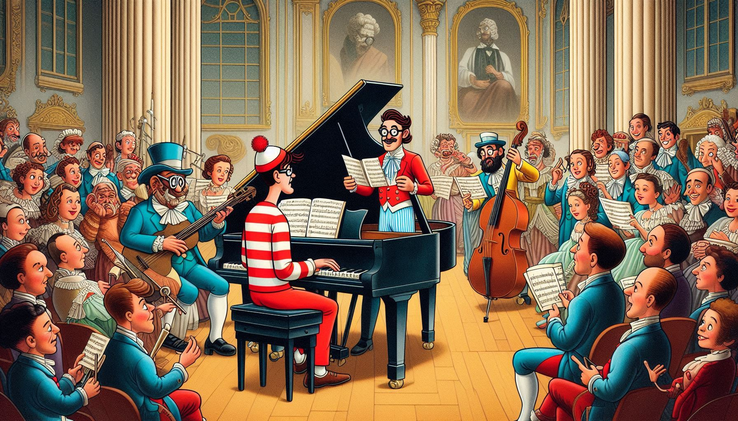
Production Design Examples
Images generated using AI
Act II, Scene 8 - singing lesson scene

Slide 24
Production Design Questionnaire
What are the reasons behind your choices? Are your choices based on the music, story, or libretto, and/or a combination of these?
How are you visually representing the time and location?
How are you visually communicating mood and emotion?

Slide 25
Present

Slide 26
Reflection
Share thoughts on the production design process.
How has your experience with adapting a story visually change your perspective on storytelling or your approach to developing ideas?

