Slide 1
Exploring Story Adaptation
Enriching the Humanities Through Opera
Made possible by the generous support from the

Slide 2
What is story adaptation and how is it relevant to opera?
Today’s Objectives:
Analyze an opera synopsis based on a literary work.
Compare a literary work with the opera adaptation synopsis.
Identify elements of adaptation across multiple versions of the same key scene present in the literary source and opera.
Collaboratively brainstorm a pitch for an opera adaptation of the literary work.

Slide 3
Write down the first word that comes to mind.
Opera
Malcolm X
Adaptation

Slide 4
Timeline of Malcolm X’s Life
Malcolm Little was born in Omaha in 1925
As a class, complete timeline of major events in Malcolm X’s life.

Slide 5
X: The Life and Times of Malcolm X Synopsis
The opera presents 12 vignettes from the life of Malcolm X, from youth to his death: abject poverty in Depression-era Lansing to adolescence in Boston to Mecca (the site of his pivotal hajj, the traditional Muslim pilgrimage), as well as a number of places in New York City, including a mosque, the streets of Harlem, and, finally, the site of his assassination in 1965, the Audubon Ballroom and West 165th Street.

Slide 6
Talk & Turn
Compare the opera synopsis with the timeline created and The Autobiography of Malcolm X.
What events did the librettist choose to include and what did they leave out?
Is there a difference in point of view? In historical context? In narrative structure?
What else did you notice?

Slide 7
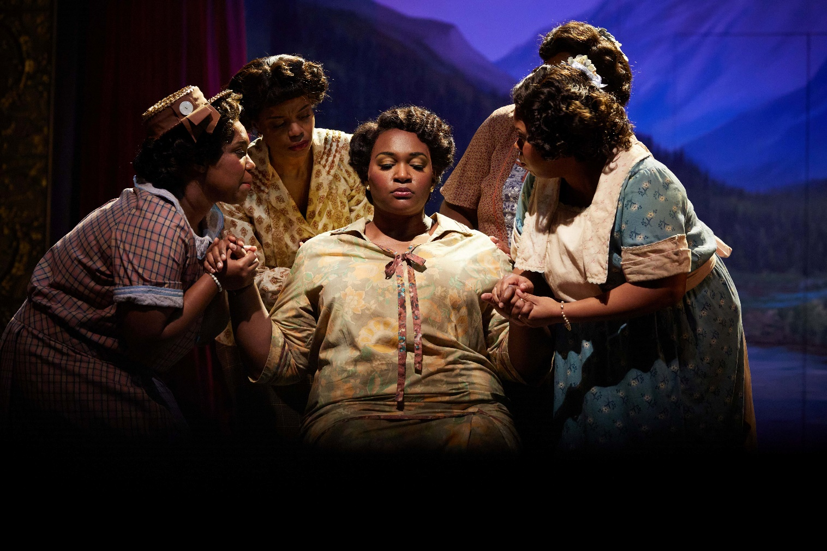
Key Scene #1: Act I, Scene 1: A man was on the tracks (Reverand Little is Dead)
The police arrive at the Little family home with news that Reverend Little, Malcolm’s father, was found dead on the train tracks. A family friend breaks the news to Louise Little.
X: The Life and Times of Malcolm X, Seattle Opera (photo: Philip Newton)
Notes:
https://ondemand.metopera.org/performance/detail/d15c1abe-32a4-598b-a775-8c419741e411

Slide 8
Key Scene #1 continued
Met Opera on Demand: Track #6. Act I: A man was on the tracks (Reverand Little is Dead)
00:00 – 02:43
Notes:
https://ondemand.metopera.org/performance/detail/d15c1abe-32a4-598b-a775-8c419741e411

Slide 9
Key Scene #2: Act II, Scene 2: You are not empty
After studying the Koran and the teachings of the Nation of Islam during his time in prison, Malcolm leaves and meets with the leader of the Nation, Elijah Muhammed. Elijah tells Malcolm to denounce his last name inherited from a history of enslavement and replace it with an X. Thus, Malcolm X is born.
X: The Life and Times of Malcolm X, Seattle Opera (photo: Philip Newton)

Slide 10
Key Scene #2 continued
Met Opera on Demand: Track #16. ACT II: You are not empty
00:00 – 5:45
Notes:
https://ondemand.metopera.org/performance/detail/d15c1abe-32a4-598b-a775-8c419741e411

Slide 11
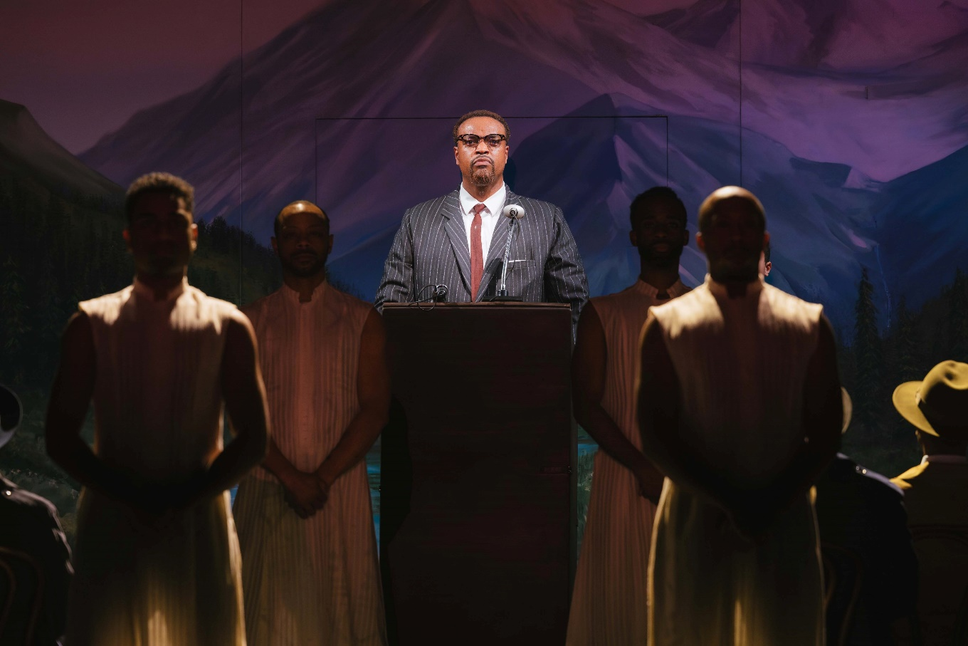
Key Scene #3: Act III, Scene 4: I have learned so much in Africa
Not long before his assassination, Malcolm X speaks to his newly founded Organization of Afro-American Unity. He shares what he learned in Africa—that their struggle connects to a larger, global fight against colonialism and racism. Though he’s warned of threats against his life, Malcolm stands firm, unaffected by the fear surrounding him.
Production photos courtesy of Seattle Opera
X: The Life and Times of Malcolm X, Seattle Opera (photo: Sunny Martini)

Slide 12
Key Scene #3 continued
Met Opera on Demand: Track #30. ACT III: I have learned so much in Africa
00:00 – 5:39
Notes:
https://ondemand.metopera.org/performance/detail/d15c1abe-32a4-598b-a775-8c419741e411

Slide 13
Adaptation Discussion
Why do we adapt stories?
Should we adapt a story based on historical events and figures? Why or why not?
Is Malcolm’s story still relevant today?
Can Malcolm’s story be set in the present?

Slide 14
Adaptation Guidelines
Adapting the Who, What, When, and Where.
Who: character/character identity
Note: character identity can be adapted, but characters may not be eliminated or added.
What: key scene, action in the story - what is happening?
When: time period, time of day, year, etc.
Where: location and setting

Slide 15
Adaptation Pitch
Who (characters in the scene):
What (scene action):
When (time period, time of year/day):
Where (location/setting):
Why did you choose to adapt the opera this way?
How will these changes affect the rest of the story?

Slide 16
Present

Slide 17
Reflection
Share thoughts on the story adaptation pitch process.
How did your understanding of Malcolm X change as you adapted it?
Were there any new insights or perspectives that emerged?

