Slide 1
Exploring Story Adaptation
Enriching the Humanities Through Opera
Made possible by the generous support from the

Slide 2
What is story adaptation and how is it relevant to opera?
Today’s Objectives:
Analyze an opera synopsis based on a literary work.
Compare a literary work with the opera adaptation synopsis.
Identify elements of adaptation across multiple versions of the same key scene present in the literary source and opera.
Collaboratively brainstorm a pitch for an opera adaptation of the literary work.

Slide 3
Write down the first word that comes to mind.
Opera
The Barber of Seville
Adaptation

Slide 4
Story Arc Review
Climax
Falling Action
Rising Action
Resolution
Exposition

Slide 5
Il barbiere di Siviglia Synopsis
In the opera Il barbiere di Siviglia, the clever and resourceful barber Figaro helps Count Almaviva win the heart of Rosina, who is closely watched by her overbearing guardian, Dr. Bartolo. The Count, desiring to be loved for who he truly is rather than for his wealth, has assumed the identity of a poor student named Lindoro to win her affection. Through a series of disguises and clever schemes, Count Almaviva reveals his true identity to Rosina, and they plan to marry. Despite Bartolo's attempts to thwart them, Figaro's wit and cunning ultimately ensure a happy ending for the young lovers.

Slide 6
Talk & Turn
Compare the story structure of The Barber of Seville, the literary work and opera.
Is the setting/time period the same for both the opera and literary work?
Is there a difference in point of view? In historical context? In narrative structure?
What else did you notice?

Slide 7
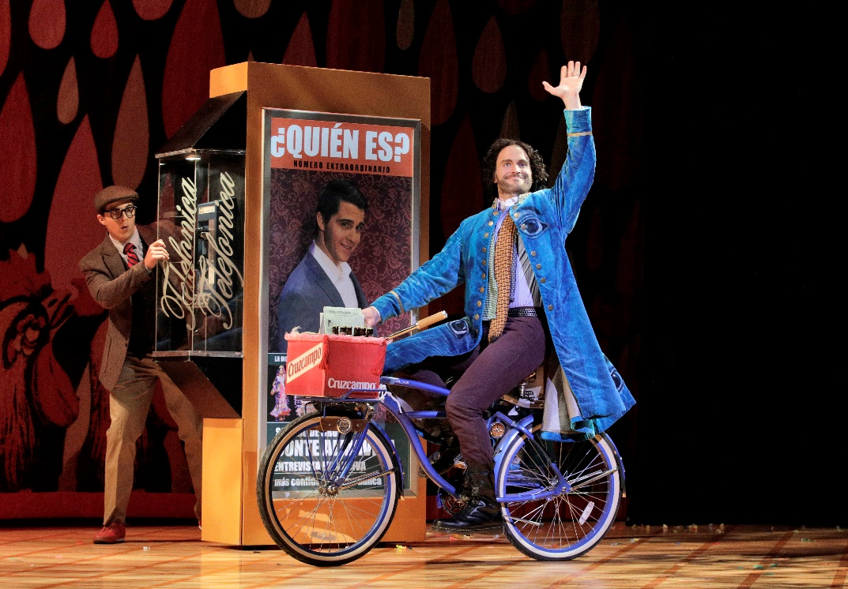
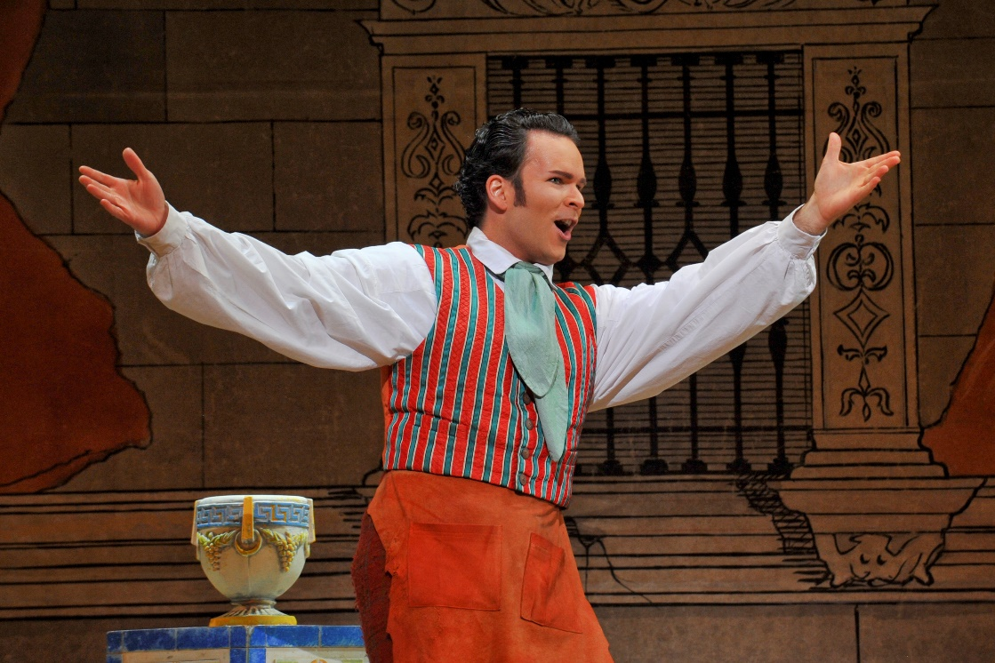
Key Scene #1
Act I, Scene 2: Largo al factotum della città (Make way for the factotum of the city)
Figaro’s entrance, the town's barber, factotum (an employee who does all kinds of work), and general busybody. Figaro proudly sings of his charmed life, where he serves as a go-between, tonsorial expert, matchmaker, and much more, eventually leading to Count Almaviva overhearing him and seeking his assistance.
Il barbiere di Siviglia, Lyric Opera of Kansas City (photo: Cory Weaver)
Il barbiere di Siviglia, Lyric Opera of Kansas City (photo: Karen Almond)

Slide 8
Key Scene #1 continued
Met Opera on Demand: Track #8. ACT I: Largo al factotum & Track # 9. ACT I: Ah, ah! Che bella vita!
#8. 02:37 – 05:02 into #9. 00:00 – 00:43
Act I, Scene 2: Largo al factotum della città
20:39 – 23:32
Notes:
https://ondemand.metopera.org/performance/detail/8cf8263c-5fe8-5160-bd82-543d43648092
https://www.youtube.com/watch?v=Ztq4oIi8mW8

Slide 9
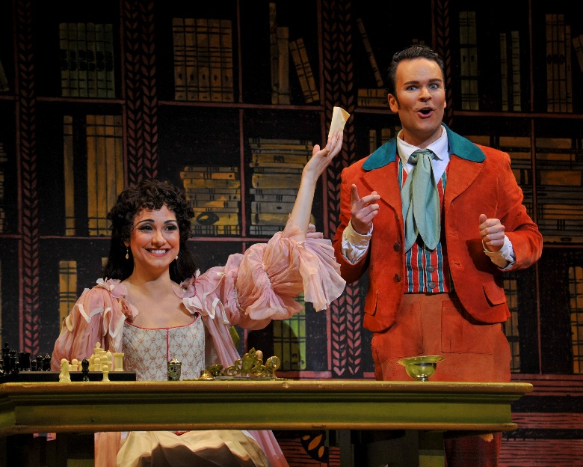
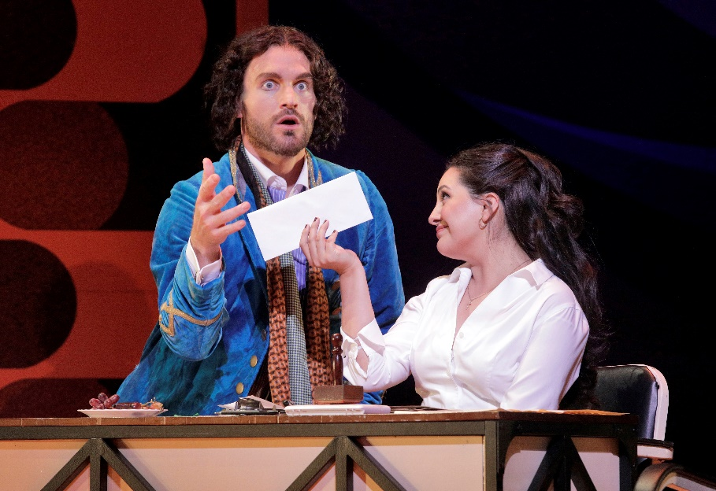
Key Scene #2
Act 1, Scene 7: Dunque io son… tu non m’inganni? (Then I am… you aren’t deceiving me?)
Knowing Count Almaviva only as Lindoro, Rosina writes to him. Dr. Bartolo becomes suspicious of Count Almaviva, and Basilio advises that Count Almaviva be put out of the way by creating false rumors about him. Figaro overhears this plan, warns Rosina, and promises to deliver a note from her to Lindoro—all in the interest of outsmarting Bartolo.
Il barbiere di Siviglia, Lyric Opera of Kansas City (photo: Karen Almond)
Il barbiere di Siviglia, Lyric Opera of Kansas City (photo: Cory Weaver)

Slide 10
Key Scene #2 continued
Met Opera on Demand: Track #17. ACT I: Dunque io son. Tu non m'inganni?
00:00 – 05:09
Act I: Dunque io son… tu non m’inganni?
1:01:23 – 1:06:32
Notes:
https://ondemand.metopera.org/performance/detail/8cf8263c-5fe8-5160-bd82-543d43648092
https://www.youtube.com/watch?v=Ztq4oIi8mW8

Slide 11
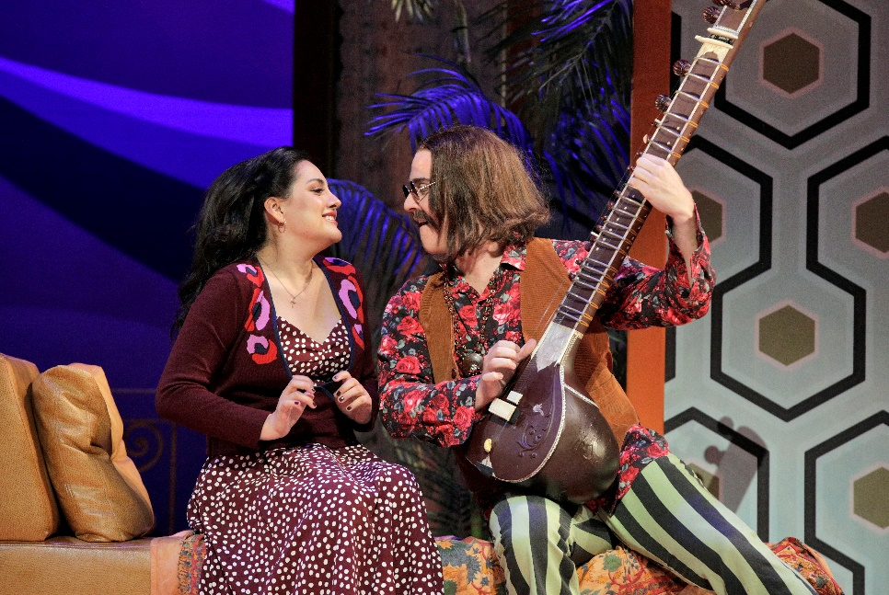
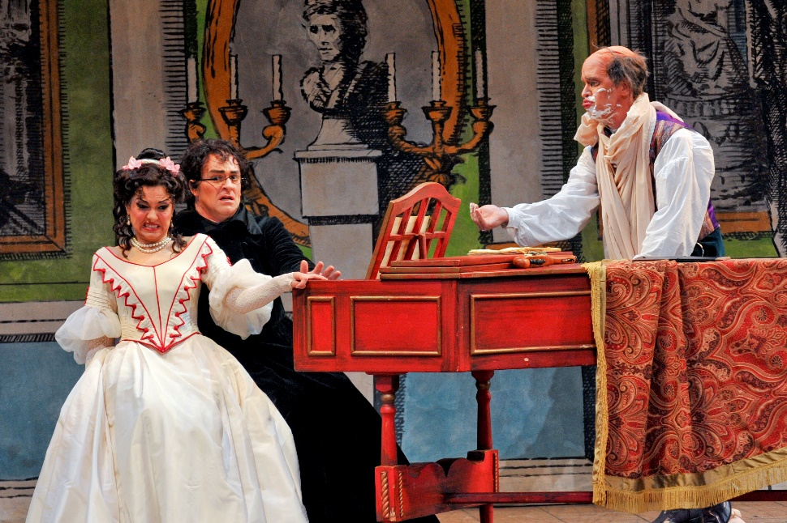
Key Scene #3
Act II, Scene 8: Contro un cor che accende amore (Against a heart inflamed with love)
Count Almaviva returns disguised as Don Alonso, a music teacher and student of Don Basilio, claiming that Basilio is sick at home. This disguise allows the Count to give Rosina her singing lesson, creating an opportunity for them to share a private moment, even with her suspicious guardian, Bartolo, present. Despite Bartolo’s efforts to control the situation, he is continually outwitted.
Il barbiere di Siviglia, Lyric Opera of Kansas City (photo: Cory Weaver)
Il barbiere di Siviglia, Lyric Opera of Kansas City (photo: Karen Almond)

Slide 12
Key Scene #3 continued
Met Opera on Demand: Track #27. ACT II: Contro un cor che accende amore
00:00 – 05:23
Act II: Contro un cor che accende amore
1:42:35 – 1:50:10
Notes:
https://ondemand.metopera.org/performance/detail/8cf8263c-5fe8-5160-bd82-543d43648092
https://www.youtube.com/watch?v=Ztq4oIi8mW8

Slide 13
Why do we adapt stories?

Slide 14
Adaptation Guidelines
Adapting the Who, What, When, and Where.
Who: character/character identity
Note: character identity can be adapted, but characters may not be eliminated or added.
What: key scene, action in the story - what is happening?
When: time period, time of day, year, etc.
Where: location and setting

Slide 15
Adaptation Pitch
Who (characters in the scene):
What (scene action):
When (time period, time of year/day):
Where (location/setting):
Why did you choose to adapt the opera this way?
How will these changes affect the rest of the story?

Slide 16
Present

Slide 17
Reflection
Share thoughts on the story adaptation pitch process.
How did your understanding of the story change as you adapted it?
Were there any new insights or perspectives that emerged?

