Slide 1
Production Design Adaptation
Enriching the Humanities Through Opera
Made possible by the generous support from the

Slide 2
How does production and visual design aid in storytelling?
Today’s Objectives:
Respond to the musical and storytelling elements of opera to develop criteria for visual artistic choices.
Refine an adaptation pitch to demonstrate critical understanding of the visual elements of production design and opera to tell a story.
Create visual representations of set and costume designs based on opera adaptation pitches.

Slide 3
Listening Activity
As you listen to the music, write down any colors, mood, spaces/places, textures, foods, etc. you can associate with the music.
Act I
03:28 – 05:30
Notes:
https://ny.pbslearningmedia.org/resource/romeo-juliette-metropolitan-opera/romeo-juliette-metropolitan-opera/

Slide 4
Roméo et Juliette Synopsis
The opera Roméo et Juliette, based on Shakespeare's play, tells the story of Romeo and Juliet, two teenagers from the feuding Montague and Capulet families. They meet at a ball, fall in love, and secretly marry, knowing their families will never approve. After Romeo kills Juliet’s cousin in a street fight, he is forced into hiding to escape the Capulets' vengeance. Meanwhile, Juliet fakes her own death to avoid an arranged marriage, but the plan goes tragically wrong. Within a few days, the drama culminates in the tragic deaths of both Romeo and Juliet.

Slide 5
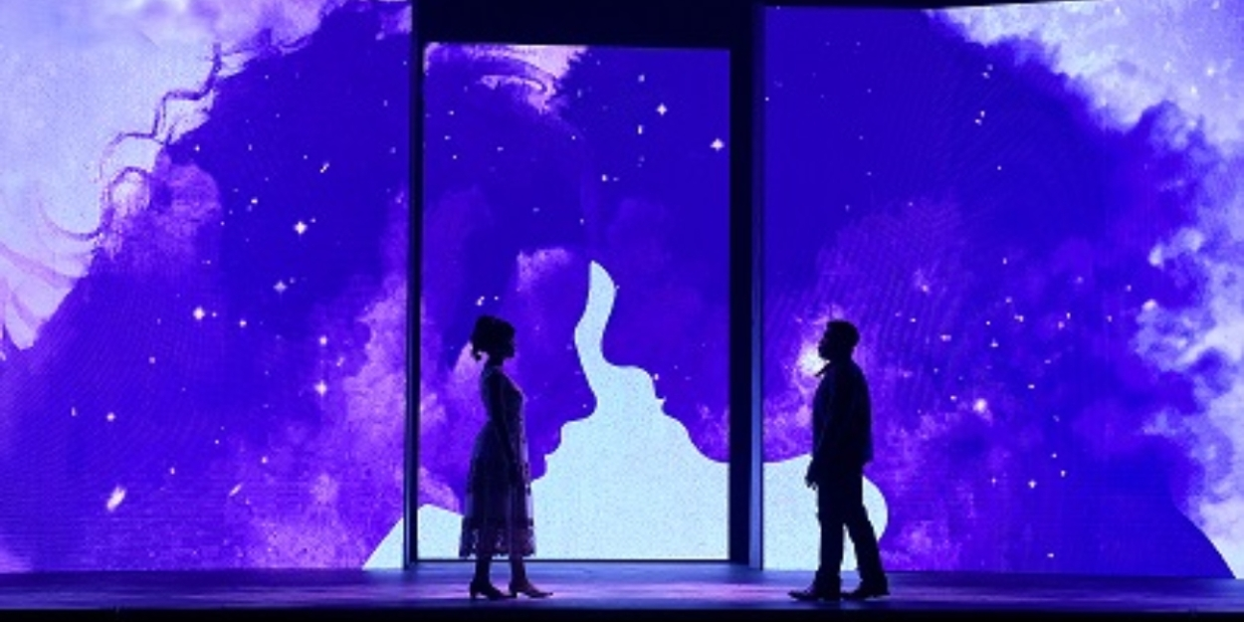
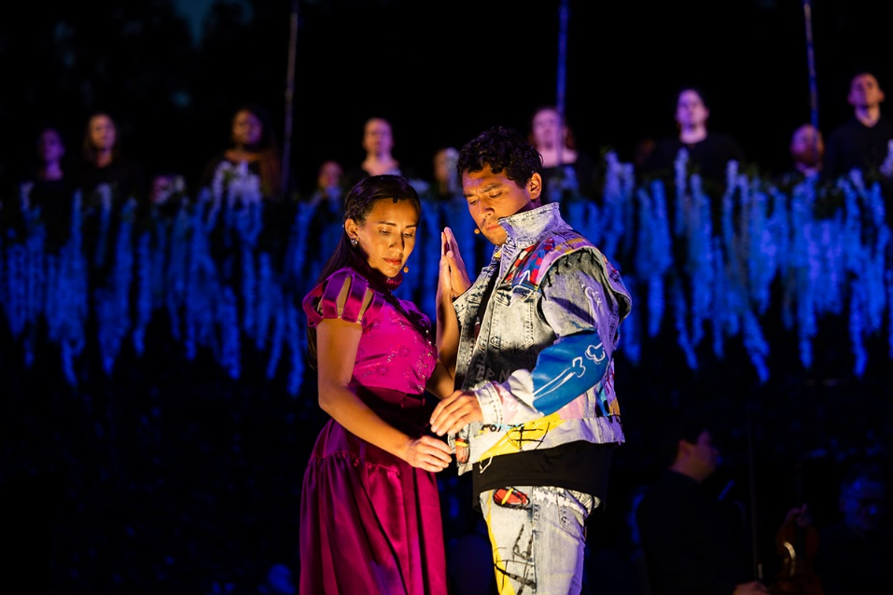
Key Scene #1
Act I: Scene 1, No. 4 - Romeo and Juliet meet
Romeo and Juliet meet at the ball and are both captivated by each other. Romeo, being more experienced, tries to woo Juliet, while Juliet, who is more innocent, is intrigued by Romeo despite the conflict with her beliefs.
Romeo and Juliet, Arizona Opera (photo: Tim Trumble)
Romeo & Juliet, Boston Lyric Opera (photo: Nile Scott)

Slide 6
Key Scene #1 continued
Met Opera on Demand: Track #15. ACT I: Ange adorable
00:00 – 04:43
PBS LearningMedia™ : Roméo et Juliette | Act I | The Metropolitan Opera
32:21 – 37:04
Notes:
https://ondemand.metopera.org/performance/detail/b89905e1-e418-5550-aacb-b3516ef9121a
https://ny.pbslearningmedia.org/resource/romeo-juliette-metropolitan-opera/romeo-juliette-metropolitan-opera/

Slide 7
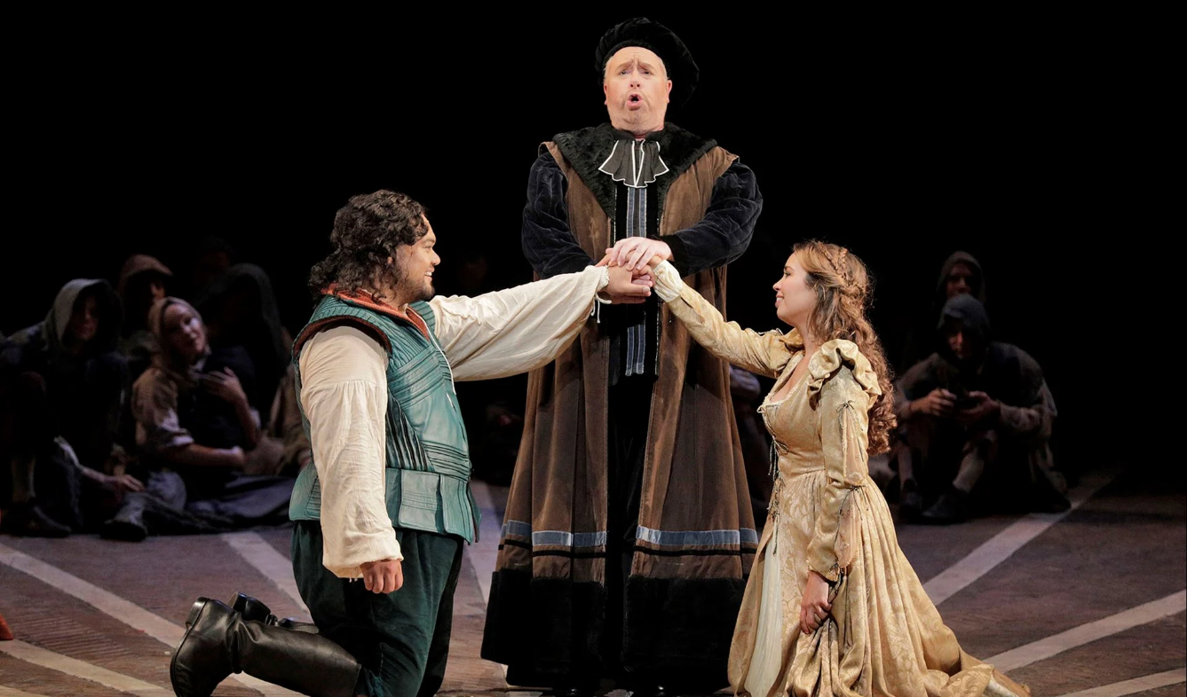
Key Scene #2
Act III: Scene 1, No. 10 - Meeting Friar Laurence
As Romeo and Juliet’s romance has developed very quickly, Friar Laurence mistakes Romeo’s lovesick behavior for feelings toward his former lover, Rosaline. Although Friar Lawrence knows he should not, he performs the marriage of Juliet and Romeo in the hope that their union will end the fighting between their families.
Romeo and Juliet, San Francisco Opera (photo: courtesy of San Francisco Opera)

Slide 8
Key Scene #2 continued
Met Opera on Demand: Track #27. ACT III: Mon père! Dieu vous garde!
00:00 – 03:32
PBS LearningMedia™ : Roméo et Juliette | Act III | The Metropolitan Opera
1:43 – 5:30
Notes:
https://ondemand.metopera.org/performance/detail/b89905e1-e418-5550-aacb-b3516ef9121a
https://ny.pbslearningmedia.org/resource/romeo-juliette-metropolitan-opera/romeo-juliette-metropolitan-opera/

Slide 9
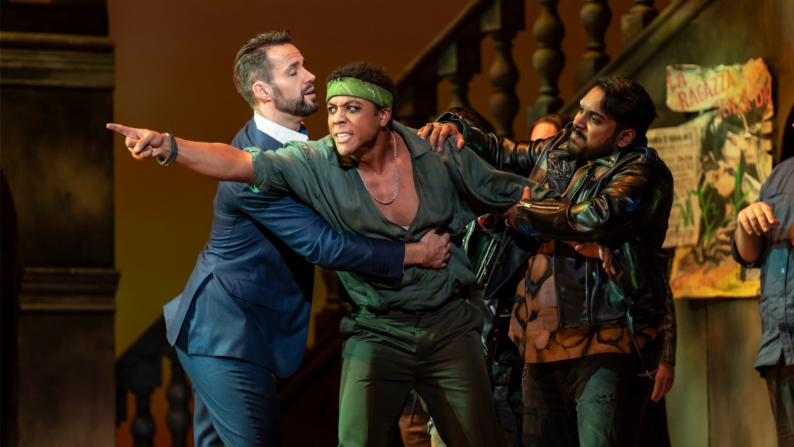
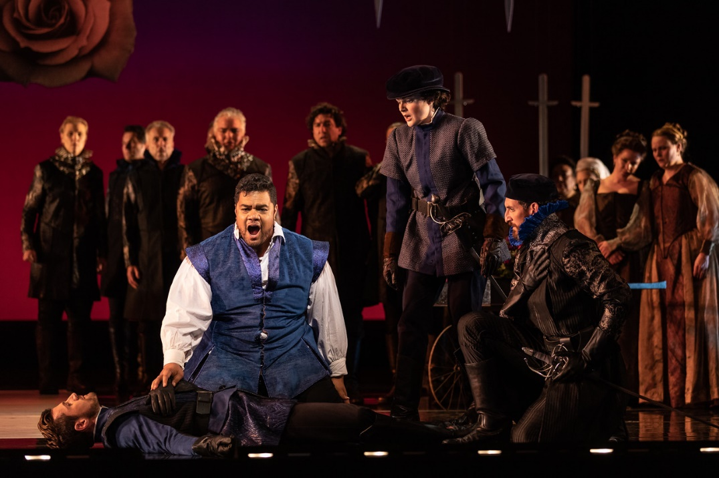
Key Scene #3
Act III: Scene 2, No. 13 - Romeo kills Tybalt
At the climax of the opera, a fierce street fight erupts between the two rival families. Romeo, desperate to stop the violence, pleads for peace, but neither side listens. During the chaos, Romeo’s best friend, Mercutio, is killed by Juliet’s cousin, Tybalt. Overcome with grief and rage, Romeo seeks revenge and kills Tybalt. This act seals Romeo’s fate, deepening the Capulets' hatred for him and leading to his exile.
Roméo et Juliette, Washington National Opera (photo: Scott Suchman)
Roméo et Juliette, San Diego Opera (photo: Karli Cadel)

Slide 10
Key Scene #3 continued
Met Opera on Demand: Track #32. ACT III: Allons! tu ne me connais pas, Tybalt,
00:06 – 05:39
PBS LearningMedia™ : Roméo et Juliette | Act III | The Metropolitan Opera
19:33 – 25:04
Notes:
https://ondemand.metopera.org/performance/detail/b89905e1-e418-5550-aacb-b3516ef9121a
https://ny.pbslearningmedia.org/resource/romeo-juliette-metropolitan-opera/romeo-juliette-metropolitan-opera/

Slide 11
Production Design Definitions
Production Design: The process of creating the visual aesthetic and environment for a film, television show, commercial, or other forms of media. It involves creating sets, props, as well as costumes, projections, and other visual elements that help bring the story to life and immerse the audience in the narrative. The Production Designer is responsible for overseeing the creation of these elements, working closely with the director, producers, and other key creatives to ensure that the visual style of the production aligns with the overall vision and tone of the project.

Slide 12
Production Design Definitions
Stage/Set Design: The art and practice of creating the physical environment in a theatrical production, film, television show, or other visual medium. This includes scenic elements and design layout for sets, lighting, props, and furniture to bring the story or concept to life. It involves arranging these elements in a way that enhances the audience's visual and aesthetic experience. Stage design may also involve creating technical elements such as sound systems, special effects, and rigging to support the production. Stage designers work closely with other production team members to create a cohesive and visually appealing environment complementing the production's overall vision.

Slide 13
Production Design Definitions
Props: A term commonly used in live performance and film production to refer to objects or items used on stage or on set to enhance the performance or scene. Props can include anything from furniture, decorations, weapons, hand-held objects, and more. Props are used to add realism and detail to a production and help bring the world of the play or film to life for the audience.

Slide 14
Production Design Definitions
Lighting Design: Refers to the art and practice of creating and controlling the lighting for a performance. This includes designing the placement and intensity of the lights and using different colors and effects to enhance the performance's mood and atmosphere. Lighting designers play a crucial role in enhancing the storytelling and emotional impact of the production, helping to set the stage, highlight performers, create a sense of place and time, and evoke different emotions in the audience. It is an integral part of the overall visual and artistic design of the production.

Slide 15
Production Design Definitions
Projection Design: The art of creating and manipulating projected images and videos to enhance the visual elements of a live event, such as a concert, theater production, dance performance, or installation. It involves using specialized software and hardware to project images, videos, or other visual content onto a surface, such as a screen, wall, or even the audience itself.

Slide 16
Production Design Definitions
Costume Design: The process of creating costumes and outfits for characters in theatre, film, television, or other visual media. It involves researching the time-period, setting, and character traits to develop pieces that help bring the character to life. Costume designers work closely with directors, actors, and other production team members to ensure that the costumes accurately reflect the vision of the production. This can involve sourcing or creating garments, accessories, and props, as well as coordinating fittings and alterations. Costume design plays a crucial role in storytelling and character development, helping to enhance the overall visual and emotional impact of a production.

Slide 17
Production Design Definitions
Hair and Makeup Design: Refers to the planning and execution of hairstyles and makeup looks for performers and actors. This creative process involves analyzing the characters or themes in the performance, researching historical or cultural references, and designing hair and makeup that enhances the overall aesthetic and storytelling of the production. Hair and makeup designers work closely with directors, costume designers, and performers to create a cohesive and visually impactful presentation on stage or screen.

Slide 18
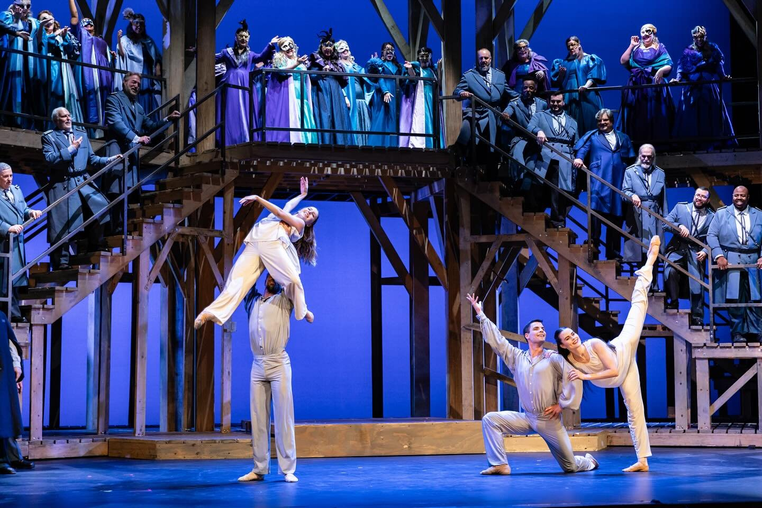
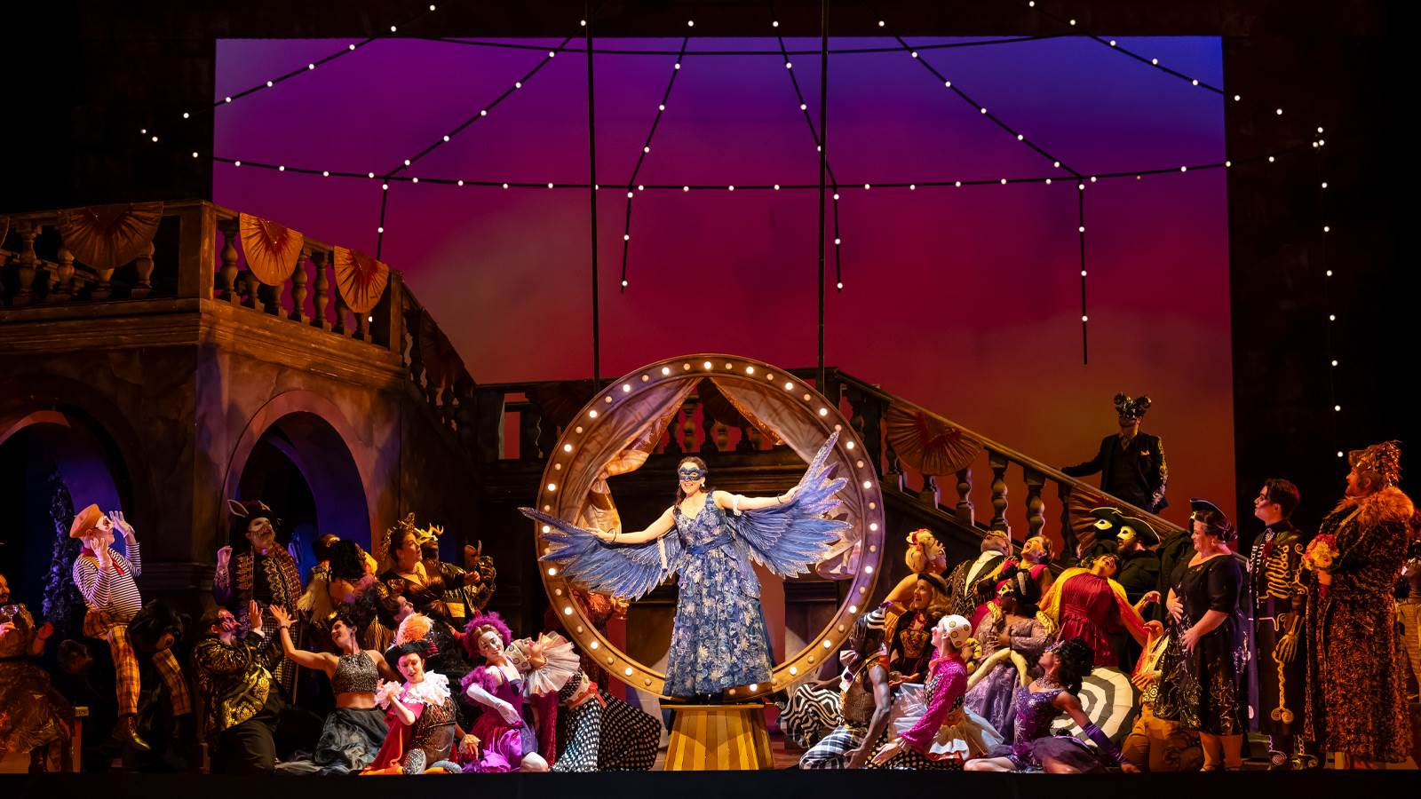
Production Design
Act I: The Capulet’s ball.
National Center for Performing Arts, China Romeo et Juliette
Roméo et Juliette, Washington National Opera (photo: Scott Suchman) Opera)
Romeo and Juliet, The Dallas Opera (photo: Karen Almond and Kyle Flubacker)

Slide 19
Elements of Design
Color
Line
Shape
Texture
Form
Space
Value
Pattern

Slide 20
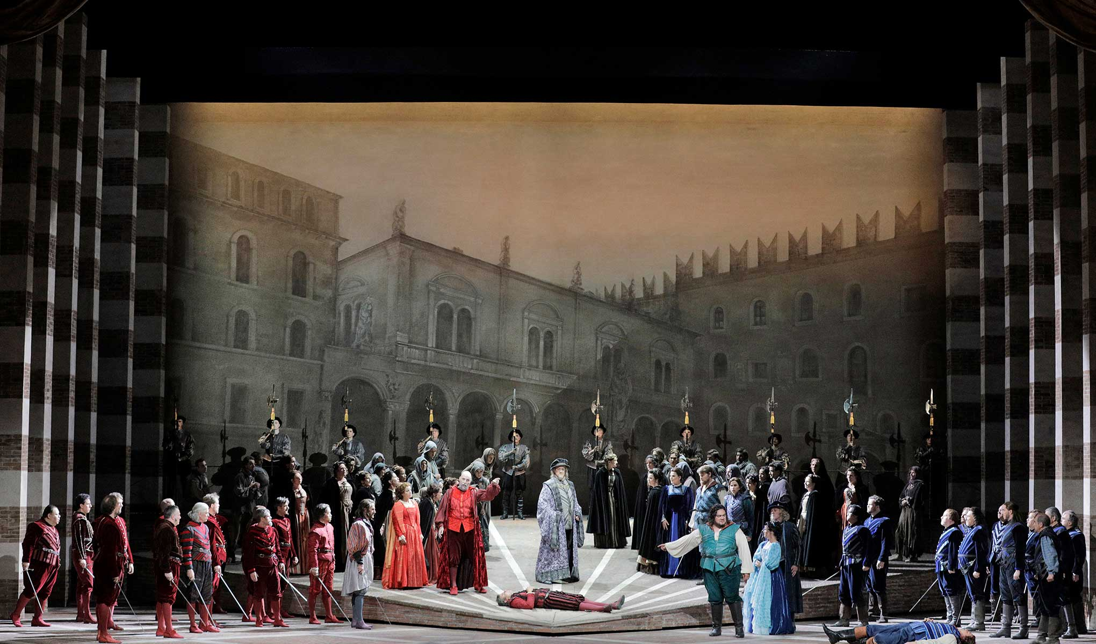
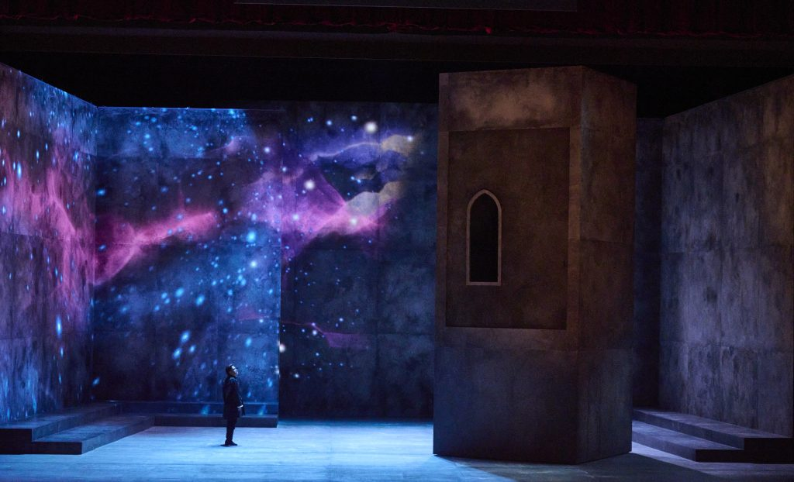
Elements of Design
Romeo & Juliet Boston Lyric Opera
Roméo & Juliette, Arizona Opera (photo: Tim Trumble)
Romeo and Juliet, San Francisco Opera (photo: courtesy of San Francisco Opera)
Space and Texture:
With the tower balcony as the only physical element, the stage feels spacious. Projections of stars and sky add texture, creating a dark yet dreamy, otherworldly atmosphere.
Color and Line:
The two families’ contrasting costumes of red and blue provide the only color and pop against the neutrals in the set, soldiers, and townspeople costumes. The element of line is used to frame the set and bring focus to the center of the stage.

Slide 21
Production Design Guidelines
Consider all that was discussed when designing your production: color, mood, textures, spaces/places, etc.
Production design should include:
Set and costume designs based on your opera adaptation pitch
At least 3 elements of design in your work

Slide 22
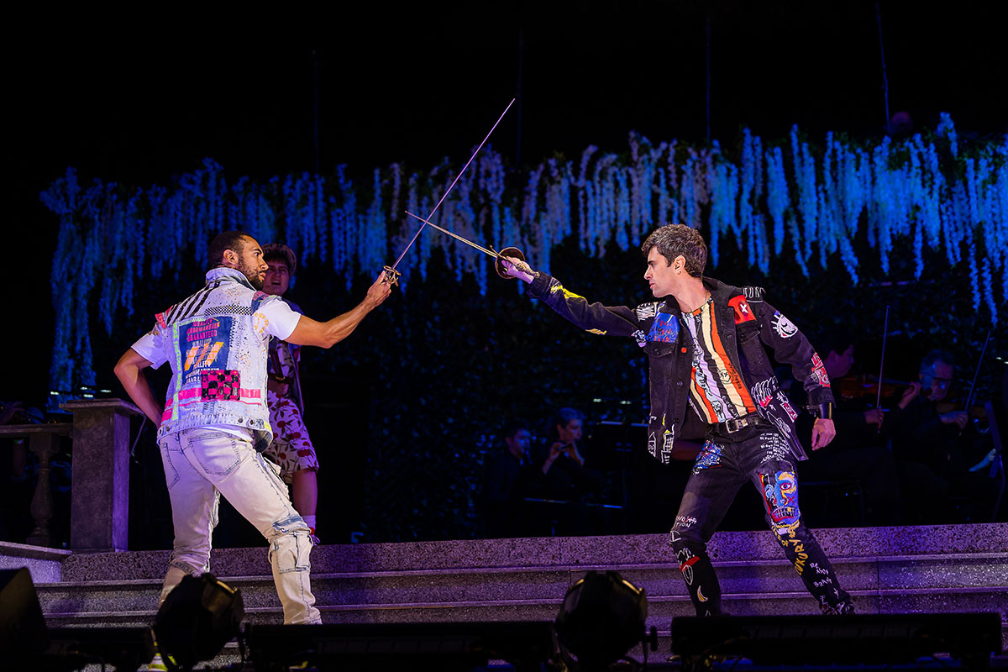
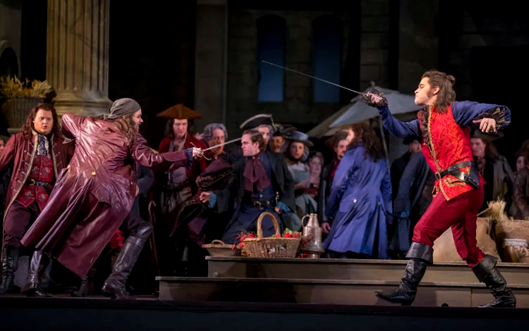
Production Design Examples
Act III: Scene 2, No. 13 - Mercutio and Tybalt dueling, before Romeo steps in.
Romeo & Juliet, Boston Lyric Opera (photo: Nile Scott)
Roméo et Juliette, Lyric Opera of Chicago (photo: Andrew Cioffi)

Slide 23
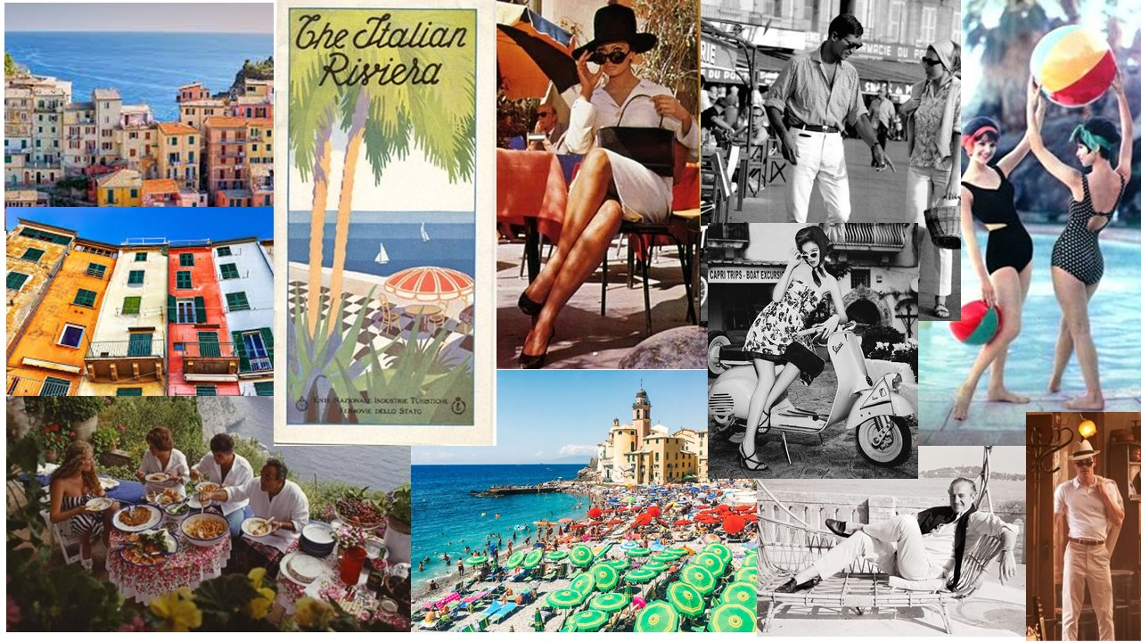
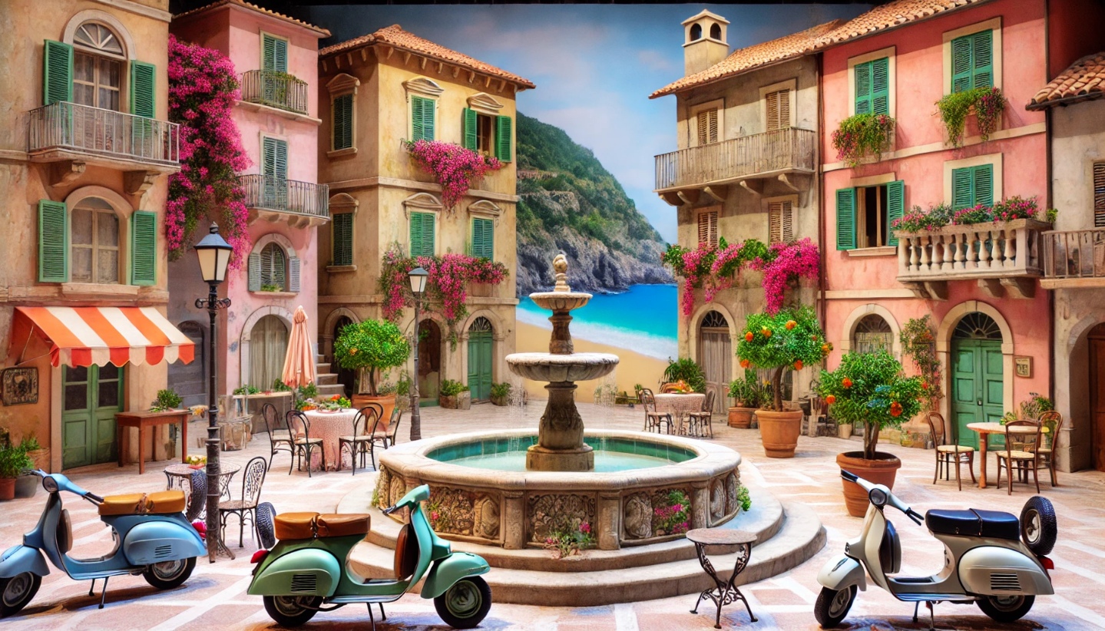
Production Design Examples
Set design depicts a picturesque town with warm, romantic pastel-colored buildings characteristic of Italian coastal architecture. A fountain at center stage, surrounded by Vespa scooters, evokes a lively community, the era, and serves as a focal point for the piazza.
Mood/concept board for Roméo et Juliette in 1960’s Italian Riviera. The aesthetic captures the charm and elegance of that era, with a Mediterranean atmosphere and 1960’s fashion that complements the romantic and tragic tones of the story.
Images generated using AI

Slide 24
Production Design Questionnaire
What are the reasons behind your choices? Are your choices based on the music, story, or libretto, and/or a combination of these?
How are you visually representing the time and location?
How are you visually communicating mood and emotion?

Slide 25
Present

Slide 26
Reflection
Share thoughts on the production design process.
How has your experience with adapting a story visually change your perspective on storytelling or your approach to developing ideas?

